Slide 1
Sediment Volume Search Sonar: Sequim Bay Demonstration Results
Daniel C. Brown, Shawn F. Johnson, David P. Williams,
J. Daniel Park, Jason H. Philtron, & Cale F. Brownstead
Pennsylvania State University, University Park, PA, USA

Slide 2
Acoustic surveys for remediation of unexploded ordnance
Historical military activities have resulted in unexploded ordnance (UXO) in marine environments
These items present a difficult environmental remediation problem due to challenges with underwater sensing
SVSS (Sediment Volume Search Sonar) is a purpose-built detailed ordnance survey system for very shallow water (<5m)
MC2 Charles Oki/Navy
The SERDP/ESTCP munitions response program develops and demonstrates technologies addressing these issues for both terrestrial and underwater remediation sites
Notes:
Points of emphasis
UUVs or towed systems are difficult to deploy in <5m
This pushes the design to include sensors mounted to surface craft
Also: very shallow water is energetic area (objects move) and higher chance of human interaction

Slide 3
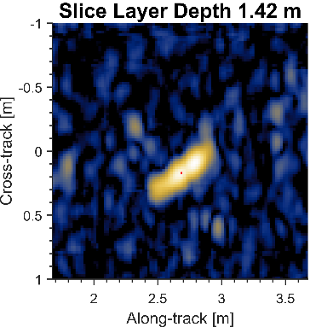
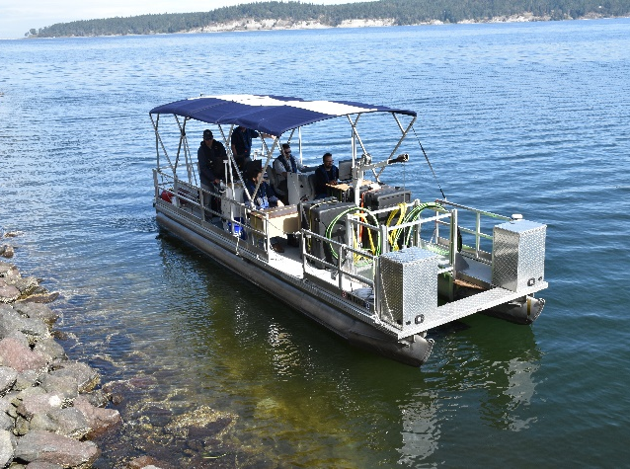
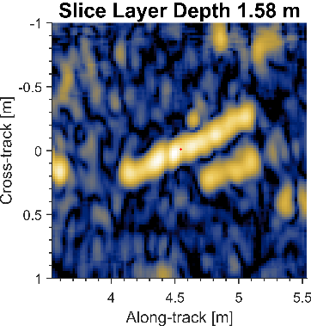
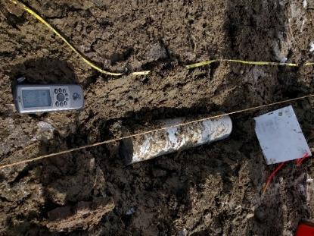
Sediment Volume Search Sonar
Newly designed transmit and receive systems clearly demonstrate improved performance over baseline SVSS
The purpose built hardware is designed to operate over a wide range of frequencies, in very shallow environments, against buried ordnance
Leverages established signal processing, synthetic aperture reconstruction, data quality review, and post-mission analysis pipeline
Initial engineering test at SERDP/ESTCP site
18-23 Sept, 2024, Sequim Bay, WA; installed and supported by PNNL
These results are currently under analysis; acoustic performance discussed here
Notes:
We approached this problem looking to leverage an existing test platform and sensor.
Custom hardware development has produced new projectors and new receivers
Hardware new since last time the SVSS was presented at this conference
SVSS is not just a sensor, but a system. It was developed by PSU for this program
It is a down-look sonar because the purpose is to look for buried objects (inherently limits area coverage rate)
Previous test datasets released to community and this one will be as well

Slide 4
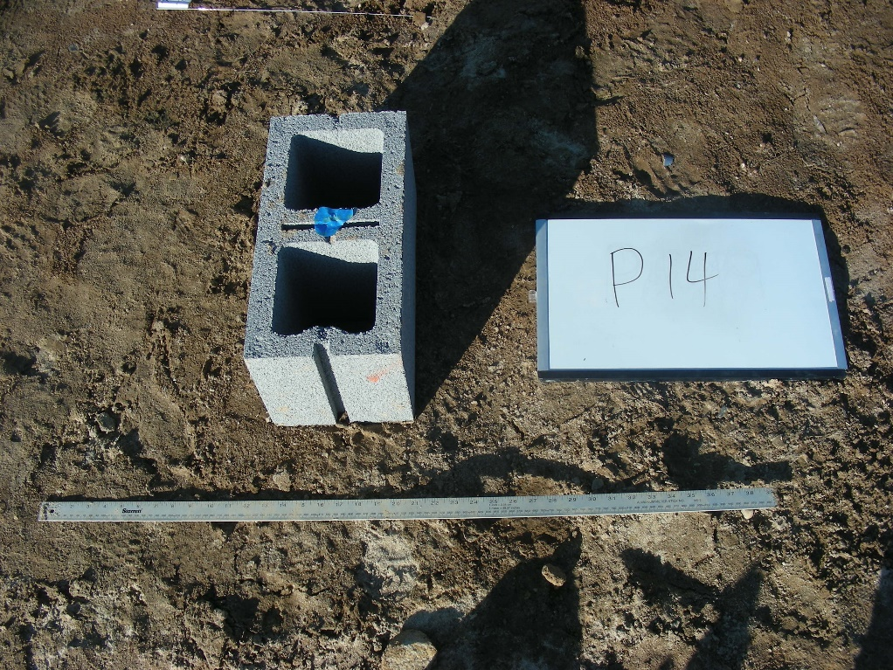
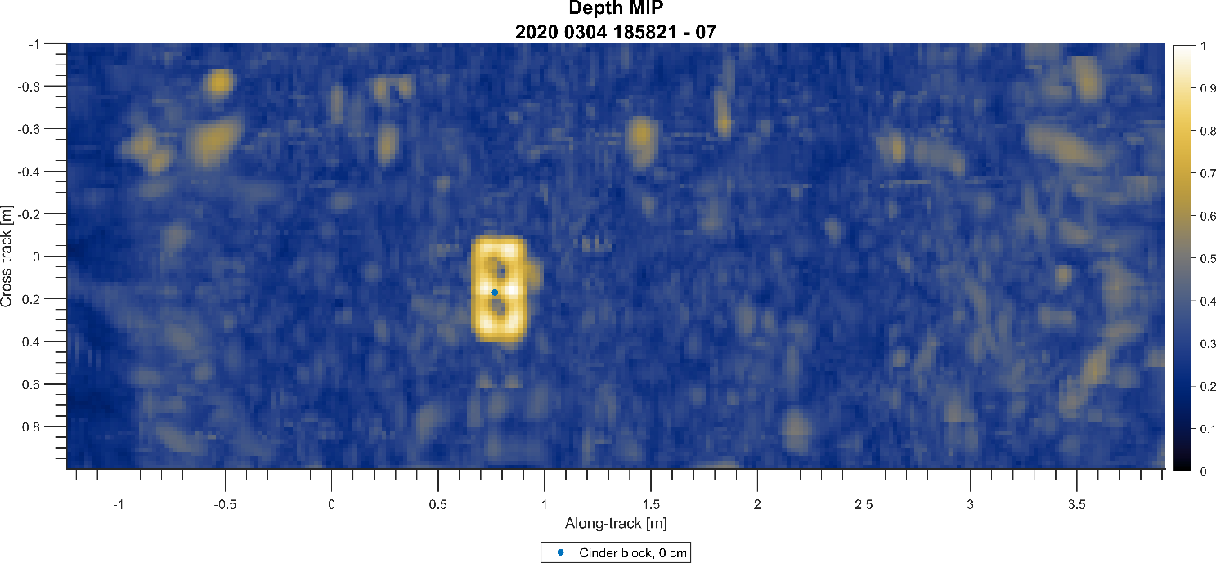
Flush Buried Shotput
Proud Short Al Cylinder
Proud Long Al Cylinder
9 cm Buried Short Al Cylinder
6 cm Buried Long Al Cylinder
16 cm Buried Shotput
Notes:
Upper image is from the local reservoir
Shows three surface objects on the left an three buried objects on the right. Shotput is not visible, but the late scattering returns are.
Man made objects often ring
Lower image is from Aberdeen
Shows a proud cinderblock and demonstrates the sensor’s image resolution
The small blue dot is the expected location of the target based on ground truth

Slide 5
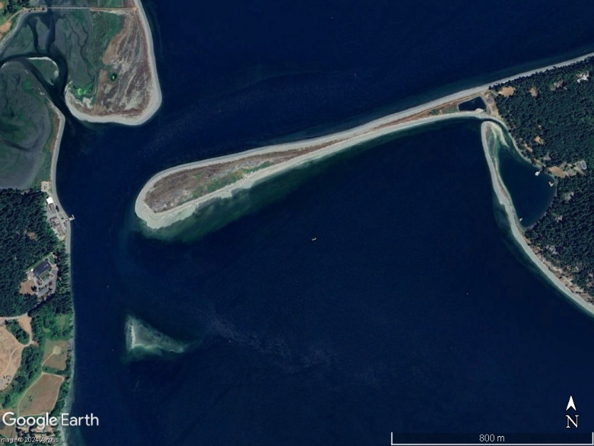
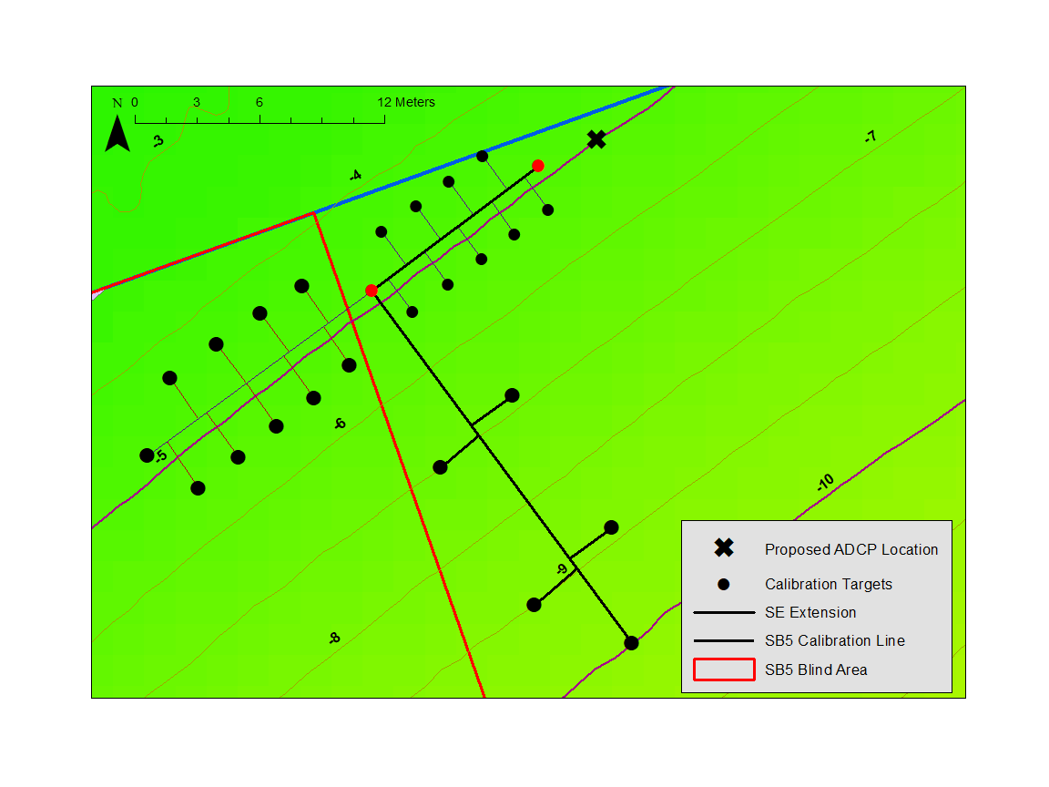
PNNL Sequim Bay Engineering Demonstration Site
Initial engineering test in SERDP/ESTCP developed site
Shallow water engineering demonstration site details
Water depth: 3+ meters
Target types:
Ordnance / Science / Clutter
Test Schedule:
Unload SVSS: 9/17/2024
System Checkout: 9/17/2024
Testing: 9/18 – 9/23/2024
Load SVSS: 9/24/2024
Depart: 9/24/2024
Notes:
Eel grass is protected, and is not to be disturbed
Objects are proud, half-buried and fully-buried

Slide 6
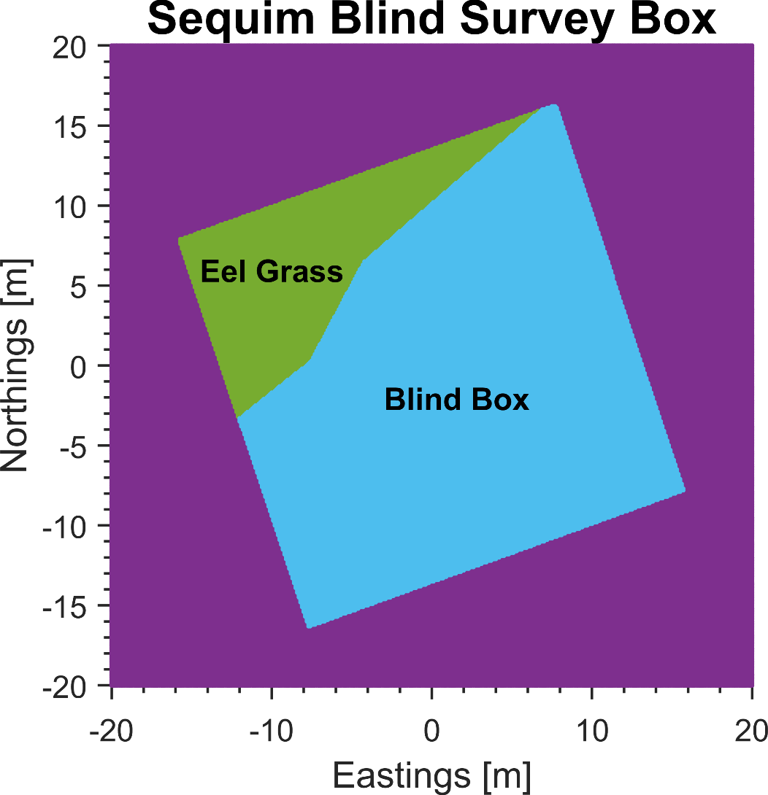
PNNL Sequim Bay - Blind Survey Box
Survey box selected to balance
Avoiding areas with seagrass
Providing shallow water testing
These objectives are at odds
Eel grass grows in shallow water
Shallow portion of the survey box is near eel grass line
Notes:
- To get sufficient testing done in very shallow water, significant testing was done during low tide (middle of night)

Slide 7
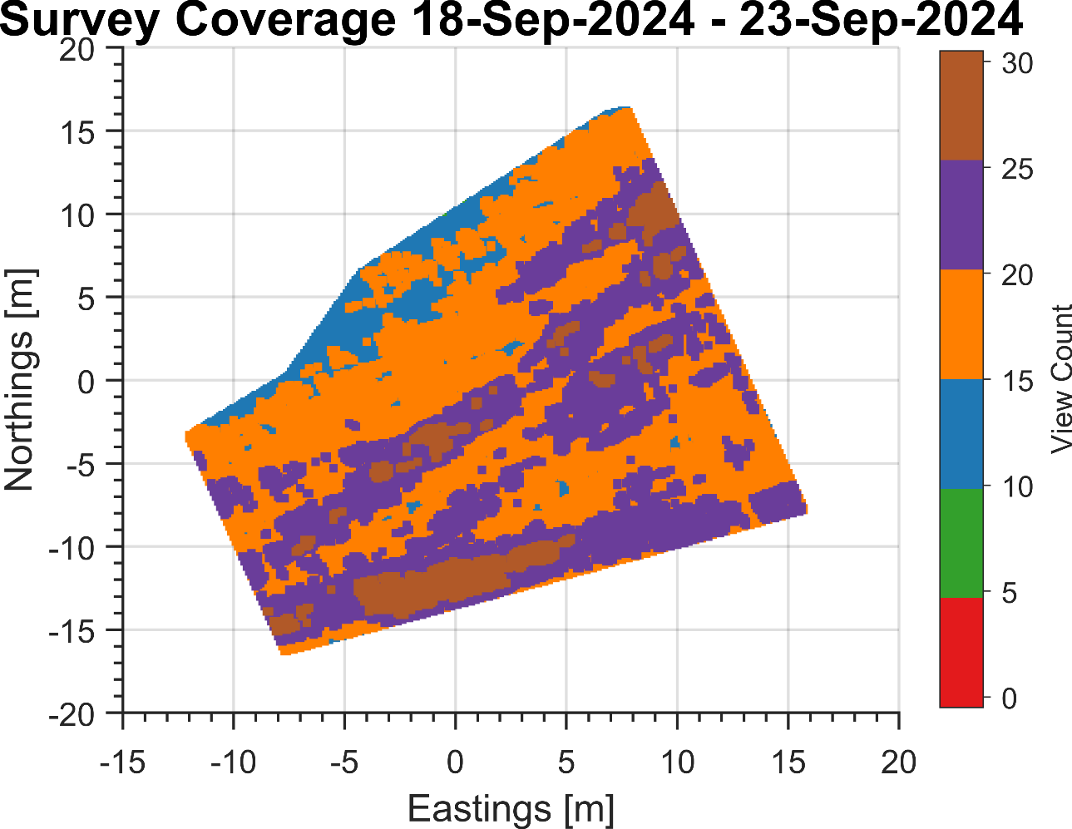
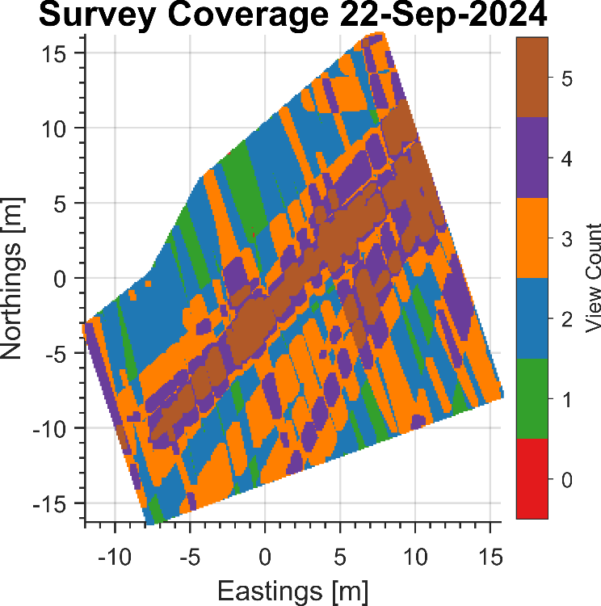
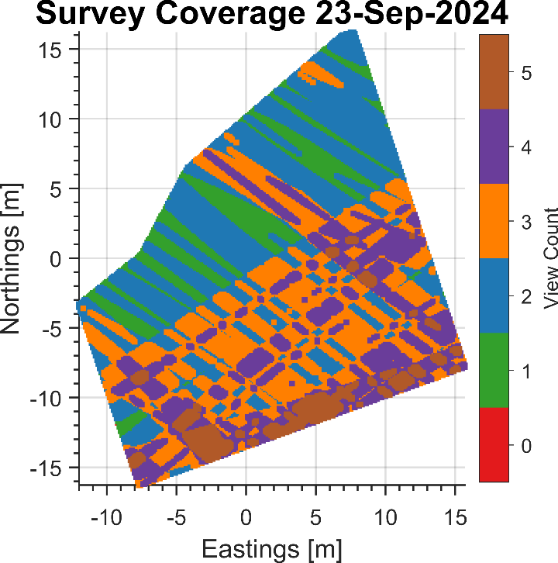
Blind Field Survey Coverage
Full Event Survey Coverage
Low Tide (2 Hour) Survey Coverage
Eel Grass Keep Out
Shallow water testing achieved surrounding low tide events

Slide 8
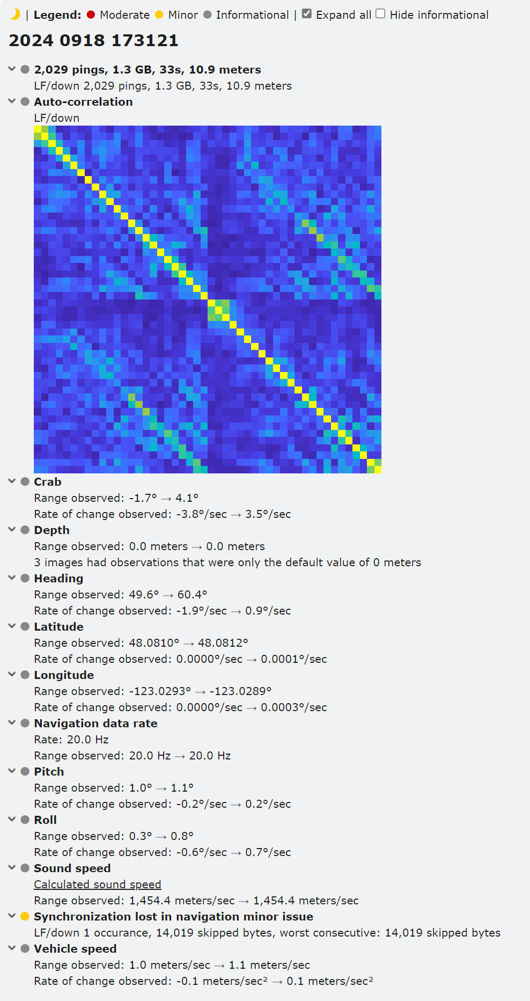
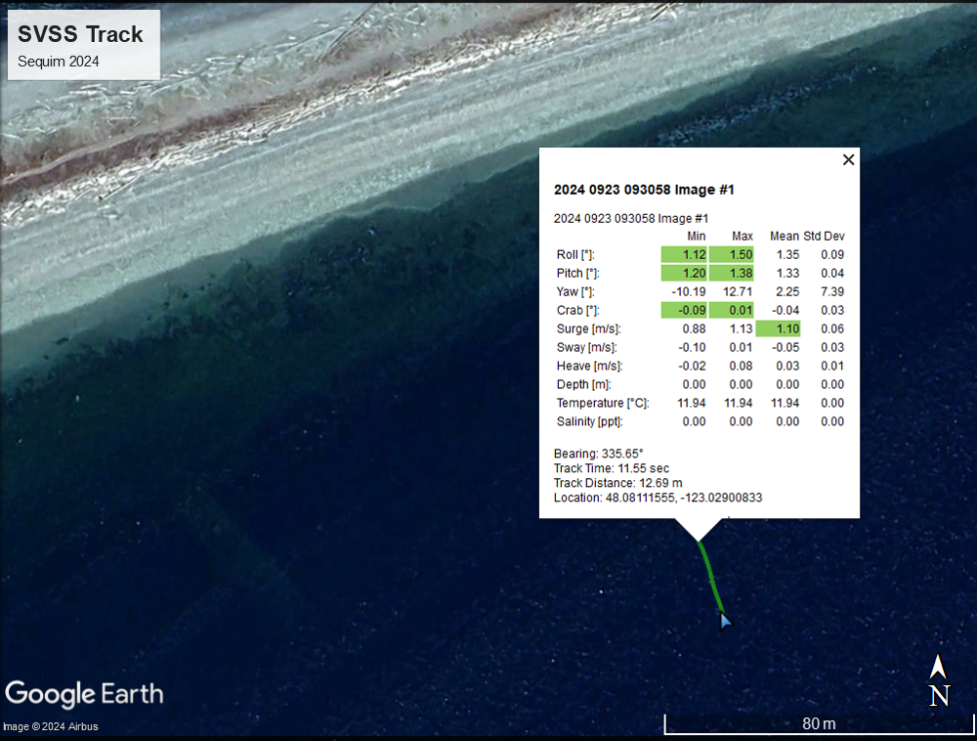
Post-Survey Automated Quality Assurance Reporting
Automated Data Quality Reports
Sensor Health & Platform Stability
Notes:
Reports produced in real-time
ASASIN has government rights asserted, is PSU/ARL product, supports SAS systems we build and limited # of commercial systems
Reports can be provided with the dataset

Slide 9
Example Imagery from Sequim Bay Site
Cross Track Maximum Intensity Projection
Eel Grass
Proud Cylinder
Elevated Interface Scattering
Resonant Late Returns

Slide 10
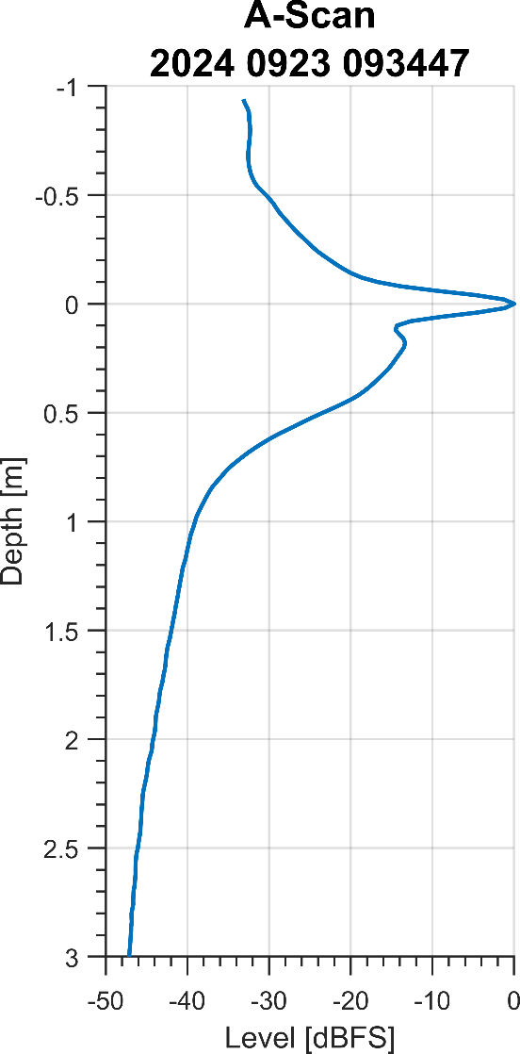
Enhanced Interface Scattering Observed
Pseudo A-Scan
Interface scattering strength appears to have a +15 dB enhancement over sub-bottom strength in the upper 15 cm. Aligns with PNNL diver observation of a consolidated shell hash layer during deployment
Notes:
Desloping helps with image interpretation and analysis, specifically with the environmental conditions
Note you can’t just rotate the image because x and y position need to be preserved
Divers mentioned they had to chip away at the shell hash to bury objects

Slide 11
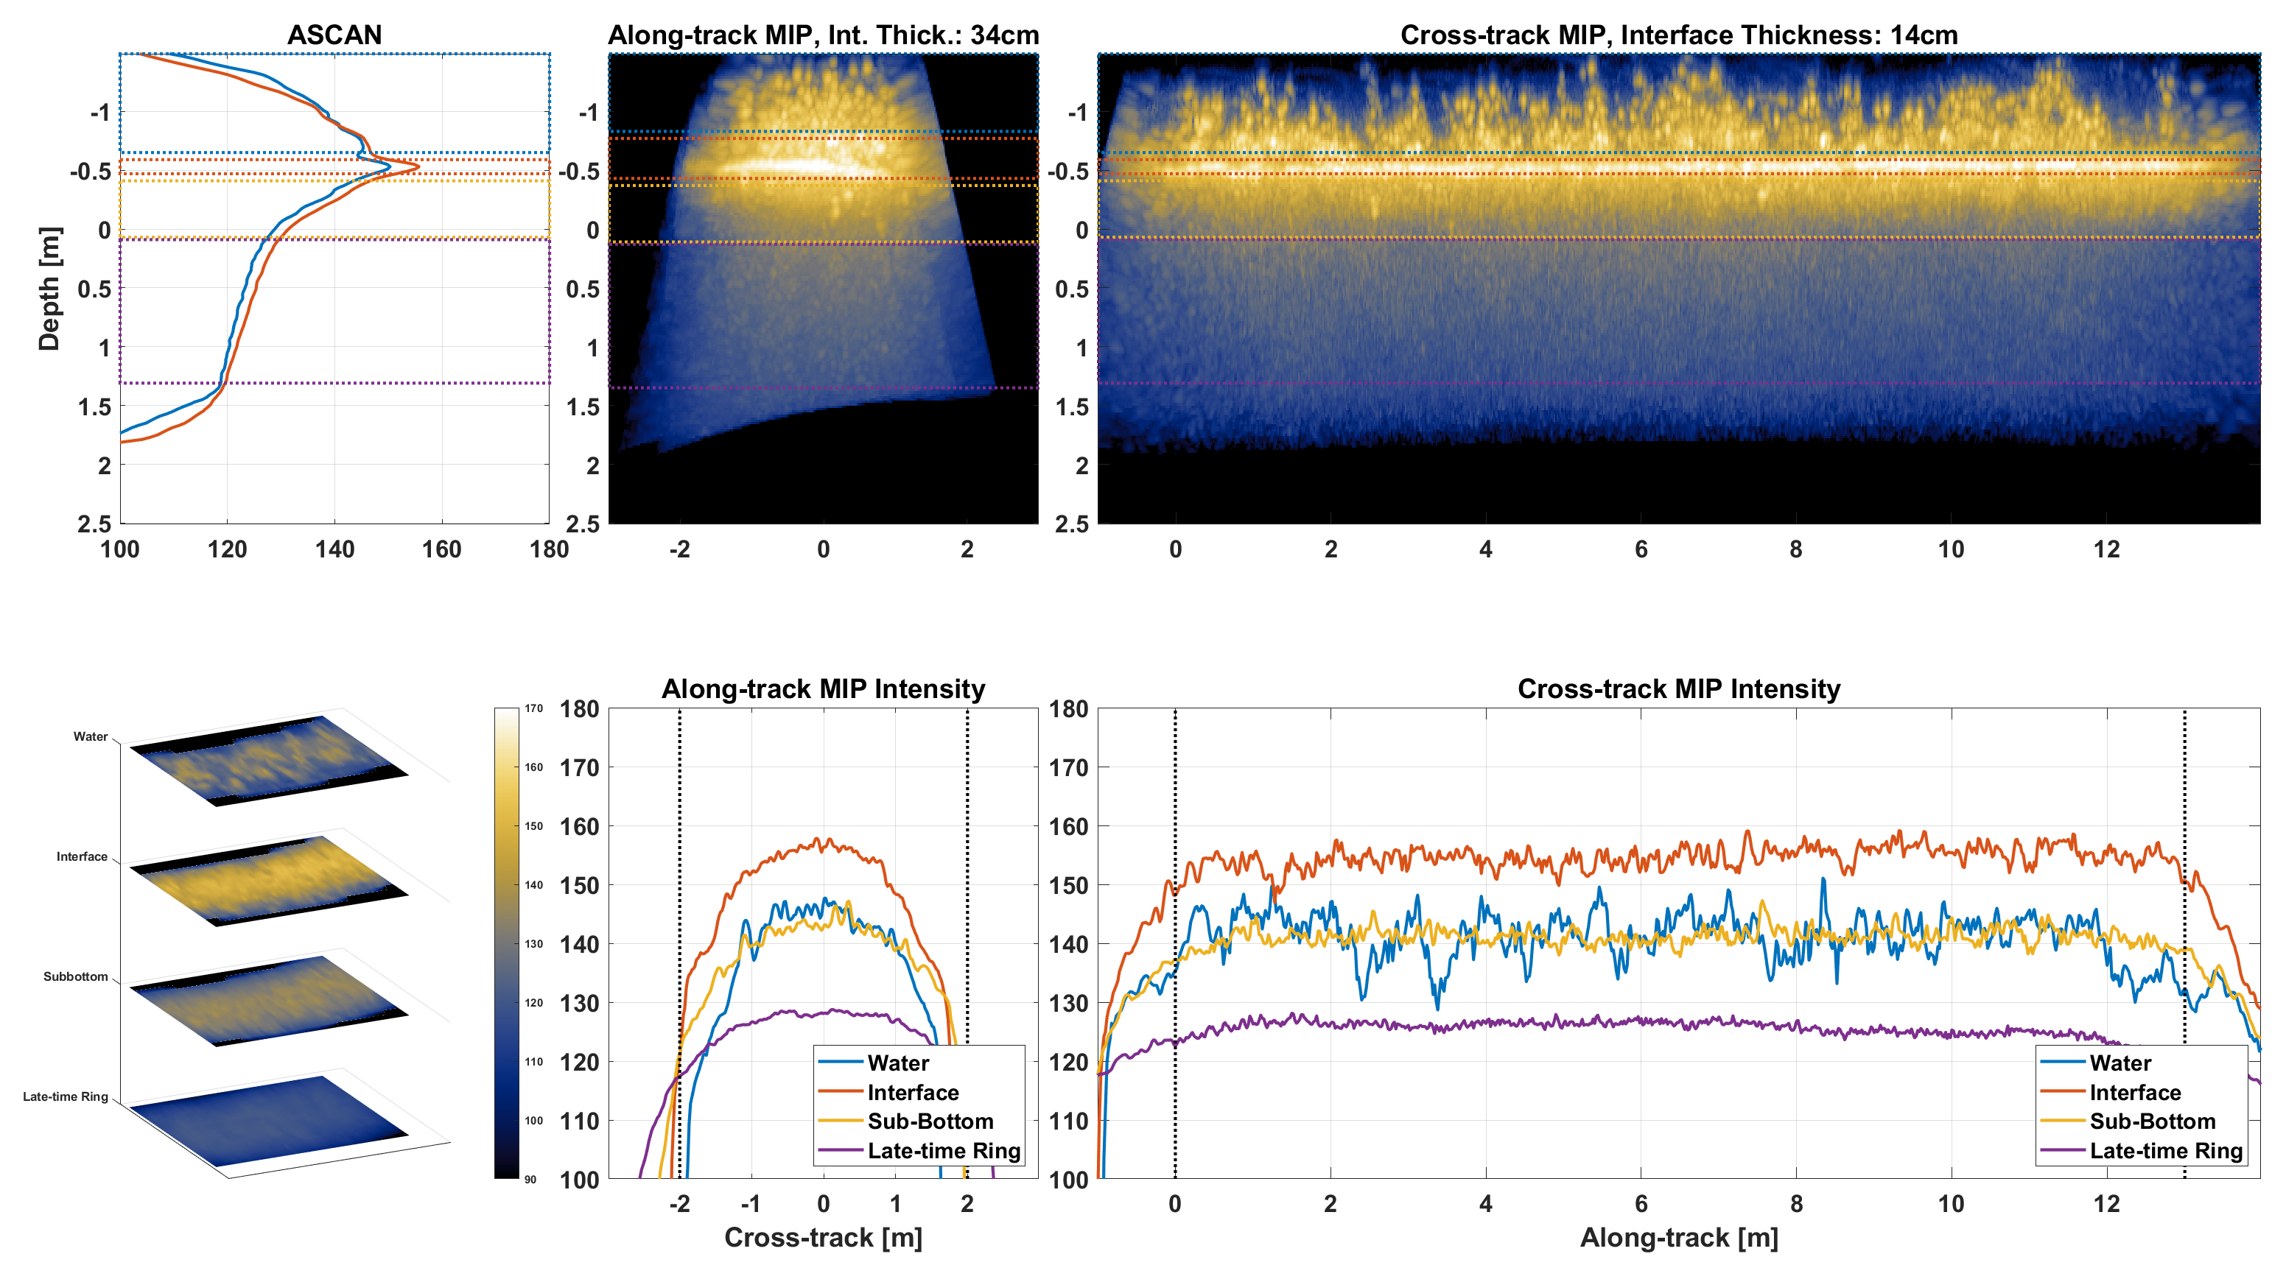
New Analysis Techniques Are Being Developed
Pseudo A-Scan
Water
Interface
SubBottom
Late-Time
Water
Interface
SubBottom
Late-Time
Notes:
Amplitude information in each depth region is used to understand the environment
Goal to understand environment in relation to sensor performance

Slide 12
New Data Quality Reports Are Being Developed
Interface
Sediment Layer Backscattering
Water Column - Interface
Estimate Eel Grass Coverage

Slide 13
New Data Quality Reports Are Being Developed
Interface
Sediment Layer Backscattering
Water Column - Interface
Estimate Eel Grass Coverage
Notes:
Can estimate eel grass coverage from acoustic response
Can also use this type of data to assess the environment and whether it is suitable for sensor evaluation

Slide 14
Modeling Acoustic Penetration
Fine Silt at 25kHz
Medium Sand at 25kHz
Shell Hash at 25kHz
Acoustic penetration depth is highly dependent on sediment properties.

Slide 15
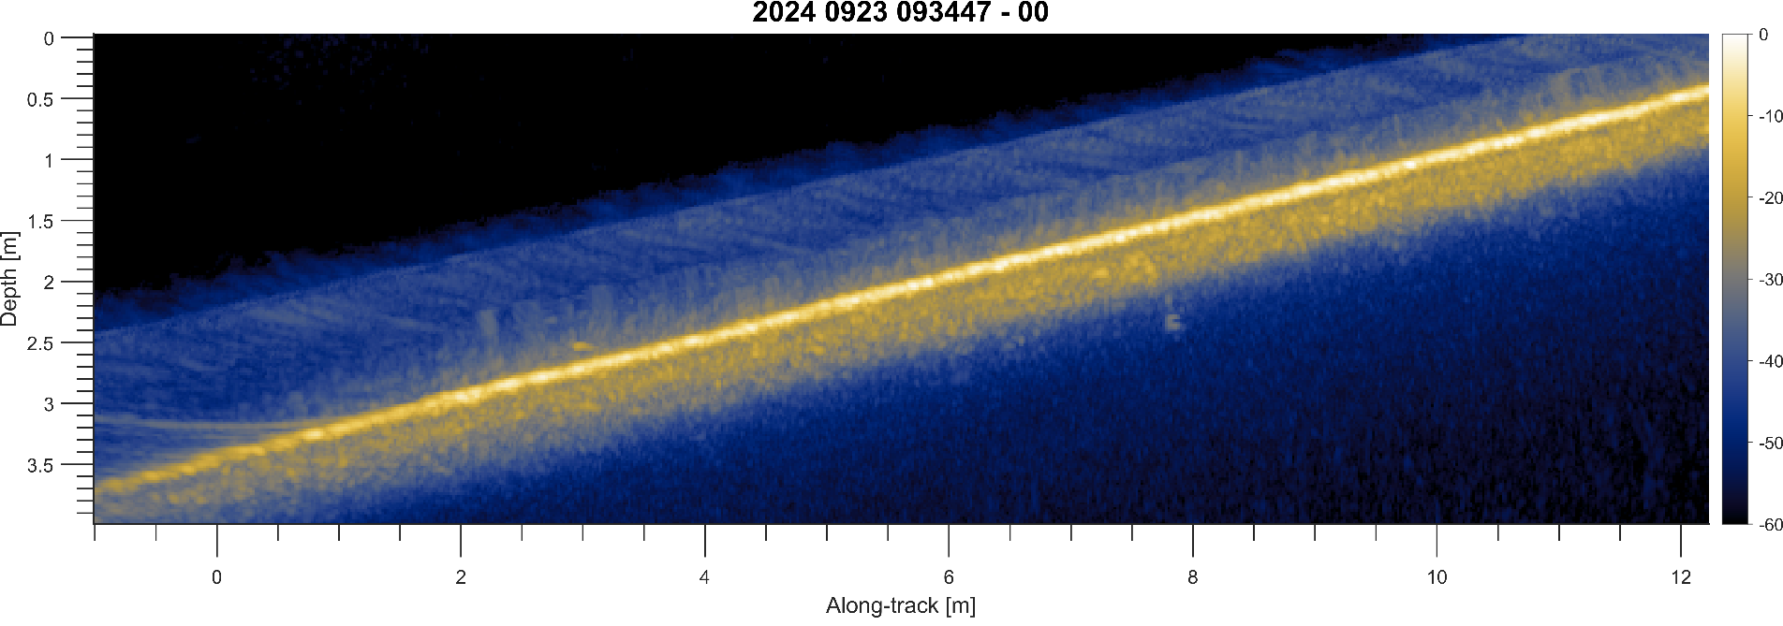
Observed Acoustic Penetration
Silt / mud site (w/ original hardware)
Shell hash over sand site (w/ improved hardware)
Notes:
Silt/mud allows for a lot of acoustic penetration.
Shell has layer blocks some acoustic energy, so penetration is not as deep
If we have access to sediment core data we can model the environment and simulate the expected performance

Slide 16
Conclusions
Sediment Volume Search Sonar (SVSS) is a purpose-built detailed ordnance survey system for very shallow water (<5m)
SVSS recently conducted Initial engineering test at SERDP/ESTCP site in Sequim Bay, WA with improved hardware
Tools are being developed to characterize the environment at the test site with the goal of associating variations in system performance with environmental complexity

Slide 17
Backup

Slide 18
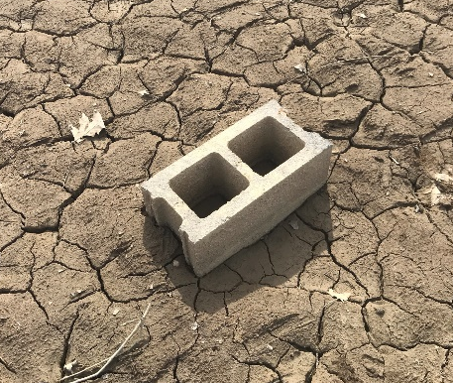
Slope orientation influences image interpretation
Cross-Track MIP
Along-Track MIP
Resonant Late Returns

Slide 19
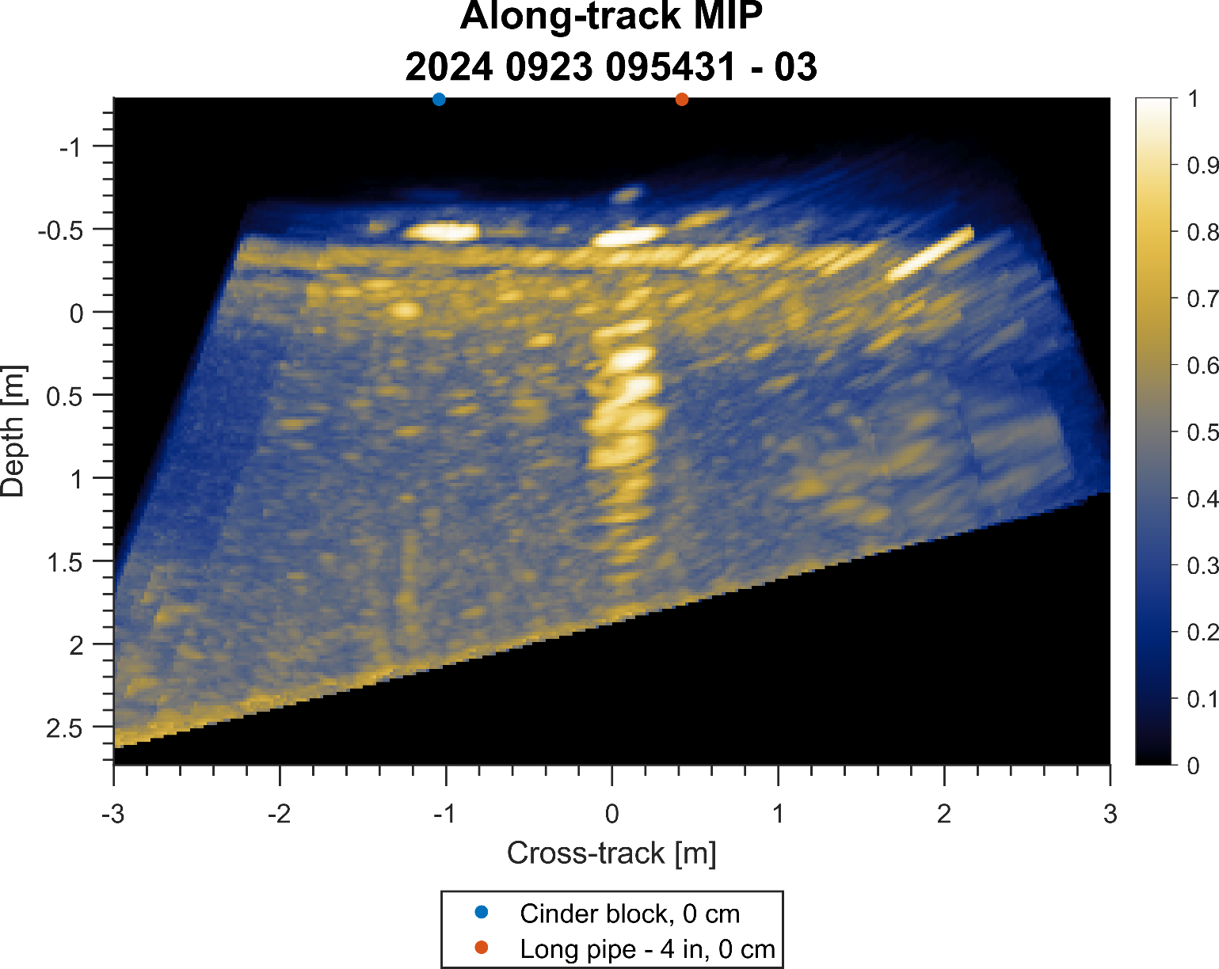
Removing image slope and background normalization improves interpretability

Slide 20
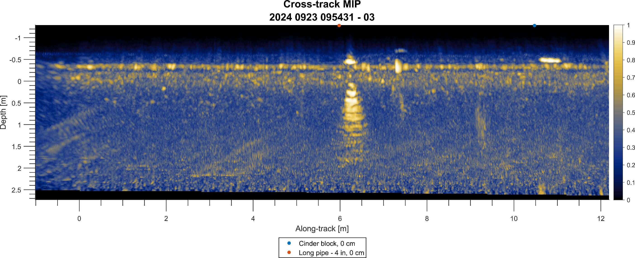
Removing image slope and background normalization improves interpretability

Slide 21
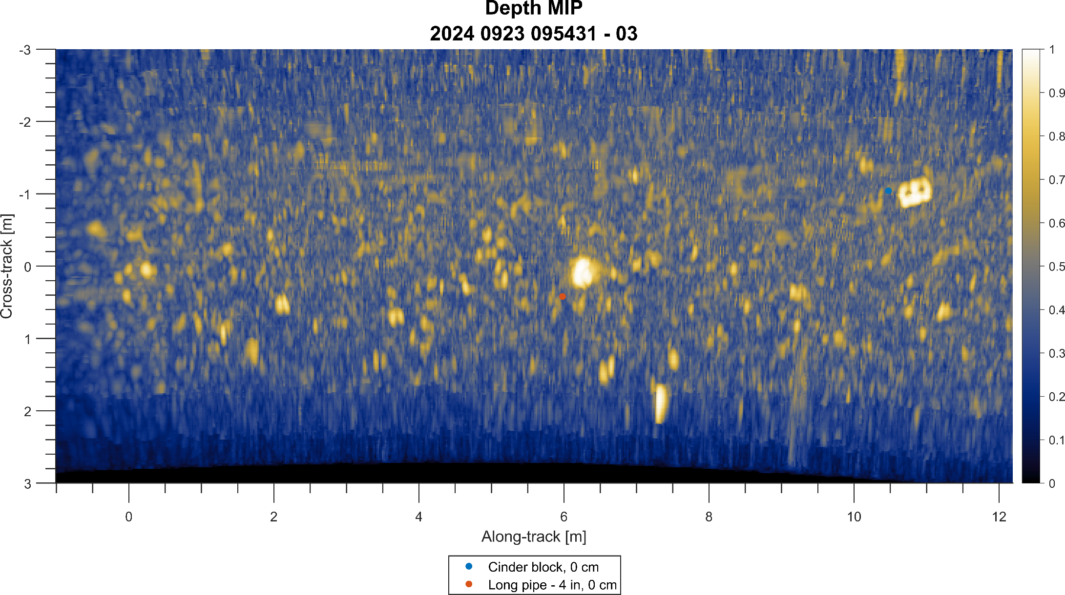
Removing seabed slope and background normalization improves interpretability

