Slide 1
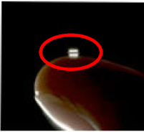
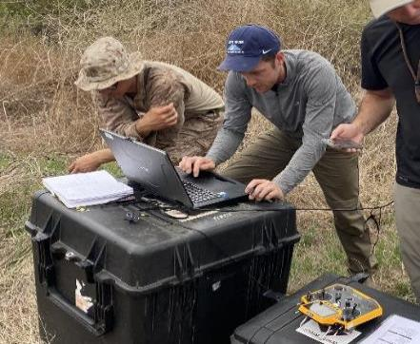
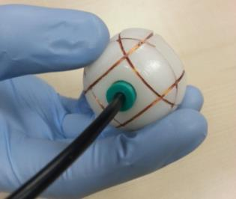
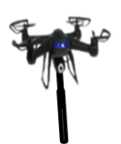
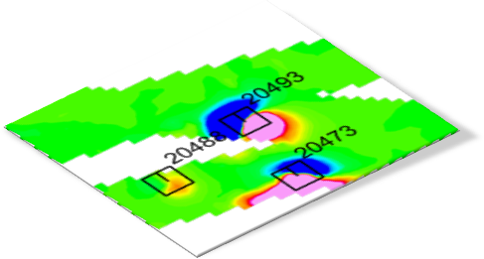
UAS Mag Surveys in Challenging Near Shore Environments
15 April 2025
Michael Gunnels | White River Technologies, Inc. | gunnels@whiterivertech.com

Slide 2
Summary
WRT UAS-MAG Technology Overview
Reid State Park (Mar 2024)
Site Prep and Flight Planning
UAS Surveying
Results
Other Technical Experiments
Conclusions

Slide 3
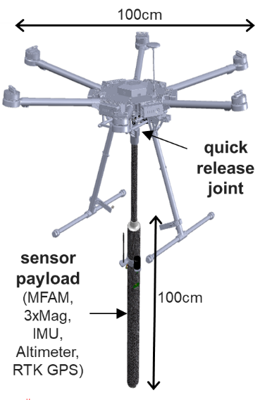
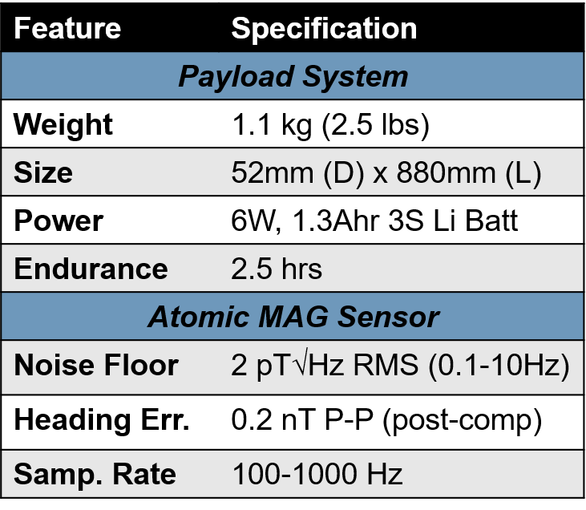
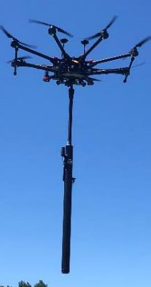
Magnetometer
Notes:
This is the core technology we’ll be talking about miniaturized magnetometers combined with medium sized UAS
Sensor is 1.4m from airframe center
Quick release to allow us to integrate sensor onto any platform with a servo rail

Slide 4
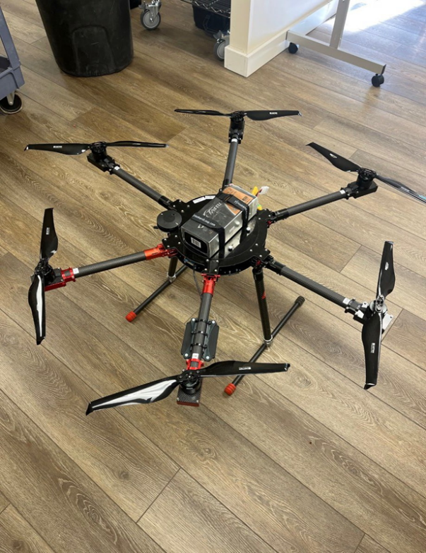
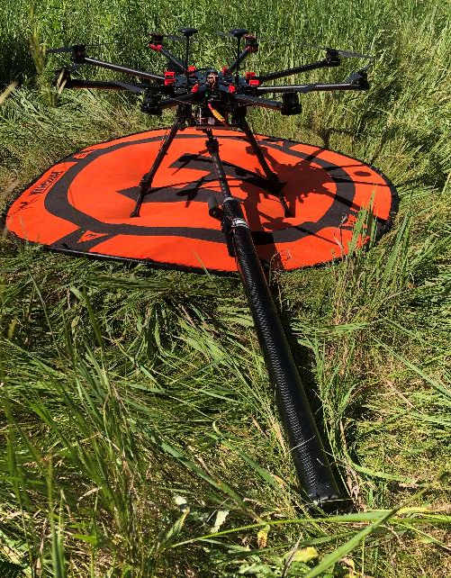
UAS Airframe(s)
Custom Cube-1000
Octo-copter, ~1m wingspan
20 min endurance
Blue Halo E-900
Hexa-copter, ~90cm wingspan
20 min endurance
Custom
Cube-1000
BlueHalo E900
Notes:
These are the two airframes that WRT uses depending on the application

Slide 5
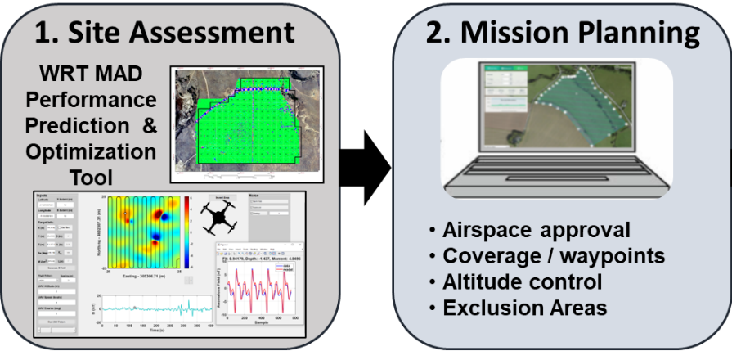
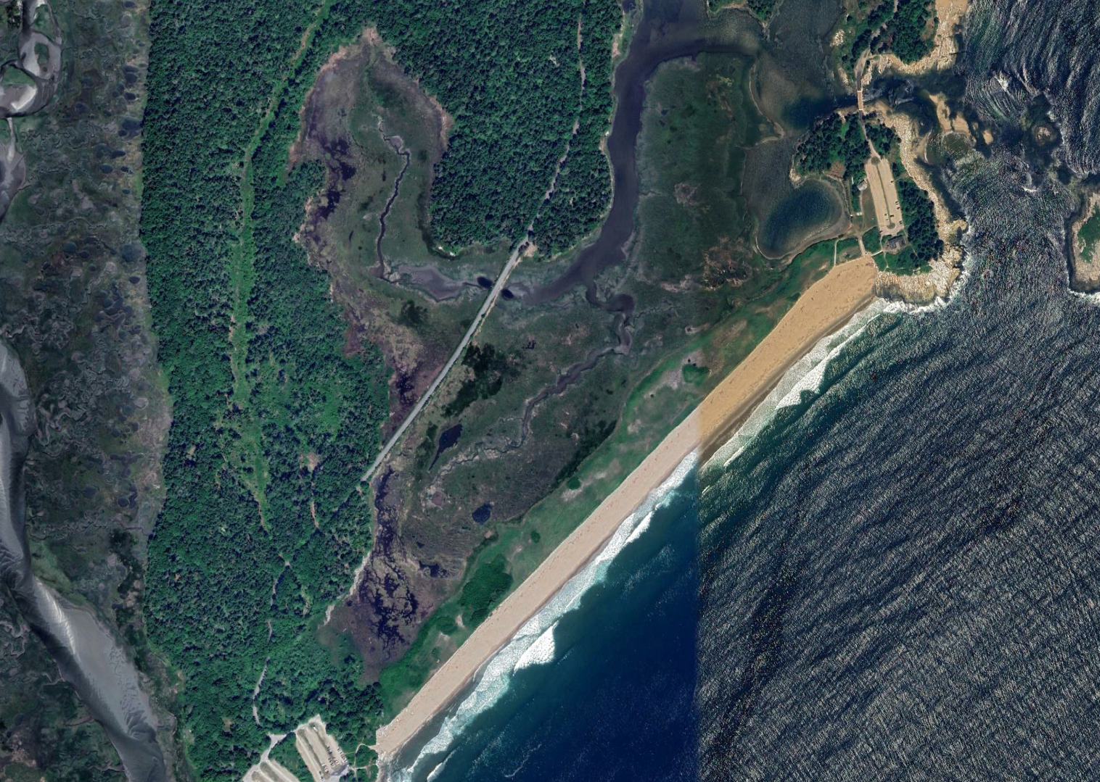
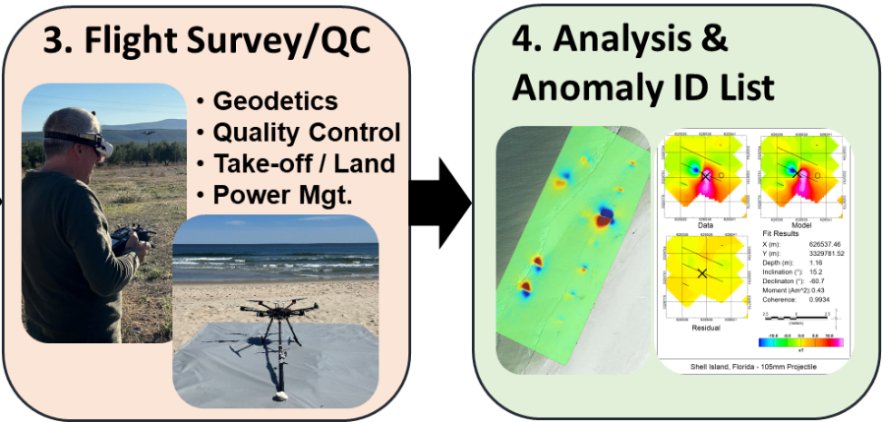
DroneMag Workflow
Site assessment
Mission Planning
MADCOM infield software
Infield processing
Analysis / Anomaly ID
• Pre deployment planning
• Site visit (if possible)
• ID of possible obstructions
Notes:
Could shorten the bullet points,
WRT MAD COM infield software
Infield data processing (Filtering, QC, Detection,
Products: (GeoTIFFS, CSVs, PNGs, GeoJSON / JSON files)

Slide 6
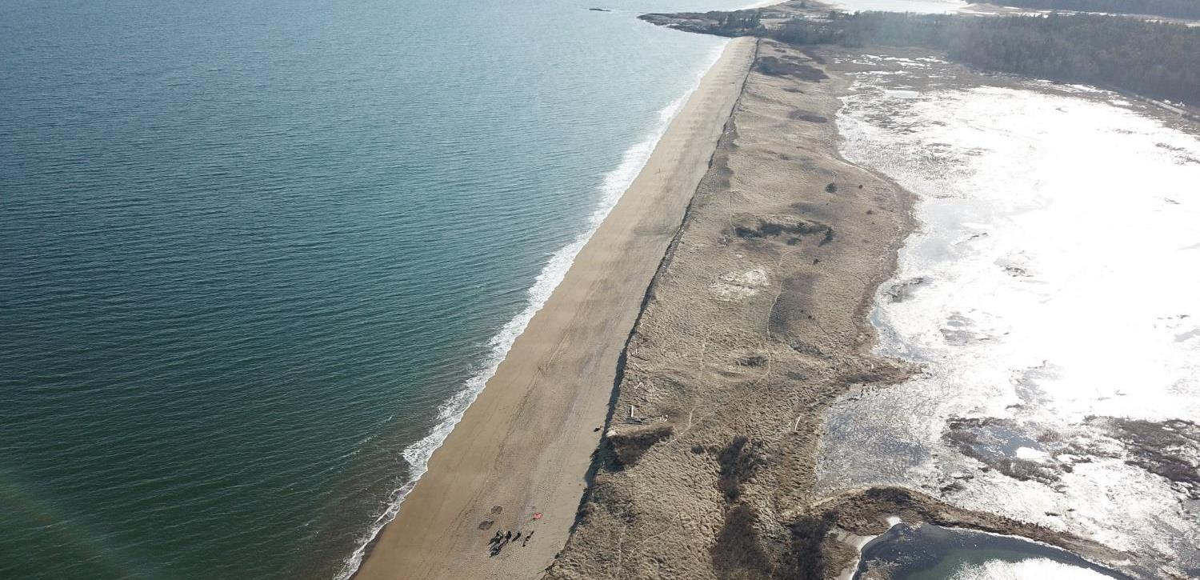
Reid State Park, Maine
Demonstration for ESTCP Phase I project
1-mile-long surf, beach, dunes, and marsh
Onsite for 8 days, IVS / seeding, 42 MAG sorties
Beach
Dunes
Surf
Marsh

Slide 7
UAS Mission Planning
Careful pre-deployment planning of UAS sorties,
Split MRS up into 28 one-acre grids based on MQO line spacing requirement and UAS endurance
Missions were loaded onto field computer

Slide 8
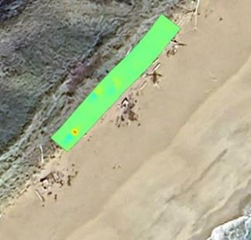
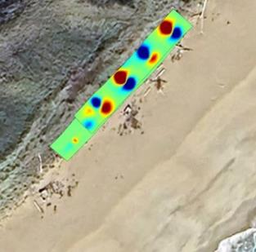
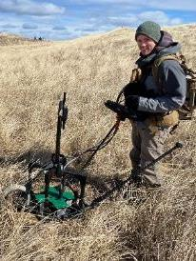
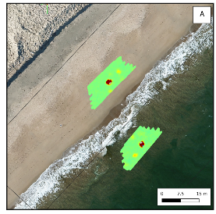
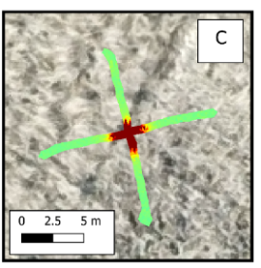
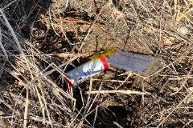
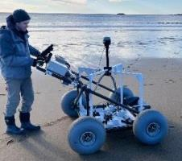
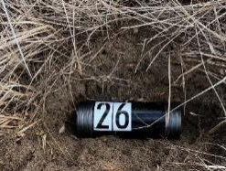
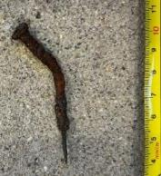
IVS and Seeding
IVS Seeds (4 items, 50m long)
QC Seeds (41 Total: 2 per grid)
Pre-install MAG Map
Initial MAG IVS Survey
MAG+APEX surveys
LG-ISOs, Cal Magnets
RTK-GPS Surveyed
We used APEX and APEX handheld to validate the LG ISO targets.
Notes:
2.25” rocket was the primary TOI

Slide 9
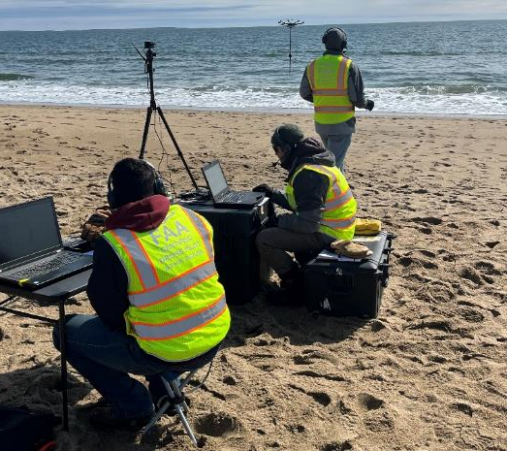
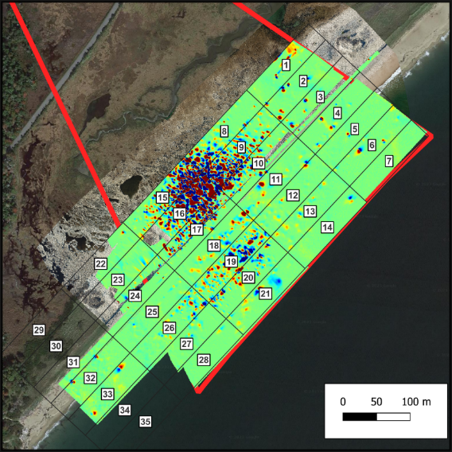
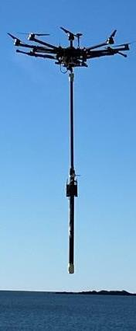
Results: UAS Surveying
Each grid was ~ 1 acre
Completed 10 grids / day
Survey Days: 3
Notes:
Mosaic detection map from 30 sorties showing a magnetic anomaly detection map over all of the MRS

Slide 10
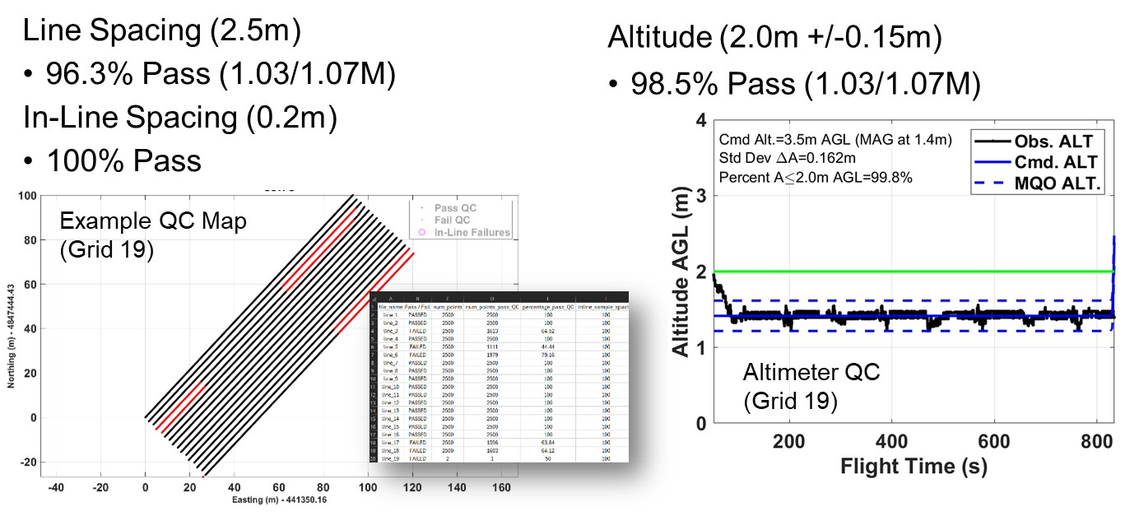
Results: UAS Surveying Performance
DAGPCAP style MQOs
1 million data points passed 2.5m spacing requirement
Cmd. altitude was 3.5m, sensor at 1.4m, < 2m MQO
Notes:
We commanded the airframe to be 3.5m
Mag is therefore at 1.4m
Max altitude based on the main TOI at the site was 2m, so Percent A<2.0m AGL

Slide 11
Results: Detection Performance
Notes:
3.5m up in the air,

Slide 12
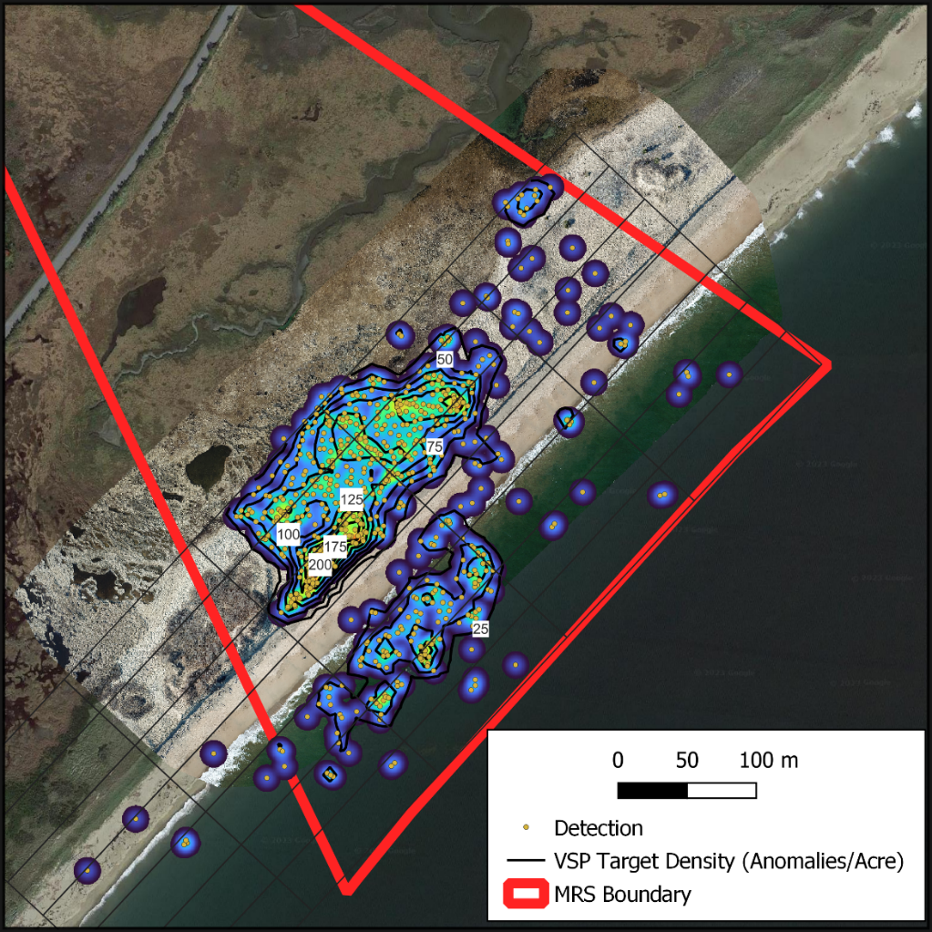
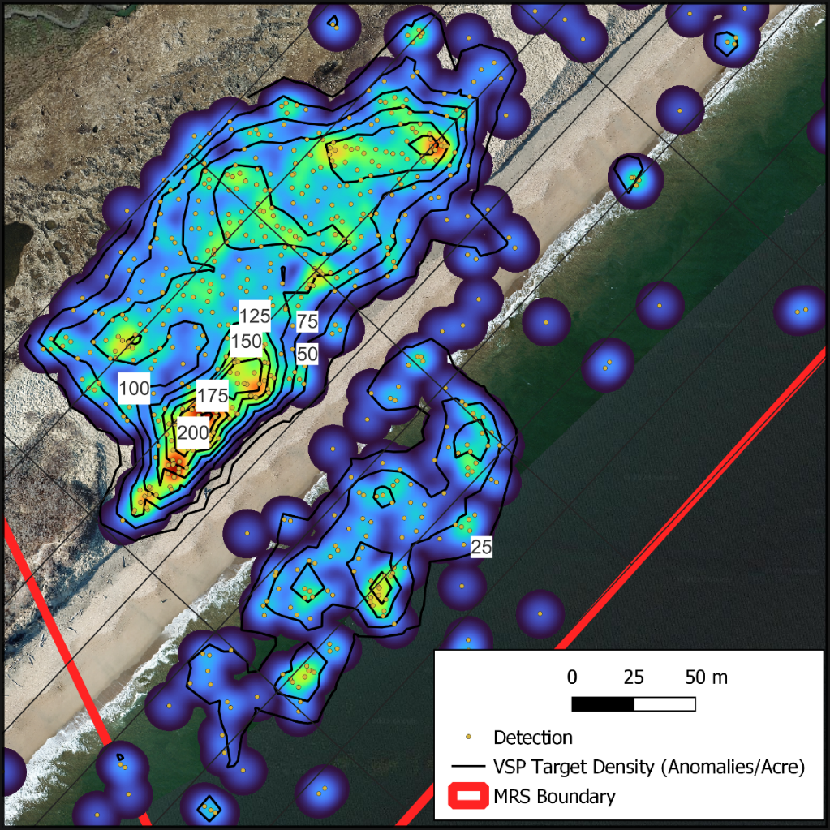
Results: Anomaly Density Estimates
Site wide target densities obtained on 30 acre site in ~ 3 days
Dipole detections used in VSP to estimate density

Slide 13
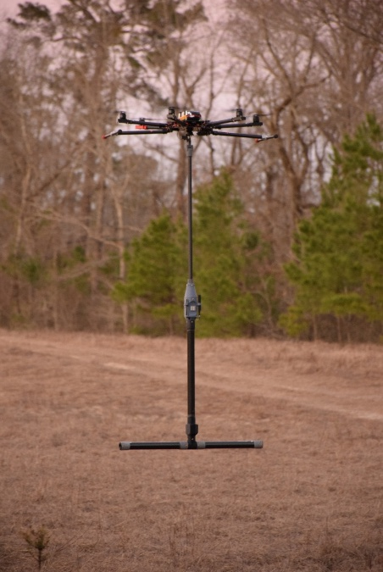
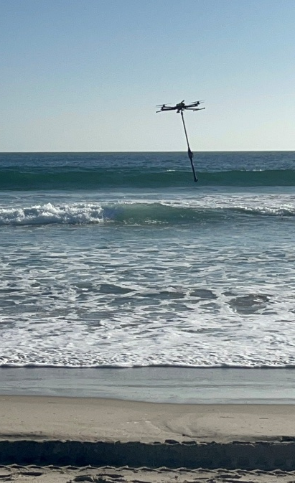
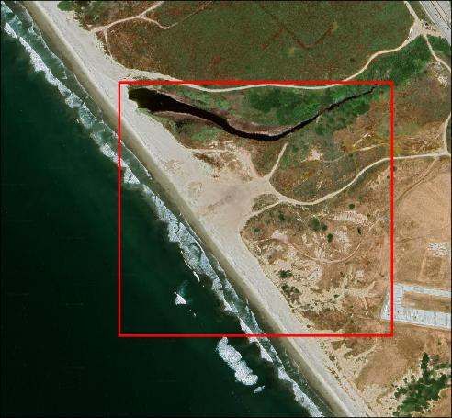
Other Technical Experiments
Shell Island, FL – ESTCP Project (2023)
Technical Experiment with government stake holder (2024). Testing two sensor gradiometer.
Technical Experiment with government stake holder (2025)

Slide 14
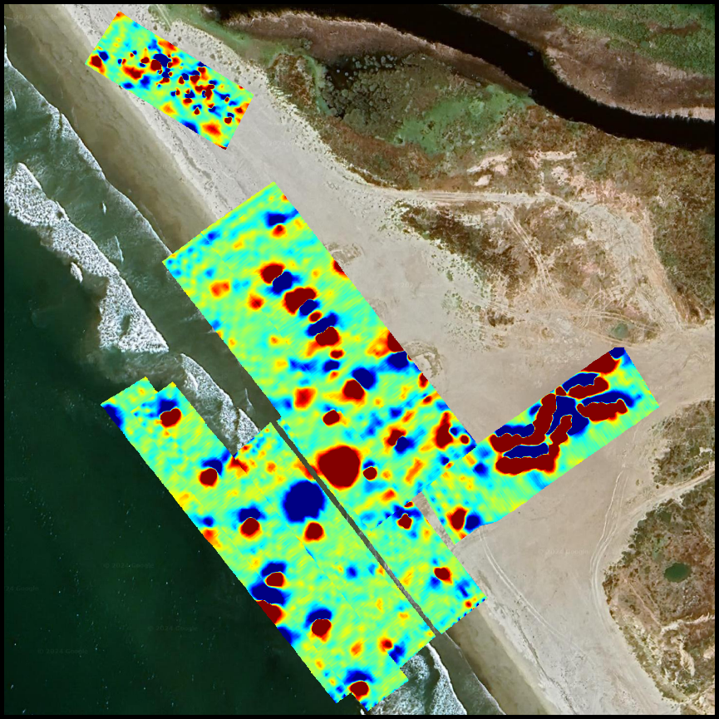
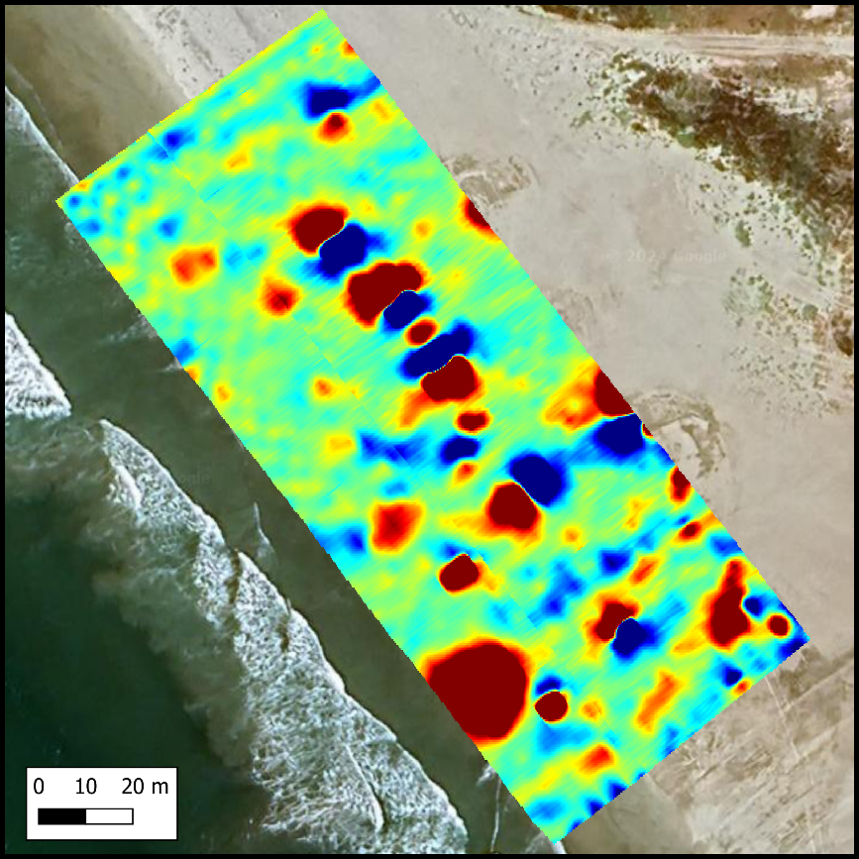
Results: Explosive Threat Detection
Approximately 7 sorties flown from both land and sea
Surf zone sortie flown from boat and landed on beach
Various metallic targets detection and localized

Slide 15
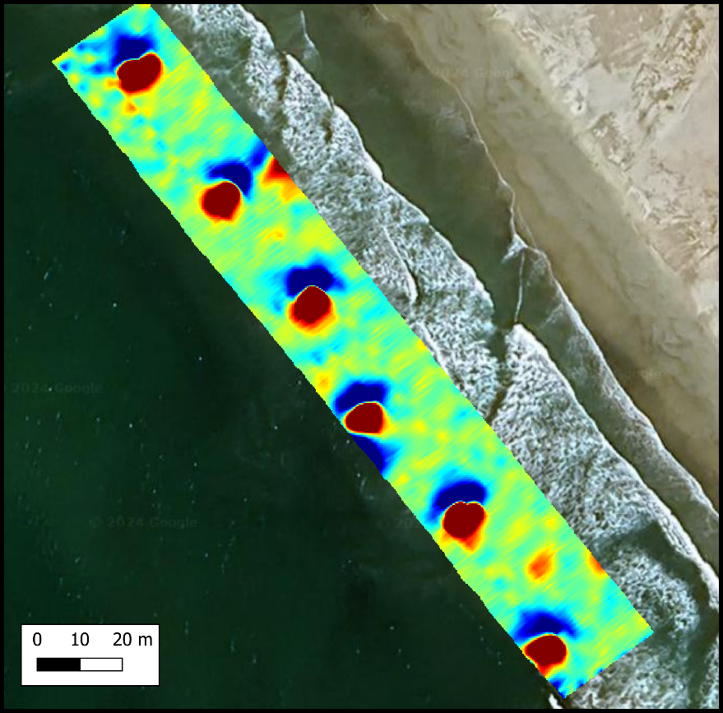
Boat Ops
Performed 3 sorties from boat
Carried out survey over surf
Autonomous Landing on the shore

Slide 16
Conclusions
Drone based magnetometry is an effective method for Wide Area Assessment, i.e., characterizing a large area to understand level of contamination or munition hazard throughout the area.
Careful mission planning will result in efficient data collection, accurate/reproducible line spacing, and precise altitude control across larger sites.

Slide 17
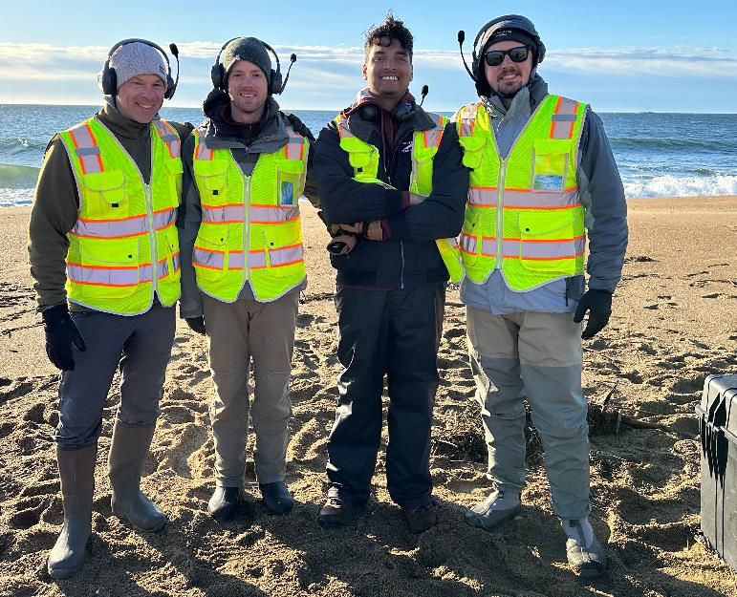
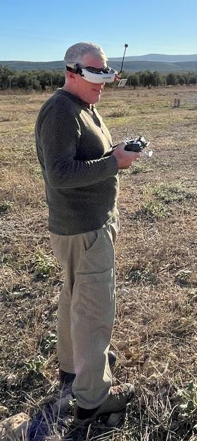
Acknowledgements
Flight Crew and Team
Dr. Greg Schultz,
DB Bhowmick,
Andrew Masters,
Dr. Martin Helmke

Slide 18
Backup Slides

Slide 19
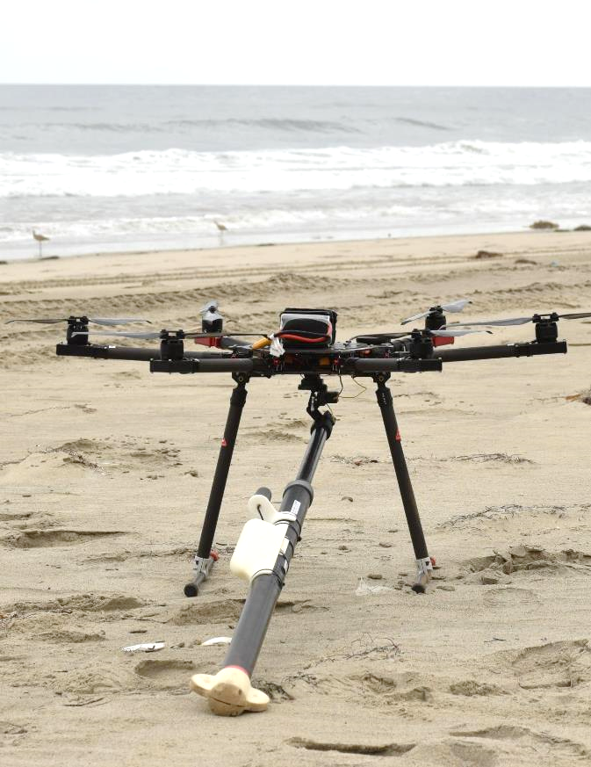
UAS Specs
Parameter | Specification
Drone Altitude (AGL) | 3.0-5.0 m
Sensor Altitude (AGL) | 1.1-3.1 m
Altitude Control | ±0.11 m
Waypoint Control | ±0.21 m
Survey Flight Speed | 3 m/s (5.8 kts)
Transit Flight Speed | 11.3 m/s (22 kts)
Sampling Rate | 200 Hz
Ground Sampling Distance | 3.75 cm
Detection/Report Rate | 0.25 Hz
Endurance | 30 min
Range | 3.5 – 4 km
Time-to-Anomaly Map | 60 sec
Time-to TOI Localization | 2 sec / TOI

