Slide 1
Shallow Underwater Advanced Geophysical Classification Survey Lessons Learned at East Coast Site
Ricky Mataitis, (Jacobs, Albuquerque, NM, USA)
Steve Saville (Jacobs, Knoxville, TN, USA)
Matthew Cook (Seaview Geophysical, Dexter, MI, USA)
Kevin Kingdon (Black Tusk Geophysics, Vancouver, BC, CA)
David Sinex (Black Tusk Geophysics, Vancouver, BC, CA)

Slide 2
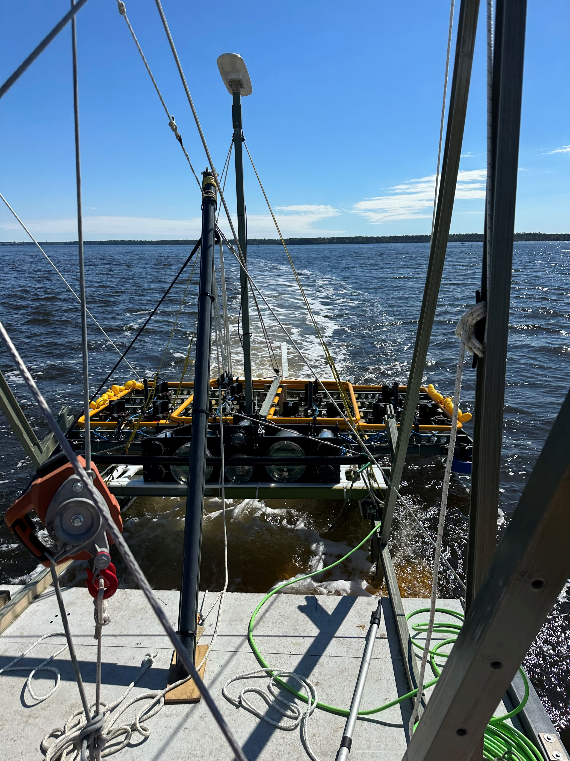
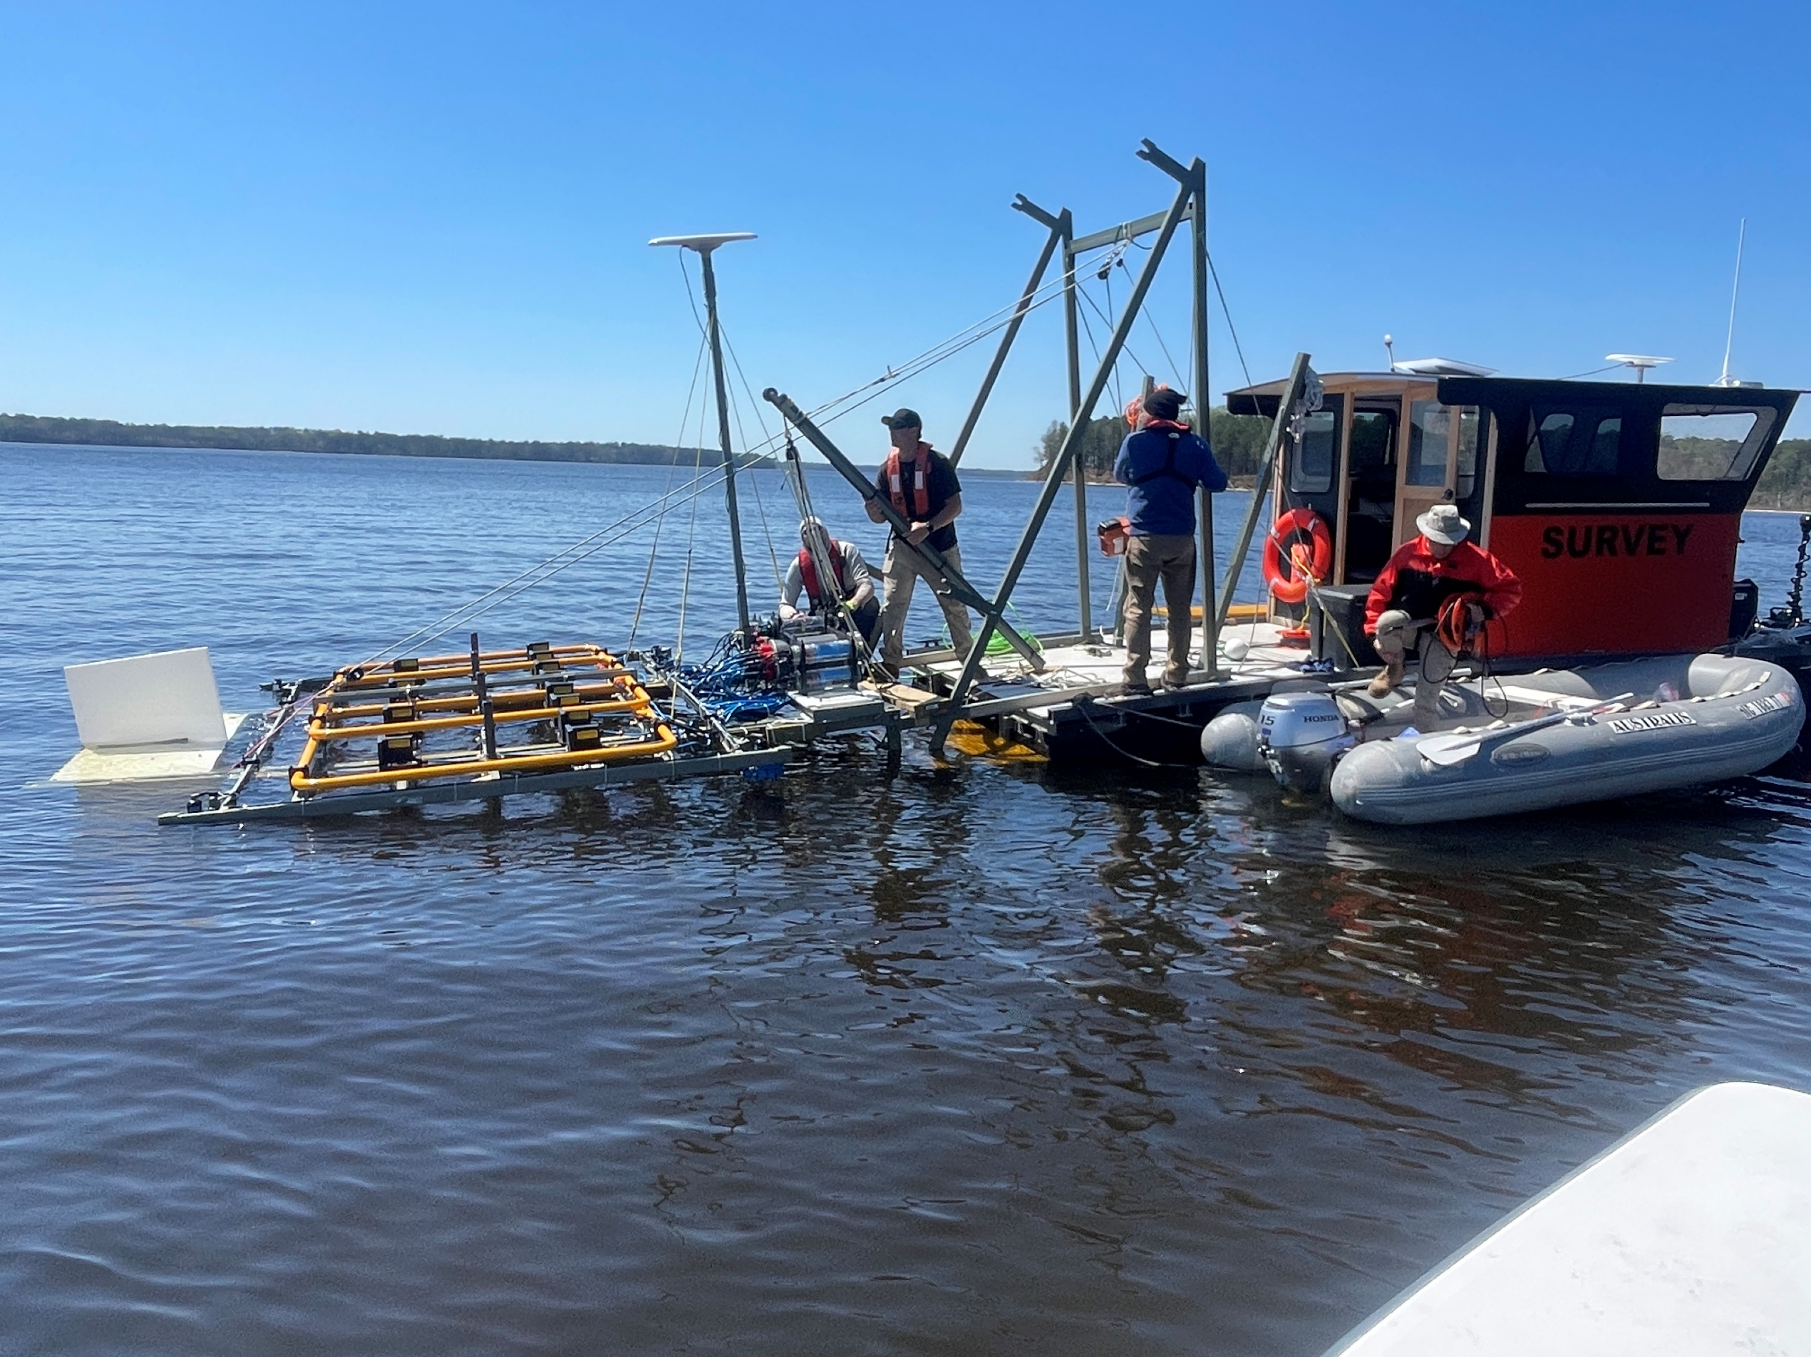
Quality Assurance Project Plan (QAPP)
Project Objective: 100% coverage of 172 acres of tidal Munitions Response Site using the UltraTEM-4 Marine AGC System
The acceptance criteria for Measurement Quality Objectives (MQO) were revised based on further understanding of the technology’s capabilities in shallow water and to achieve the project’s goals

Slide 3
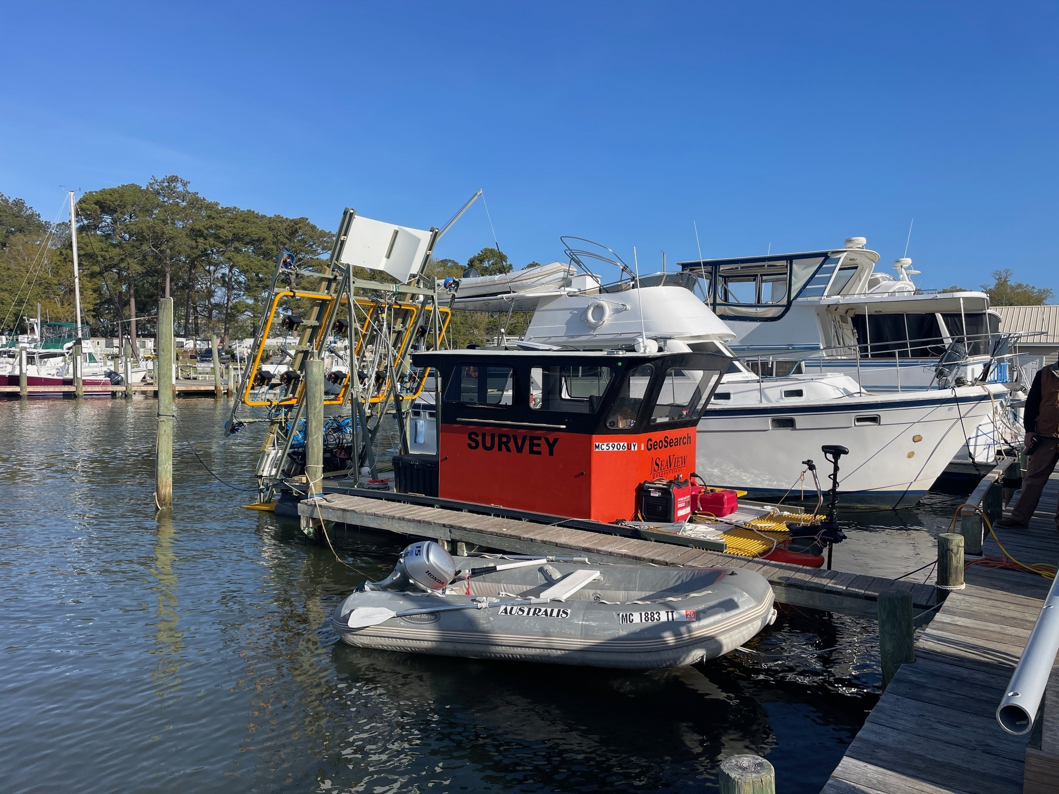
Measurement Quality Objectives
Positioning and Classification of Instrument Verification Strip (IVS) Items and Quality Control (QC) Seeds
Sensor Attitude
Sensor Altitude
Dynamic Noise Assessment
Survey Area Coverage
Survey vessel and UltraTEM array

Slide 4
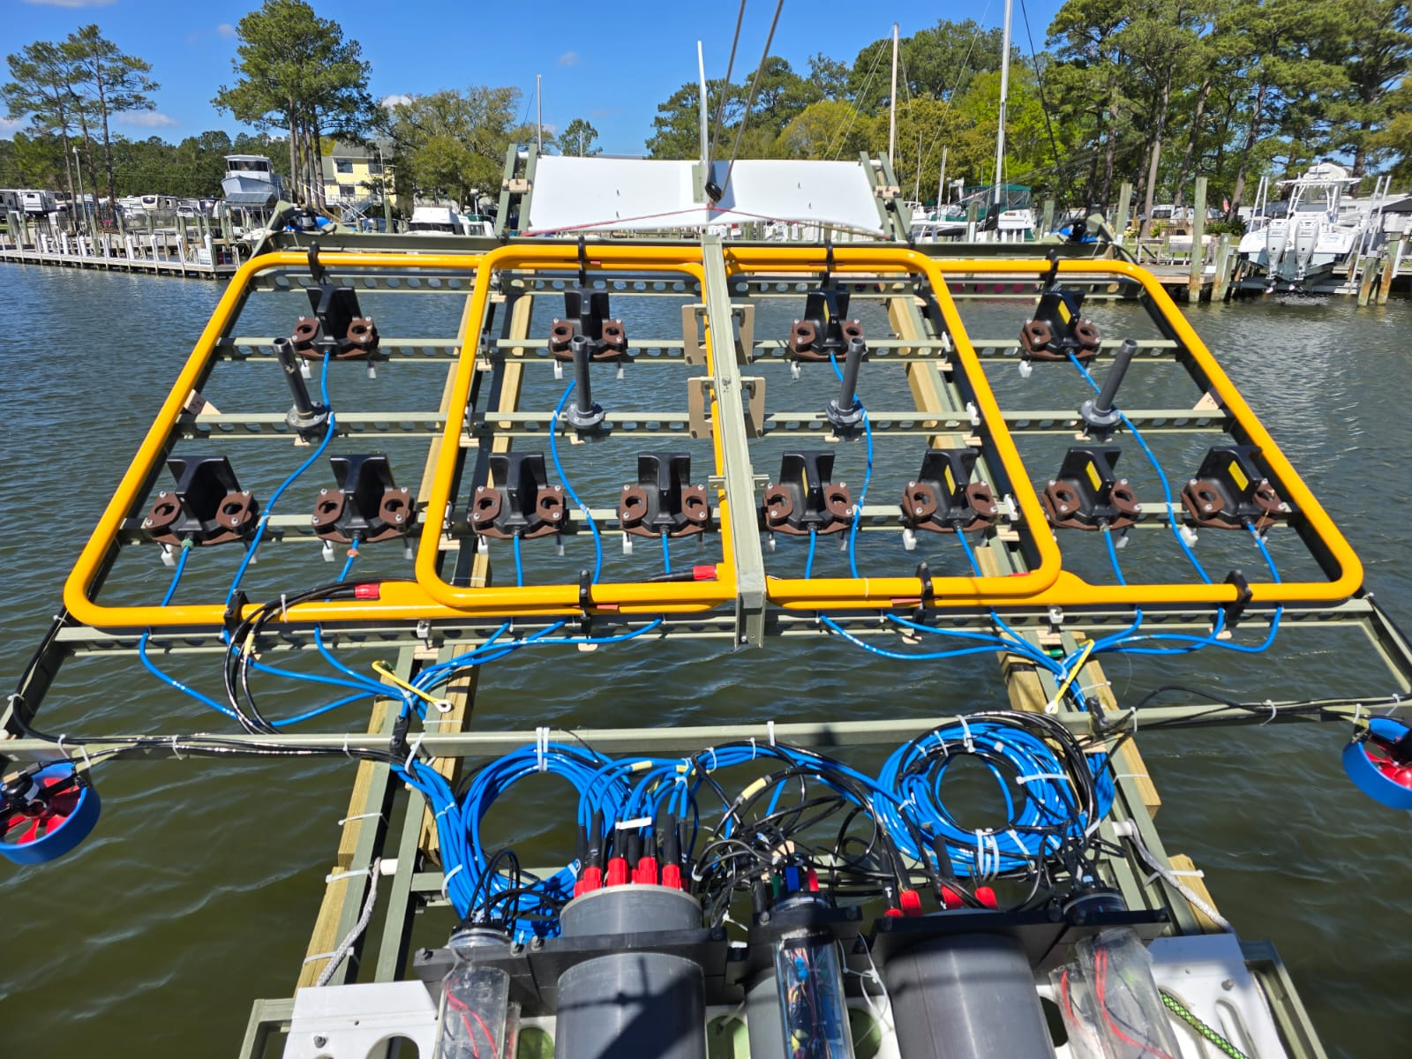
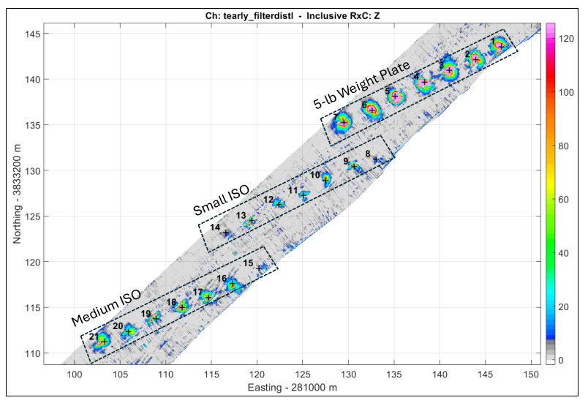
IVS Positioning and Classification
µV/A
Gridded UltraTEM data and locations of IVS Items
Marine UltraTEM Array consists of 3 transmitter loops and 12 receiver cubes with a 4 square meter footprint. Red boxes highlight sectors of array

Slide 5
IVS Positioning and Classification
Measurement Quality Objective | Original Acceptance Criteria | Revised Acceptance Criteria
Dynamic Positioning Accuracy | Targeted positions of IVS seeds are within 0.75m of the ground truth locations | Targeted positions of two IVS seeds per each of the three sectors of the array are within 0.75m of the ground truth locations
Derived Polarizability Accuracy | Derived model response must fit the observed data with a fit coherence ≥0.8; L123 library match <0.50 - or- L1 library match <0.25 | Derived model response must fit the observed data with a fit coherence ≥0.8; L123 library match >0.90 -or- L1 library match >0.90 for two IVS seeds per each of the three sectors of the array
Polarizabilities of IVS seeds from initial IVS survey
Accuracy of initial IVS seed positions

Slide 6
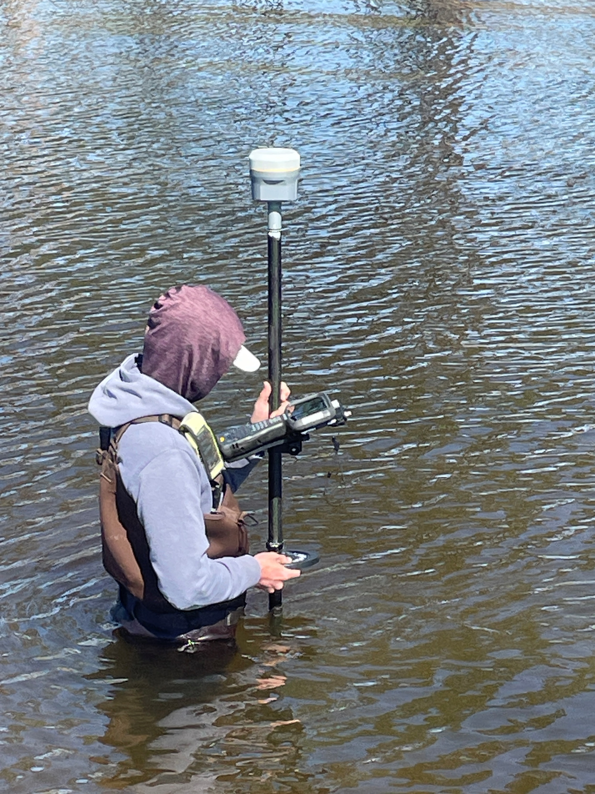
QC Seed Positioning and Classification
Measurement Quality Objective | Acceptance Criteria | Results
Classification Performance | 100% of QC seeds classified as TOI | All QC seeds were classified as TOI
Detection Survey Performance | All blind QC seeds must be detected and positioned within 0.75m radius of ground truth | Blind seeds detected with maximum horizontal offset of 0.59 m
Blind QC seeds were placed across the survey area to average one QC seed was detected per production day
Two QC seeds did not pass the horizontal positioning acceptance criteria. Seed position potentially shifted due to tidal or wind forced currents, or fisherman coming into contact with the seabed
Placing 5lb weight plate QC seed in shallow water

Slide 7
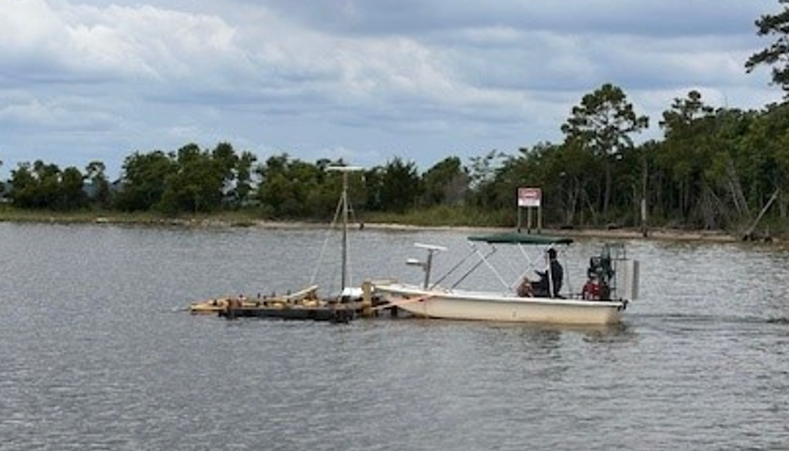
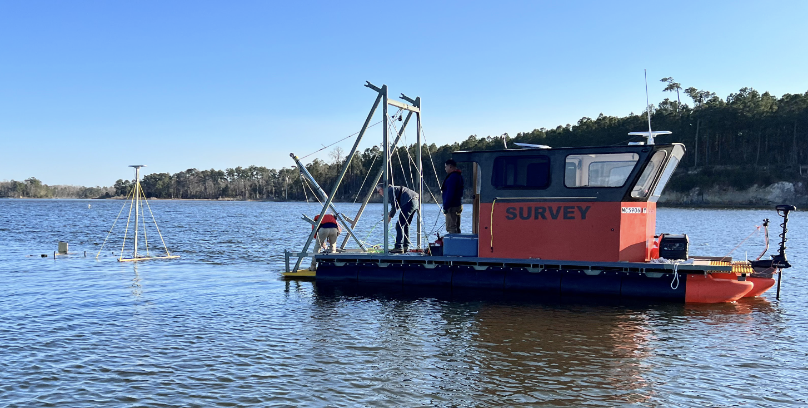
Sensor Attitude
Measurement Quality Objective | Original Acceptance Criteria | Revised Acceptance Criteria
Attitude | >90 percent of data ± 5 degrees (excluding turnarounds, site-specific access limitations, e.g., obstacles, unsafe terrain). | >90 percent of data ± 5 degrees (roll), >90 percent of data ± 15 degrees (pitch) (excluding turnarounds, site-specific access limitations, e.g., obstacles, unsafe terrain).
Shallow water data (<2 ft) collected with airboat
Deep water data (>2 ft) collected with survey vessel

Slide 8
Sensor Altitude
Measurement Quality Objective | Original Acceptance Criteria | Revised Acceptance Criteria
Altitude | >90 percent of data within 0.3m of planned altitude above seabed (1.25m) (excluding turnarounds, site- specific access limitations, e.g., obstacles, unsafe terrain). | >99 percent of data below altitude of 0.85m above seabed (excluding turnarounds, site-specific access limitations, e.g., obstacles, unsafe terrain).
An average of 98% of data from both deep and shallow water areas were below 0.85 m altitude
Data with altitude exceeding 0.85 m were retained and mitigated with a dynamic buffer calculation
Attaching pool noodles to maintain sensor altitude above seabed in shallow water

Slide 9
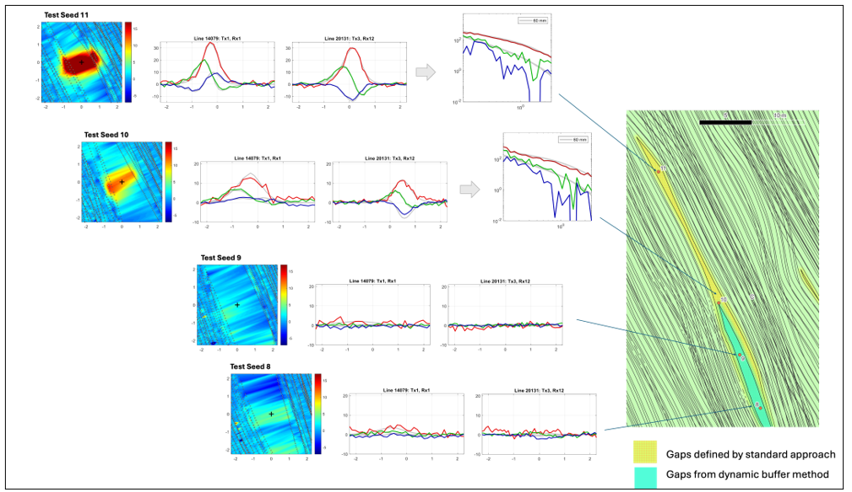
Dynamic Noise Assessment
Measurement Quality Objective | Original Acceptance Criteria | Revised Acceptance Criteria
Dynamic Noise Assessment | Dynamic noise is sufficiently low that a synthetically seeded 81mm mortar cartridge at 1.5m from Rx is properly classified | Dynamic noise (MAD) is below 2.5 within each rolling window assessed (e.g., 10m segment, 300 data point segment, etc.) (excluding areas with clear sensor response or known cultural noise sources). Small gaps due to rejected high-noise data will be inspected. If sensor response adjacent to the gap is sufficiently low to indicate no TOI is present in the gap, then the gap does not need to be filled.
Synthetically seeding coverage gaps with 60 mm mortar cartridge to verify useability of data gap

Slide 10
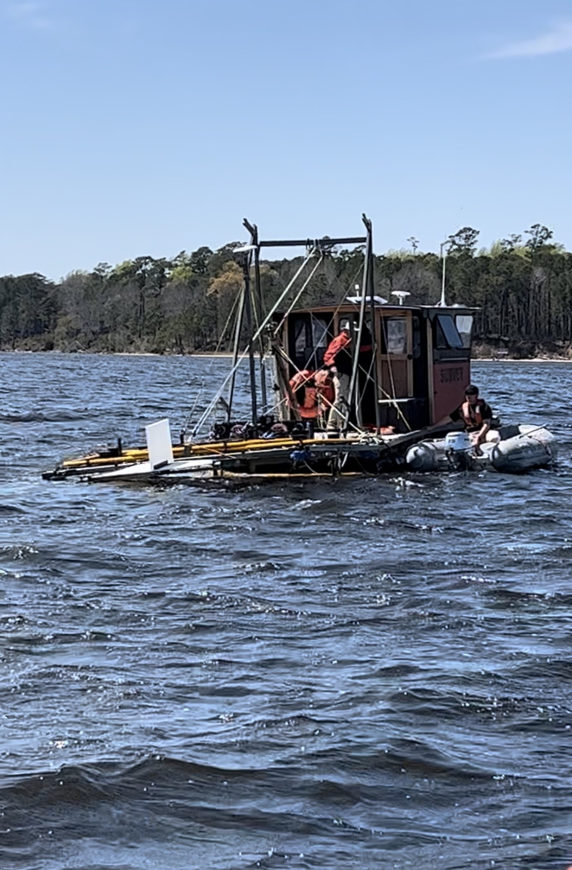
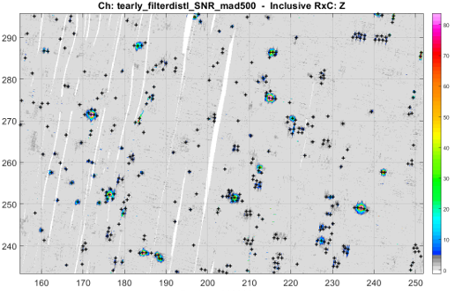
Survey Area Coverage
Measurement Quality Objective | Original Acceptance Criteria | Revised Acceptance Criteria
Coverage | 100 percent coverage (excluding site-specific access limitations, e.g., obstacles) | 100 percent coverage (excluding site-specific access limitations, e.g., obstacles, and gaps that are smaller than an area in which a TOI could be undetected) using 3.6m-wide array footprint. Small “sliver” gaps will be inspected. If sensor response adjacent to the sliver gap is sufficiently low to indicate no TOI is present in the sliver gap, then the sliver gap does not need to be filled.
µV/A
Contractor surveying in windy conditions
Examples of “sliver gaps” (highlighted by red boxes) in gridded UltraTEM data that were retained and did not require recollection

Slide 11
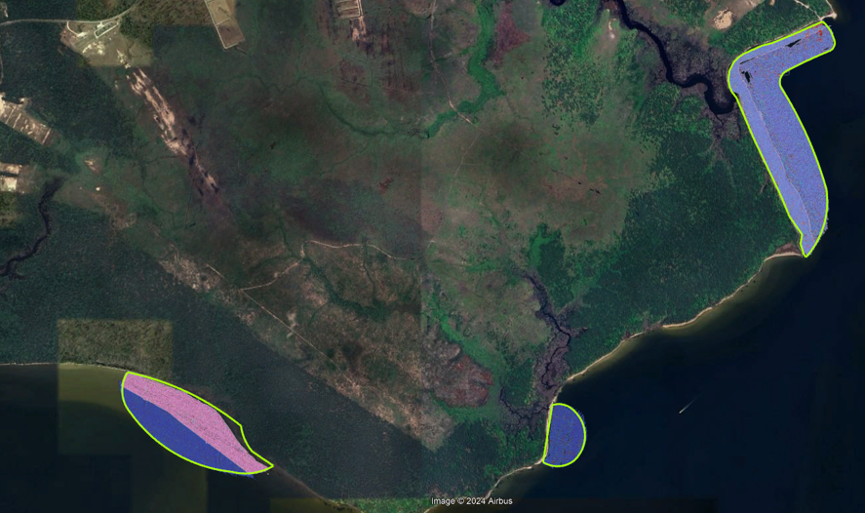
Survey Area Coverage
Surveyable Area (ac) | Coverage (ac) | Gaps (ac) | Total %
168.69 | 167.15 | 1.54 | 99.1
Survey coverage (blue and red) across the projects three survey areas (green polygons)

Slide 12
Conclusions
The lessons learned from this project provide a better understanding of the capabilities and challenges of deployment of the UltraTEM technology in a shallow water environment
Lessons may be considered when planning and developing future underwater AGC projects

Slide 13
Questions?

