Slide 1
Impacts of Latency on Temsense One-pass Classification Results
Brian Junck M.Sc.
Senior Geophysicist

Slide 2
Project Background
Remedial Design - Initially two-pass technical approach
Morphed into One-pass
Some two-pass MQOs preserved
Temsense one-pass on 113 grids
RTK and SLAM positioning
IVS data for 82 days
Data Processing
Initial processing performed using a modified workflow in v2021.2.1
Final processing performed in v2023.1.1 using One-pass workflow

Slide 3
Project Background
9 Seed Failures
QC Seeds all targeted < 0.25m
QC Seed Classification Failures
(3) Decision Statistic < 0.825
(6) Fit Coherence < 0.80
(1) Fit Location > 0.25m
No depth failures
Daily IVS MQOs pass
Ongoing SFTs Pass
No obvious issues with production data (speed, coverage, etc..)
Data levelling/filtering appropriate

Slide 4
Seed Classification Details
Grid ID | Positioning | Seed Type | Orientation | Depth (m) | Decision Statistic | Fit Coherence | Source Offset (m) | Predicted Source Type
G002 | SLAM | Small ISO80 | Horizontal | 0.20 | 0.91 | 0.75 | 0.05 | Small ISO80
G003 | SLAM | Small ISO80 | Horizontal | 0.17 | 0.95 | 0.75 | 0.06 | Small ISO40
G006 | SLAM | Small ISO80 | Horizontal | 0.25 | 0.93 | 0.76 | 0.06 | Small ISO40
G007 | SLAM | Small ISO80 | Horizontal | 0.23 | 0.98 | 0.65 | 0.27 | Small ISO80
G085 | RTK | Small ISO80 | Vertical | 0.15 | 0.80 | 0.92 | 0.07 | Small ISO40
G089 | RTK | Small ISO80 | Vertical | 0.23 | 0.69 | 0.94 | 0.14 | none
G096 | SLAM | Small ISO80 | Horizontal | 0.16 | 0.94 | 0.79 | 0.05 | 37mm Projectile
G098 | SLAM | Small ISO80 | Horizontal | 0.19 | 0.83 | 0.67 | 0.08 | Small ISO80
G100 | RTK | Small ISO80 | Vertical | 0.18 | 0.80 | 0.97 | 0.07 | MK IV Booster

Slide 5
Root Cause Analysis
Data Review
Initial Evaluation and Tests
No indicators of latency issues based on IVS MQO review
data chip size + increasing number dipoles
Corrected majority of seed failures, but not all
Deeper dive into IVS and latency
Method of latency assessment
Routine to assess latency at 0.01 sec increments
Indicators
Fit Coherence (Fit_Coh)
Library Match (LmStat_111toi)

Slide 6
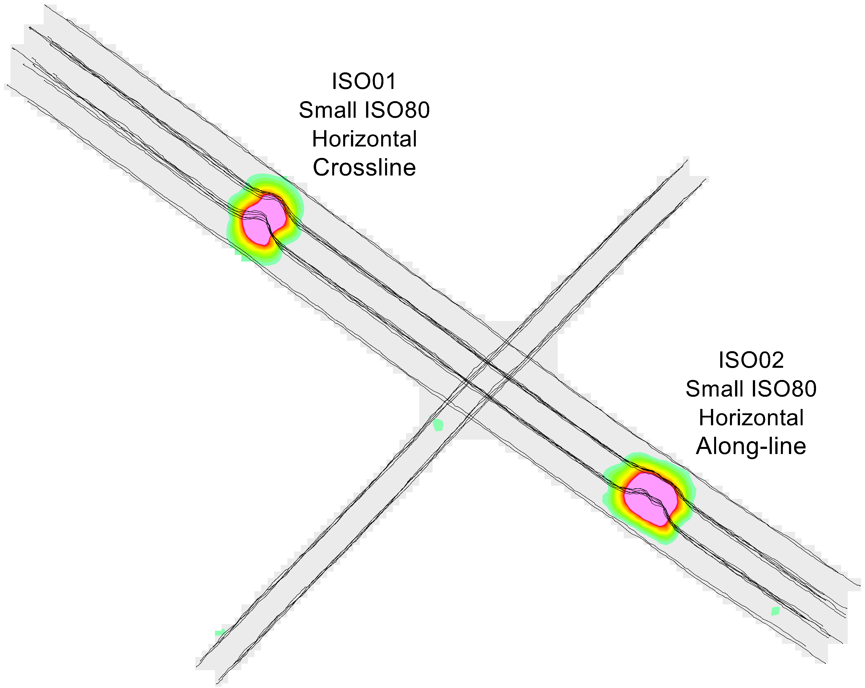
IVS Configuration
Initial IVS results
IVS configuration
Two Small ISO80
1 Horizontal Cross-line
1 Horizontal Along-line
Daily collection of 3 passes
1 seed lane
2 offset
1 noise lane
Passing detection
Ongoing < 0.25m offset
Passing classification results
Ongoing >0.90 LmStat, >0.80 Fit Coh

Slide 7
IVS Configuration
Latency: -0.13
Match Metric: 0.98
Fit Coh: 0.96
Latency: 0.00
Match Metric: 0.98
Fit Coh: 0.92
Latency: 0.05
Match Metric: 0.98
Fit Coh: 0.90

Slide 8
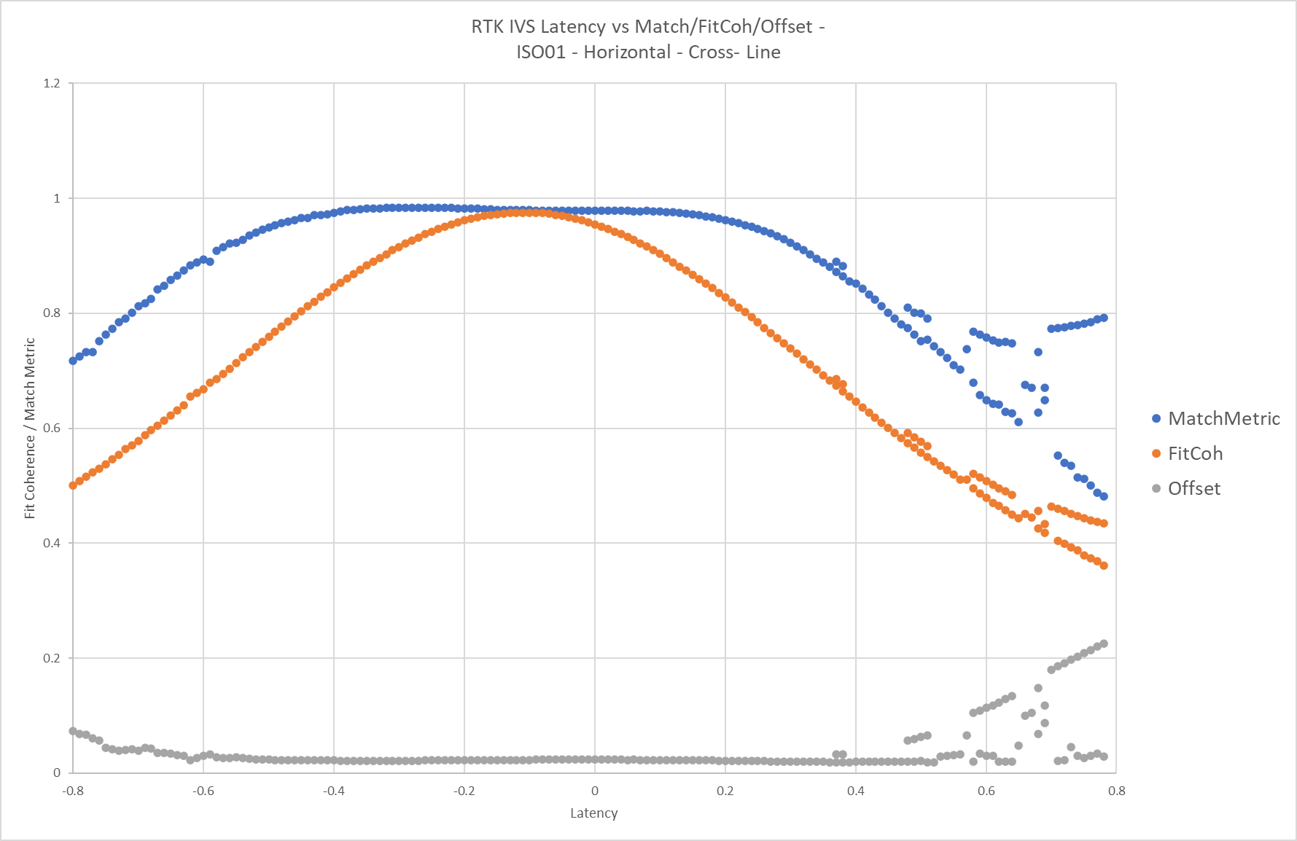
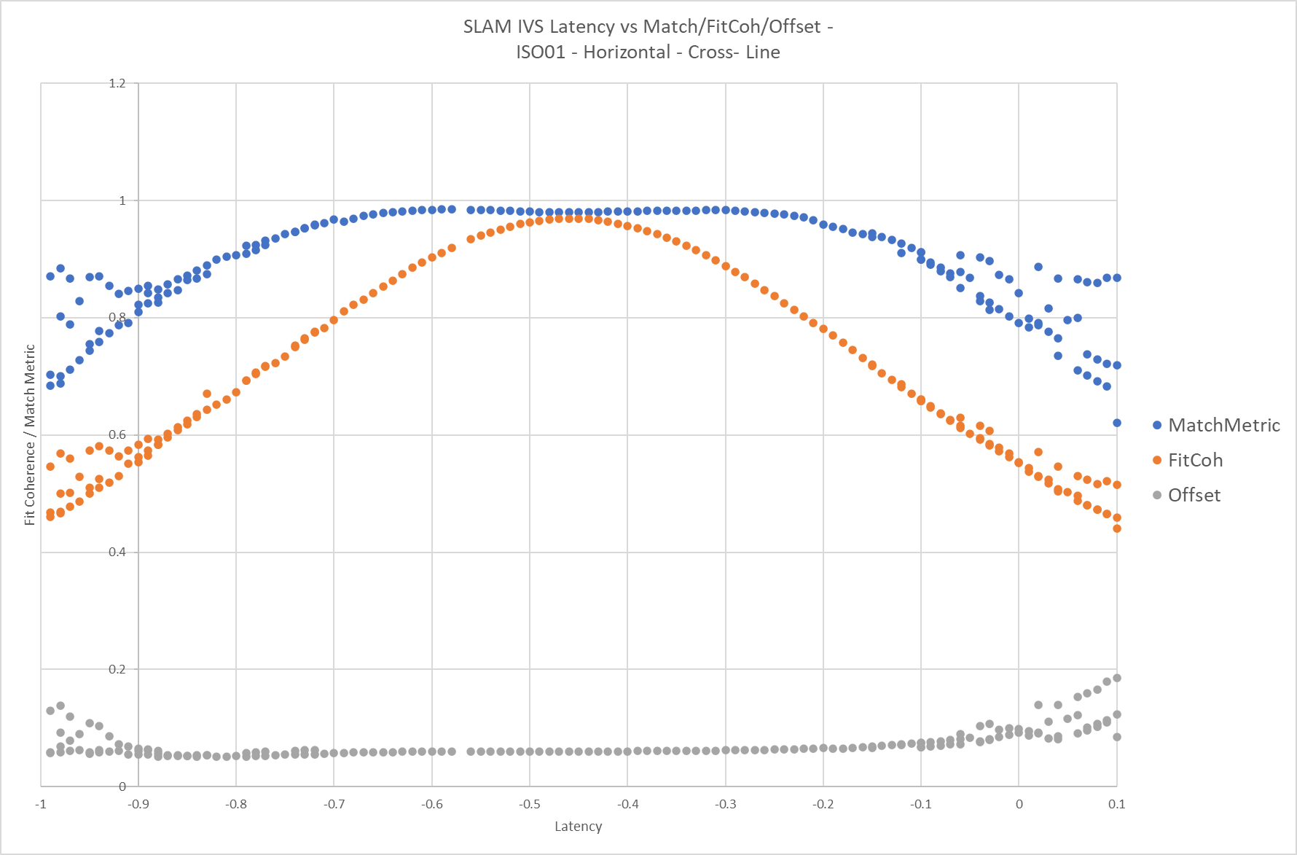
IVS Latency Assessments
RTK Latency – ISO01
SLAM Latency – ISO01

Slide 9
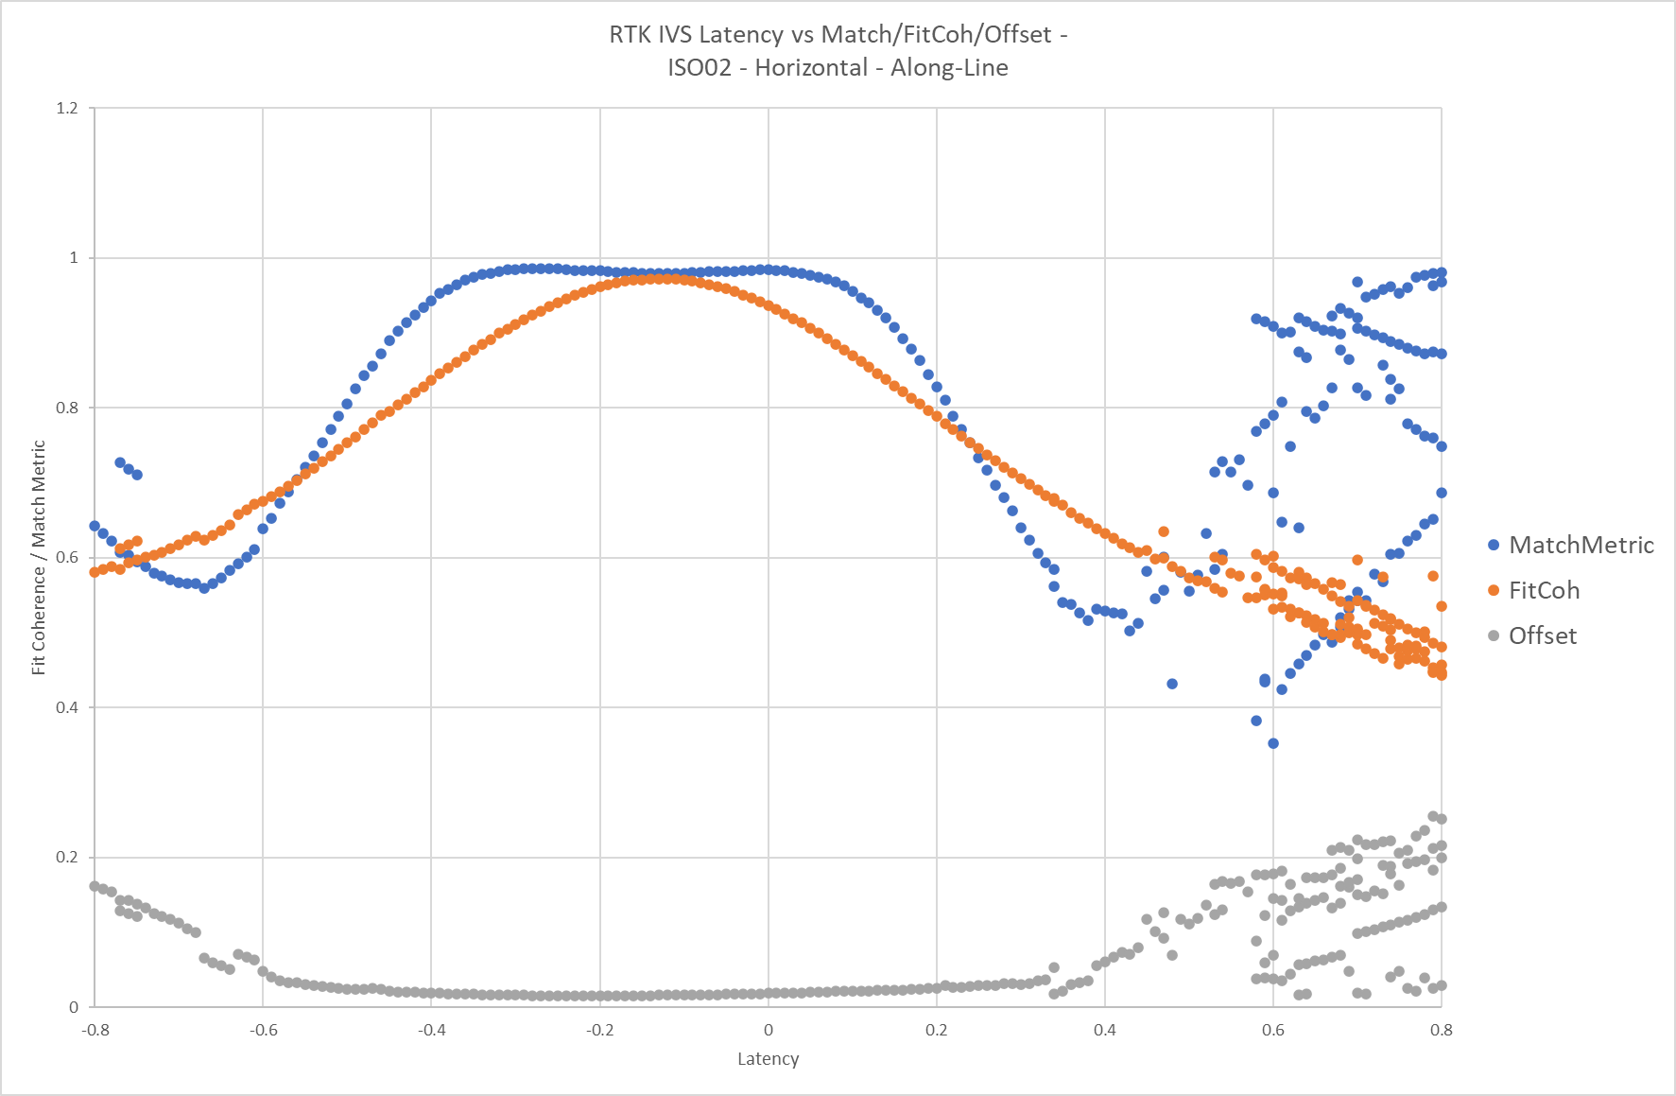
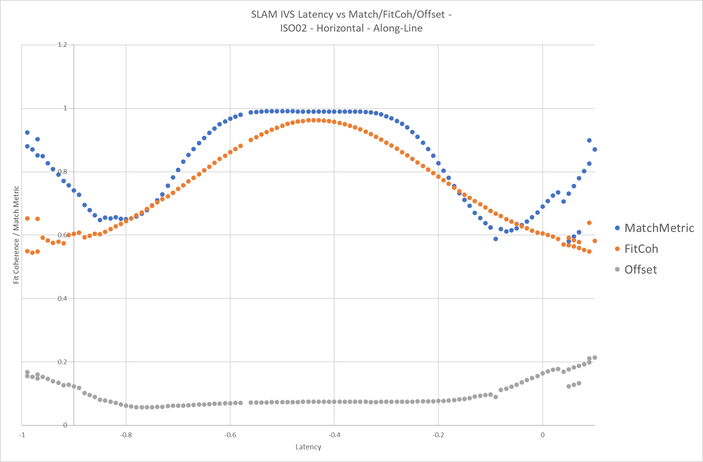
IVS Latency Assessments
RTK Latency – ISO02
SLAM Latency – ISO02

Slide 10
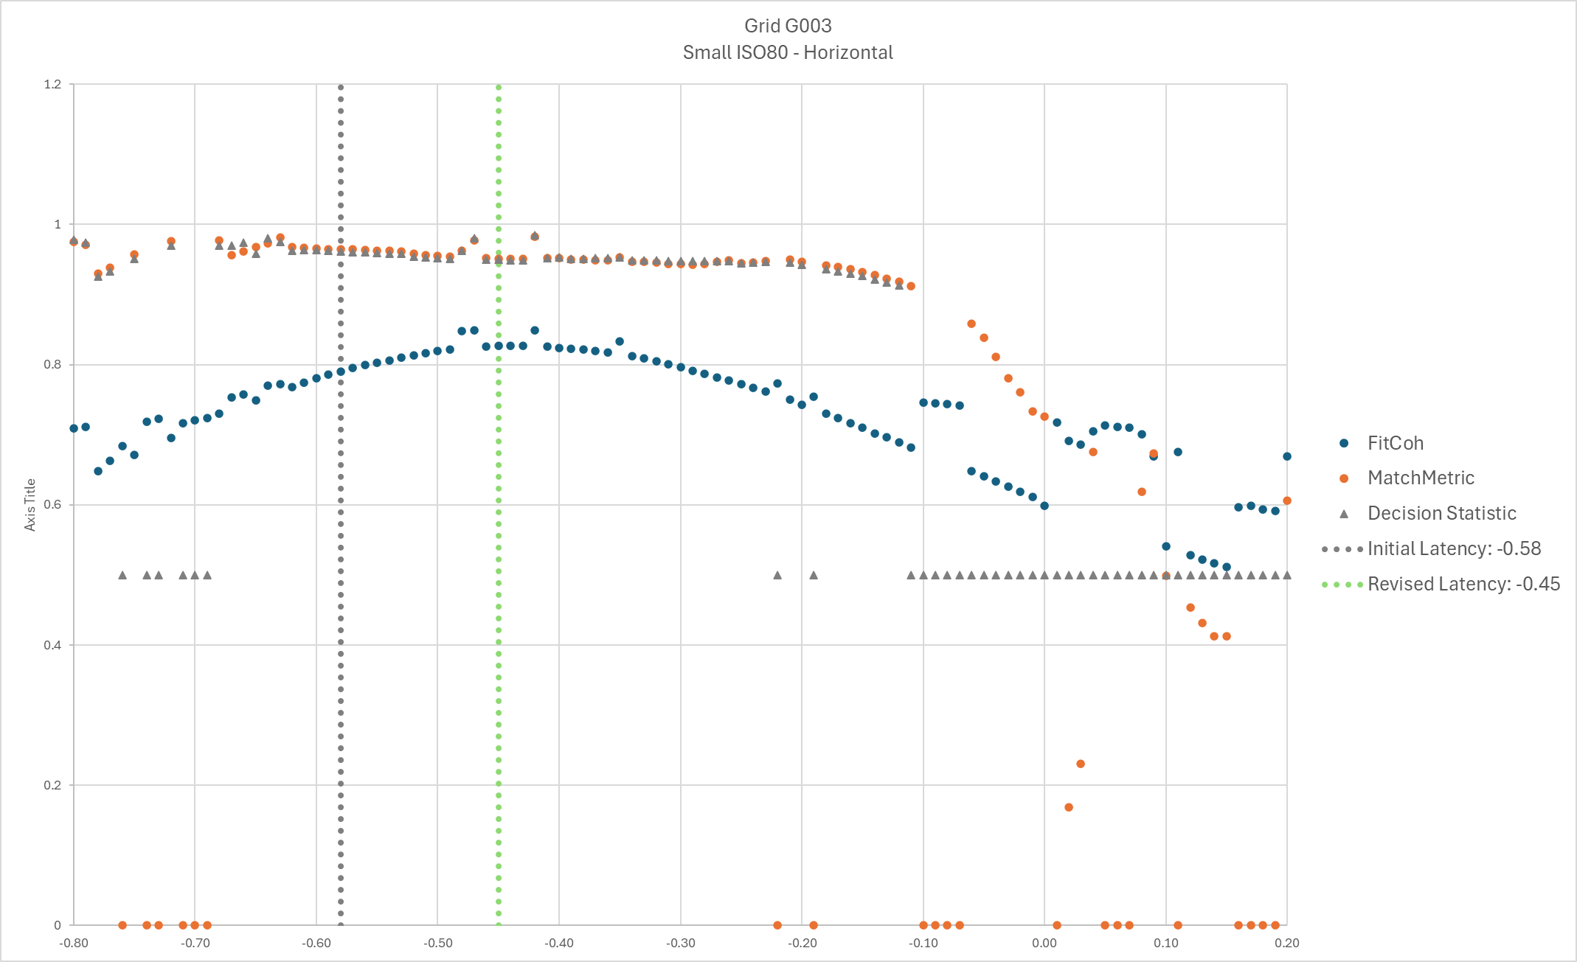
Grid Latency Assessments – Horizontal QC Seeds
Grid G003 - SLAM
SMISO80 – Horizontal
Wide latency window
Match Metric > FitCoh
DS ~= Match Metric

Slide 11
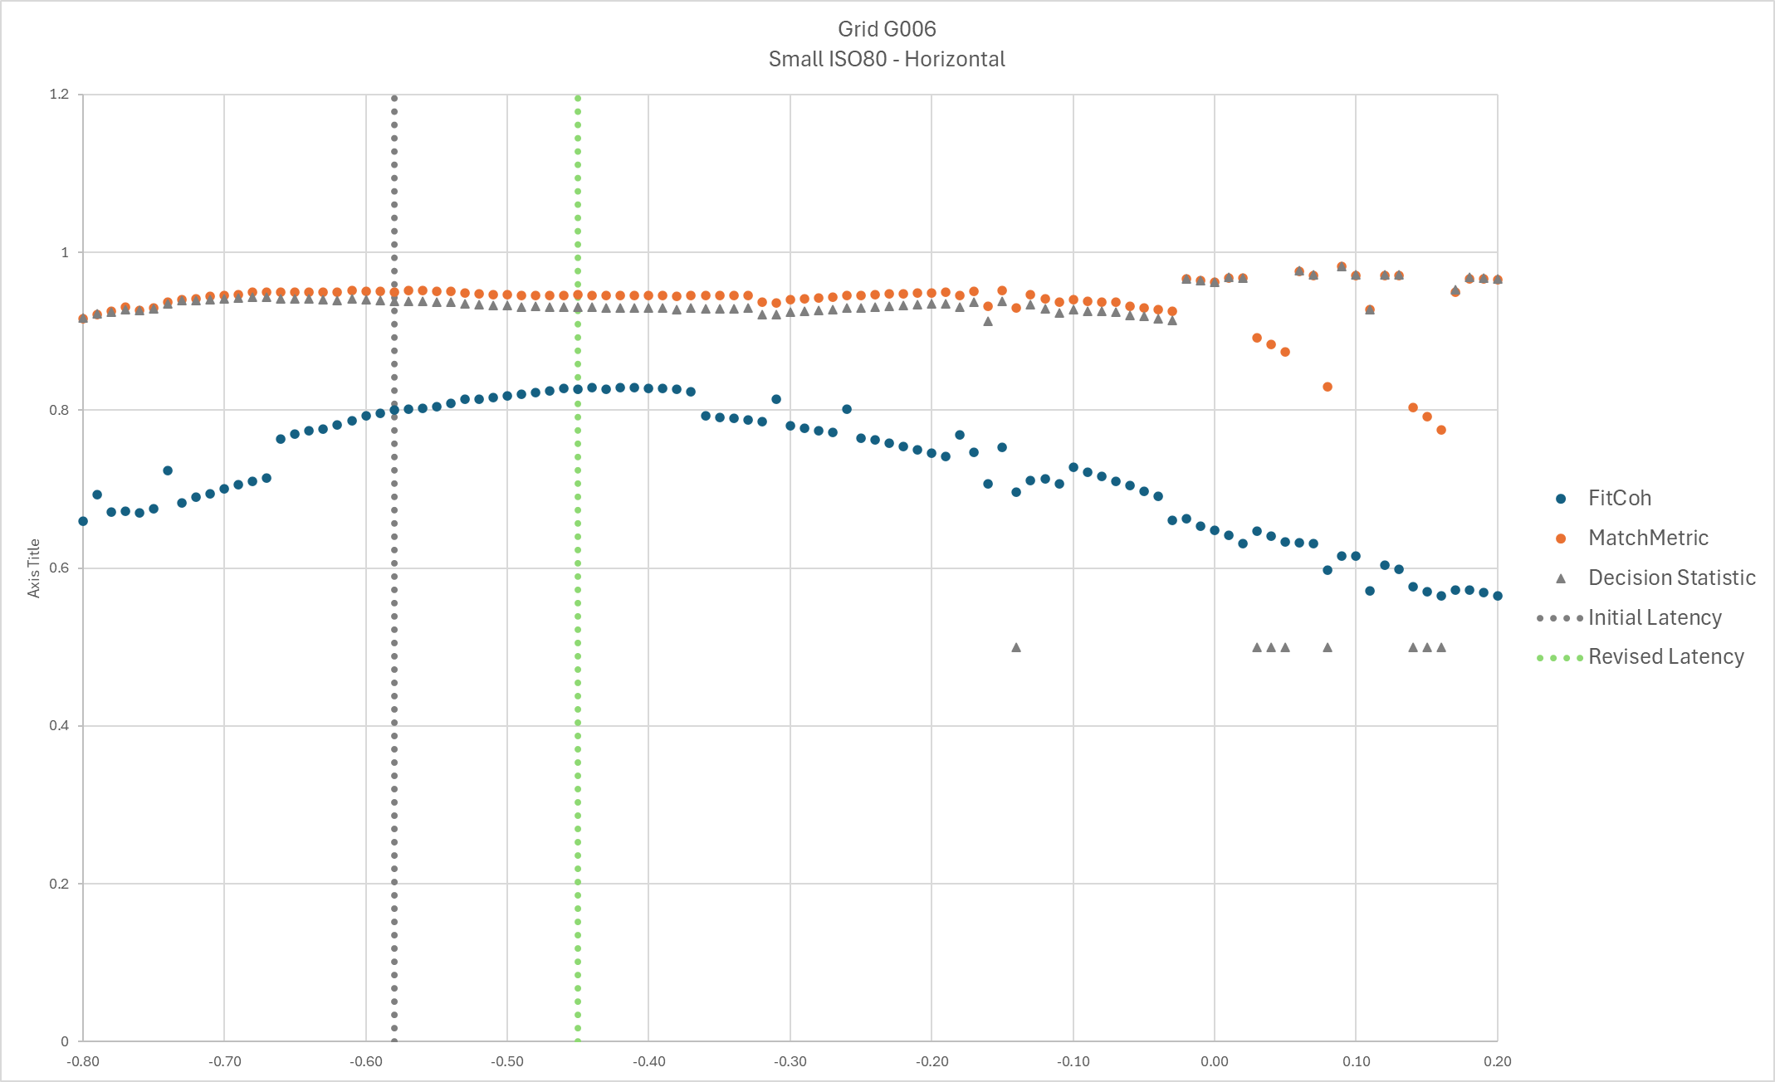
Grid Latency Assessments – Horizontal QC Seeds
Grid G006 - SLAM
SMISO80 – Horizontal
Wide latency window
Match Metric > FitCoh
DS ~= Match Metric

Slide 12
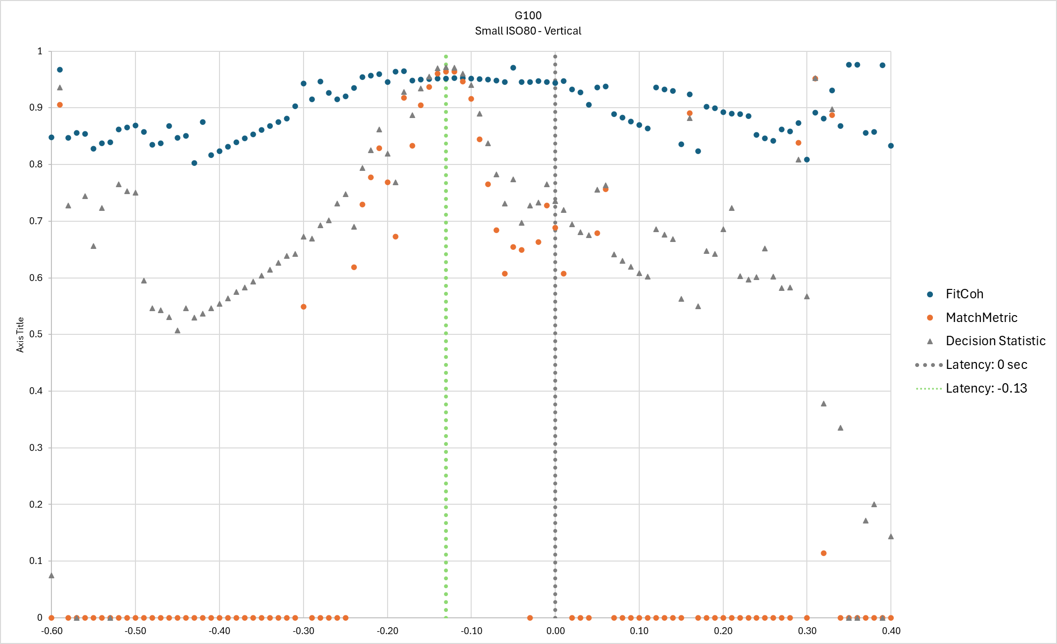
Grid Latency Assessments – Vertical QC Seed
Grid G100
SMISO80 – Vertical
Narrow latency window
Match Metric < FitCoh
DS ≠ Match Metric

Slide 13
Production Grid Corrective Action
Revised latencies applied to production data
RTK: -0.13 sec
SLAM: -0.45 sec
Data reprocessed and reclassified
v2023.1.1 using one-pass workflow
QC Seeds pass

Slide 14
Conclusions
One-pass classification (2x2 Array Geometry)
Small latency adjustments make a large impact on classification
Vertical ISO
Narrower acceptable latency window
Horizontal ISO
Generally wider latency window
General comments
Good practice to include a vertical ISO in IVS
QC Seeding program should include vertical ISOs
Perform quantitative latency assessment of IVS – not just an ‘eyeball’ test

