Slide 1
Filtering coherent powerline noise from agc data
A Case Study: Waikoloa Maneuver Area, Hawaii
Billy Baum & Jon Miller/Michael Gunnels
SAGEEP 2025
3rd Munitions Response Meeting
Denver, Colorado
April 15, 2025

Slide 2
Agenda
Introductions
Electromagnetic Noise & Powerlines
Technical Solutions (WRT)
Waikoloa Maneuver Area
Conclusions
What’s Next?
Questions

Slide 3
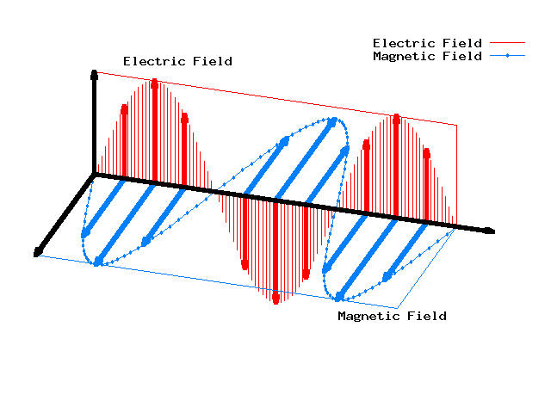
Electromagnetic Noise & Advanced Geophysical Classification
Electromagnetic (EM) Noise
Disturbances in electromagnetic signal caused by natural or man-made sources
Interference can skew measured signals from geophysical data, cause false response, reduce quality of geophysical measurements.
EM noise known to reduce the effectiveness of AGC to detect and classify UXO as Targets of Interest (TOI)
Sources of noise at Munitions Response Sites
Geology
Powerlines/Utilities
Electric Fences
Radio Transmitters
Notes:
1) Define Electromagnetic Noise by reading the 3 bullets.
2) Review sources of EM noise common at sites - “There are many types of sources of noise, the most common ones are listed here….”

Slide 4
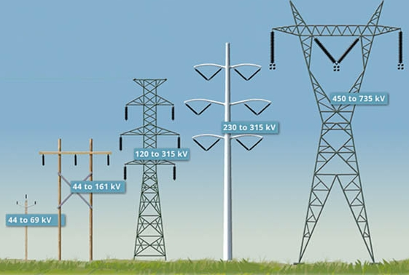
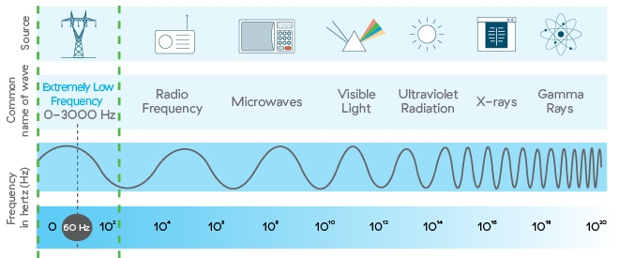
Coherent Electromagnetic Noise from overhead powerlines
Overhead Powerlines
Present at many Munitions Response sites
Loads can range and fluctuate depending on demand
Typically generate low frequency Coherent Noise (60Hz) at levels that make many geophysical investigations ineffective
Historically, areas with powerlines are left as “Data Gaps” in geophysical surveys or remediated with analog methods
Coherent Noise
Noise exhibits a consistent and predictable pattern
Consistent frequency and velocity
Can often be isolated from measurement and removed while preserving the target signal!
Notes:
“In this presentation, we’ll be focusing on powerline noise”
Read bullets
“Typically, noise from powerlines is coherent noise.” Coherent noise exhibits…..”

Slide 5
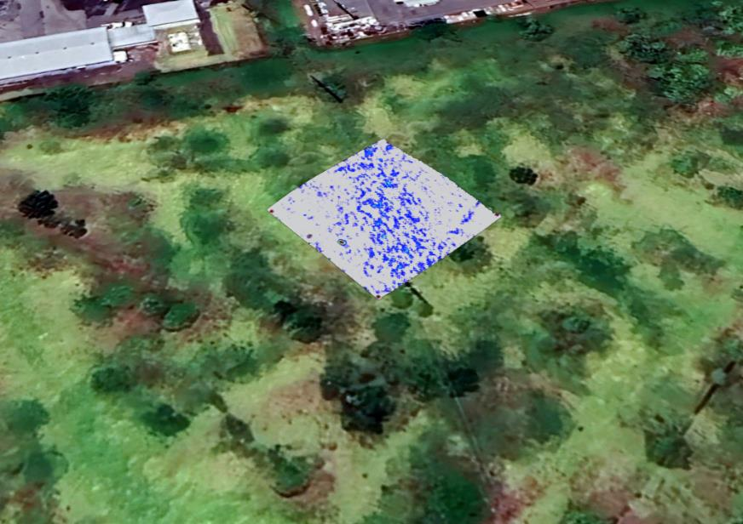
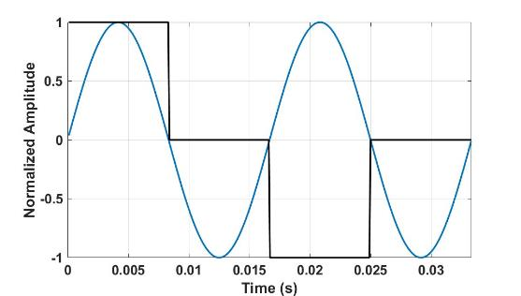
Powerline noise characteristics
Tx On
60 Hz Powerline
Tx Off
Tx Off
Tx On
(Tx+ off) – (Tx- off)
AGC sensors provide 60 Hz noise rejection
Noise reduction is effective but not complete under high voltage lines
Powerline frequency variability of ~0.5% causes small imbalances in EM noise cancellation
Effects can be significant in proximity to lines

Slide 6
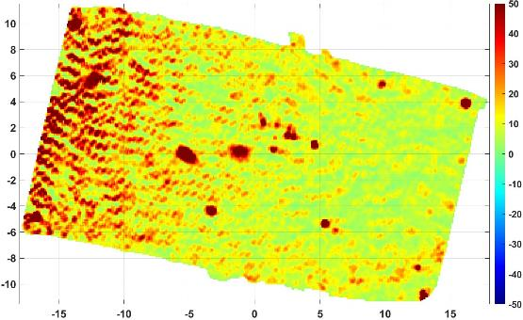
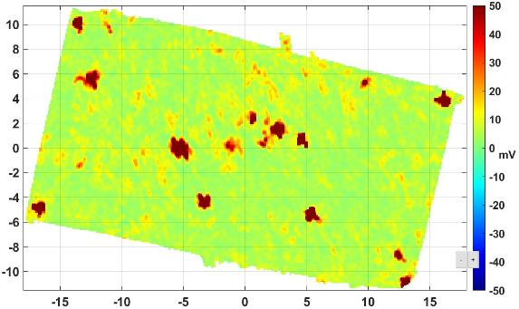
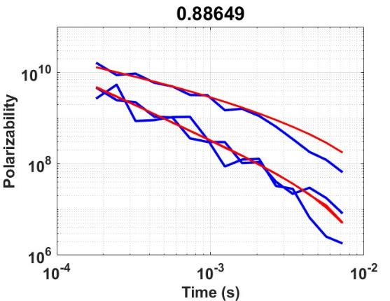
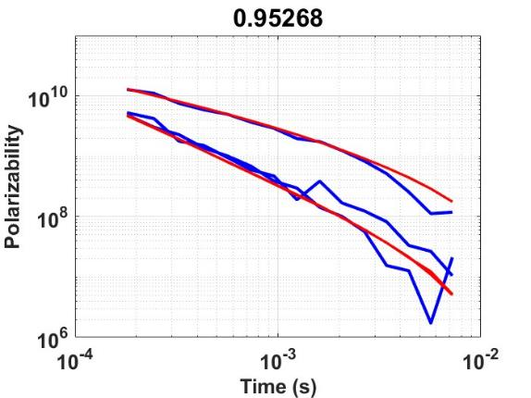
Coherence Filter Implementation
Standard Processing
Filtered Processing
Spatial and temporal patterns associated with powerlines and other coherent noise sources differ from those of “dipole-like” sources, i.e., compact metal
The coherence filter identifies non-dipole patterns and removes them from data
Initial testing and proof-of-concept performed on areas of high electromagnetic interference
Consistent improvements in library match indicate the filter improves performance in these regions
Medium ISO @ 35cm
Medium ISO @ 35cm

Slide 7
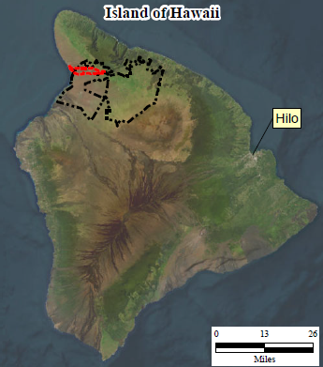
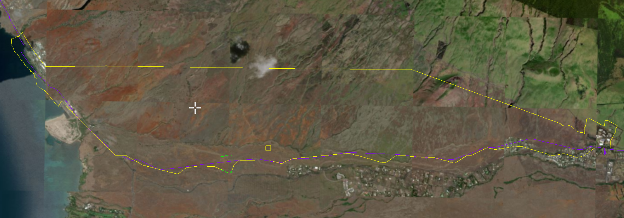
Case Study: Waikoloa Maneuver Area
HydroGeoLogic Inc. (HGL) - Remedial Investigation at WMA Sector 16
Perform RI across portions of MRS where electrical interference from overhead powerlines prevented use of geophysics and left a Data Gap
Previous RI used DGM methods highly susceptible to electromagnetic noise
RI Technical Approach
Parsons contracted to collect/analyze geophysical survey data
Use AGC on transects to delineate site into HD/LD areas
Use AGC in grids to characterize site as HUA/LUA/NEU
Key Challenge
Powerlines run E-W for entire length of MRS (purple line on figure)
90%+ of all transects traverse under path of the powerline
Implement WRT’s Coherence Filter
Notes:
The next few slides will provide a case study about Filtering this Coherent Powerline Noise from AGC Data at a site in Hawaii.
HGL was contracted by the Army Corps of Engineers…. and Parsons was scoped to handle the geophysics
Point out overall map and inserts

Slide 8
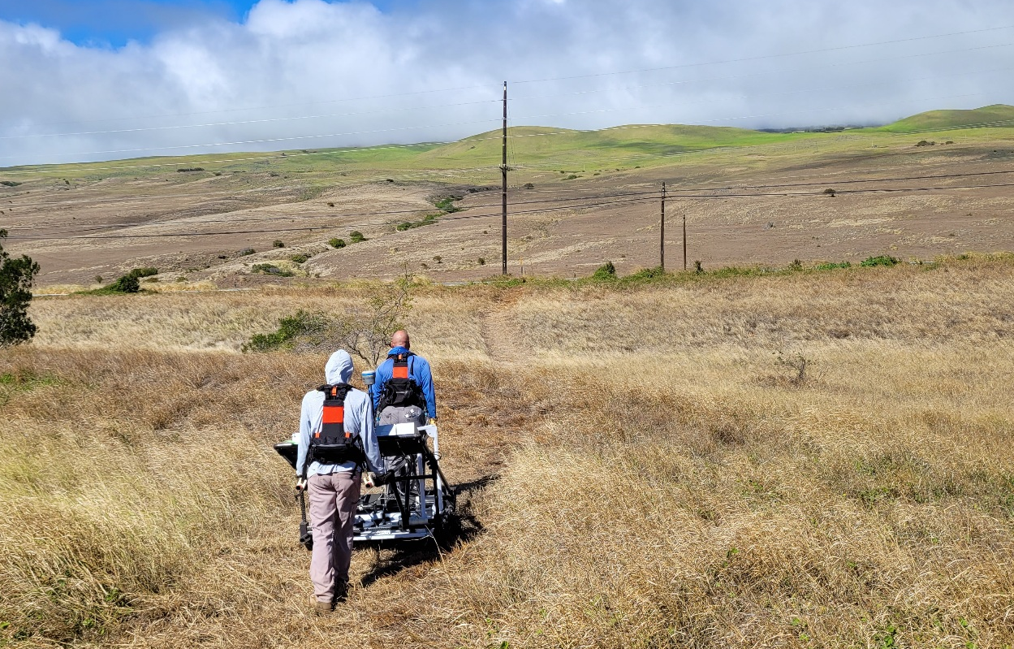
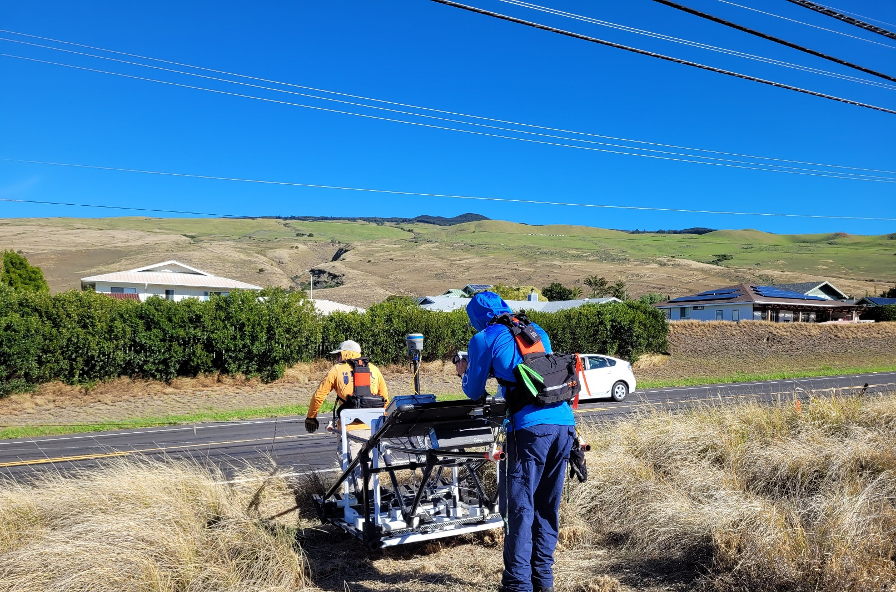
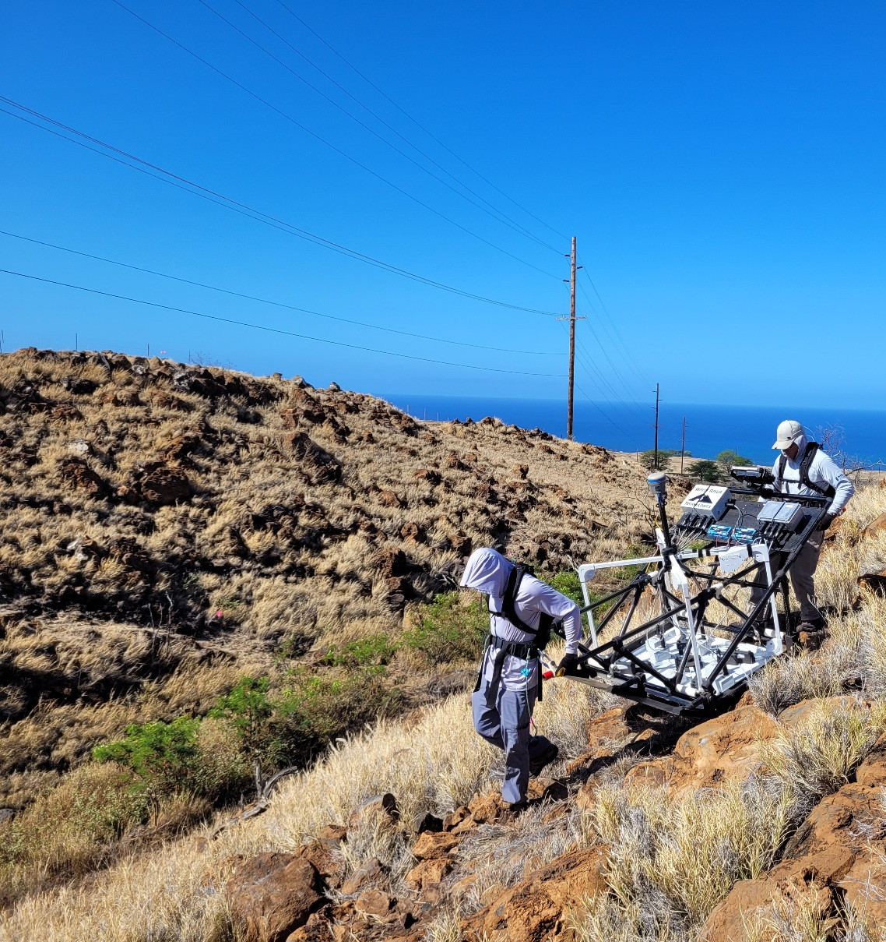
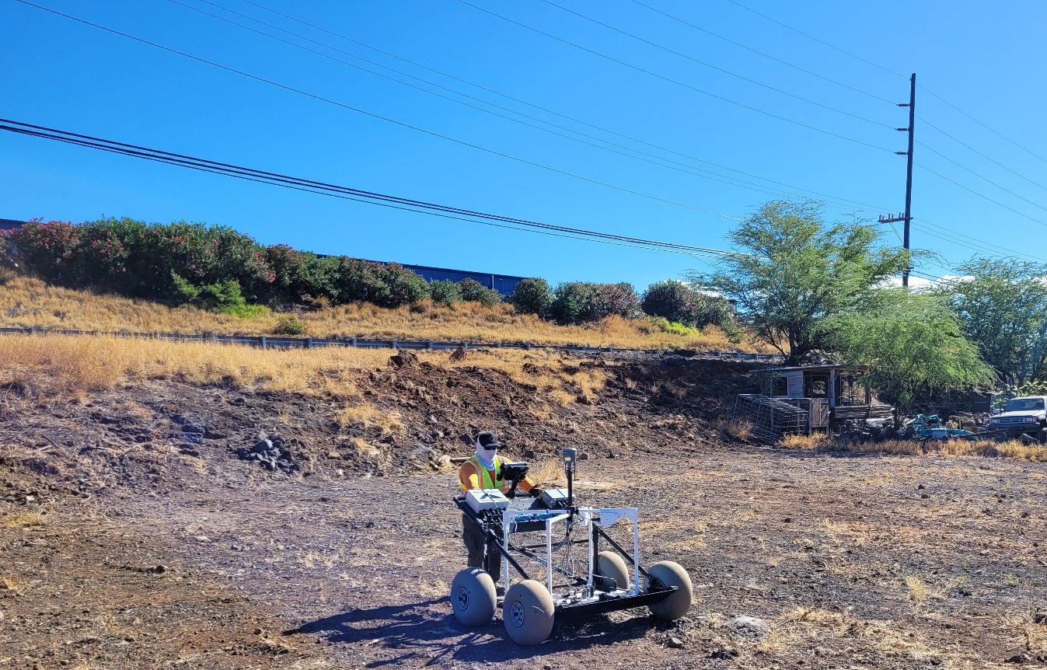
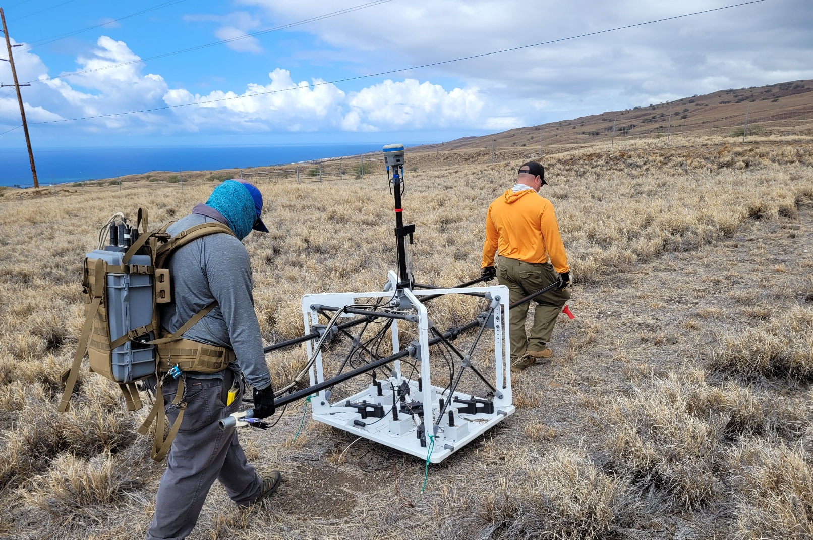
Powerlines at WMA Sector 16

Slide 9
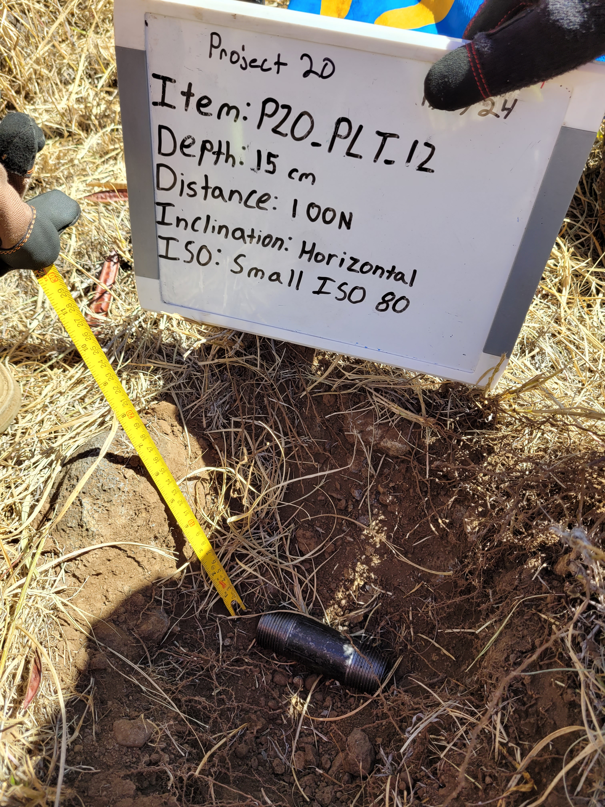
Coherence filter Assessment
Powerline Assessment Survey
“Evaluate effectiveness of WRT’s Coherence Filter to minimize coherent electromagnetic powerline noise without compromising the APEX’s ability to detect and classify seed items as TOIs”
8 Transects
40 Small ISO80 test items - Not “blind” seeds!
Horizontal (worst case scenario)
10 - 25cm deep
0-ft, 100-ft, 200-ft intervals from powerlines
Data Collection & Analysis
Transects collected with APEX
Data analyzed in EM Class in 2 batches
Without Coherence Filter & With Coherence Filter
Compare results
Notes:
Before implementing the Coherence Filter our client wanted us to design and perform an assessment to “Evaluate…… “
What we came up with was the assessment shown here:
Once the test bed was installed we went into transect collection with the APEX and analyzed the data in 2 batches……

Slide 10
Assessment results Summary
Non-Coherence Filtered Results
39 of 40 test items classified as TOI
Average ‘Confidence’ (Library match) = 0.946
Average Fit Coherence = 0.98
1 test item not classified as TOI was located at 0-ft interval from powerlines
3 sources within 1m ROI, none meet QAPP criteria to be considered TOI
Low Match, High Z offset, High XY Offset
Coherence Filtered Results
40 of 40 test items classified as TOI
Average ‘Confidence’ (Library match) = 0.910
Average Fit Coherence = 0.95
On Average, test items had lower Confidence and Fit Coherence after Coherence filtering, but all test items were successfully classified as TOI.
Notes:
High level overview or the results form that comparison are shown here
(bullets)
We’ll take a closer look at the one test item that was not classified as TOI on the next slide.

Slide 11
Test item PLT-08A Comparison
Small ISO80, Horizontal, 0.25m BGS, 0’ from Powerline
Non-Coherence filtered dataset: Non-TOI (Confidence below threshold)
Coherence Filtered dataset : TOI
Filter Type | Test Item ID | Source ID | Horizontal Offset (m) | Fit Depth (m) | Vertical Offset (m) | Fit Coherence | Confidence (Match) | Best Matching Library Item | Result
Unfiltered | P20_PLT_08A | NCF-00453 | 0.05 | 0.58 | 0.33 | 0.93085 | 0.8086 | Medium ISO80 | Non-TOI (Low Confidence) & Vertical Offset Fail
Filtered | P20_PLT_08A | SU01-00346 | 0.04 | 0.37 | 0.12 | 0.91815 | 0.8857 | 37mm Projectile M74 | TOI (meets all criteria)
Non-Coherence Filtered Polarizabilities
Coherence Filtered Polarizabilities
Notes:
Test item 8 was a Small ISO80………
The table provides the filtered and unfiltered classification results.
Taking a look at the polarizabilities shows us that……

Slide 12
Assessment results (Cont.)
WRT’s Testing during development of the Coherence filter indicated Confidence and Fit Coherence values should be higher in filtered data.
Why were the average Confidence and Fit Coherence values lower in the filtered dataset from Waikoloa?
For test items 100’ & 200’ offset from powerlines, Geologic Noise (non-coherent background response) likely impacted data more than the powerline noise did.
For test items under powerlines, coherent noise likely impacted data more than geology did.
Account for geology in the coherence filter parameters?
White River adjusted coherence filter parameters to account for elevated geology
40 out of 40 test items still classified as TOI
Adjusting filter parameters increased the Confidence and Fit Coherence values for many of the seeds, most notably the deepest seeds that were directly beneath the powerlines.
Filter is most beneficial for low SNR targets that are in the presence of highest coherent noise
Notes:
Read bullets

Slide 13
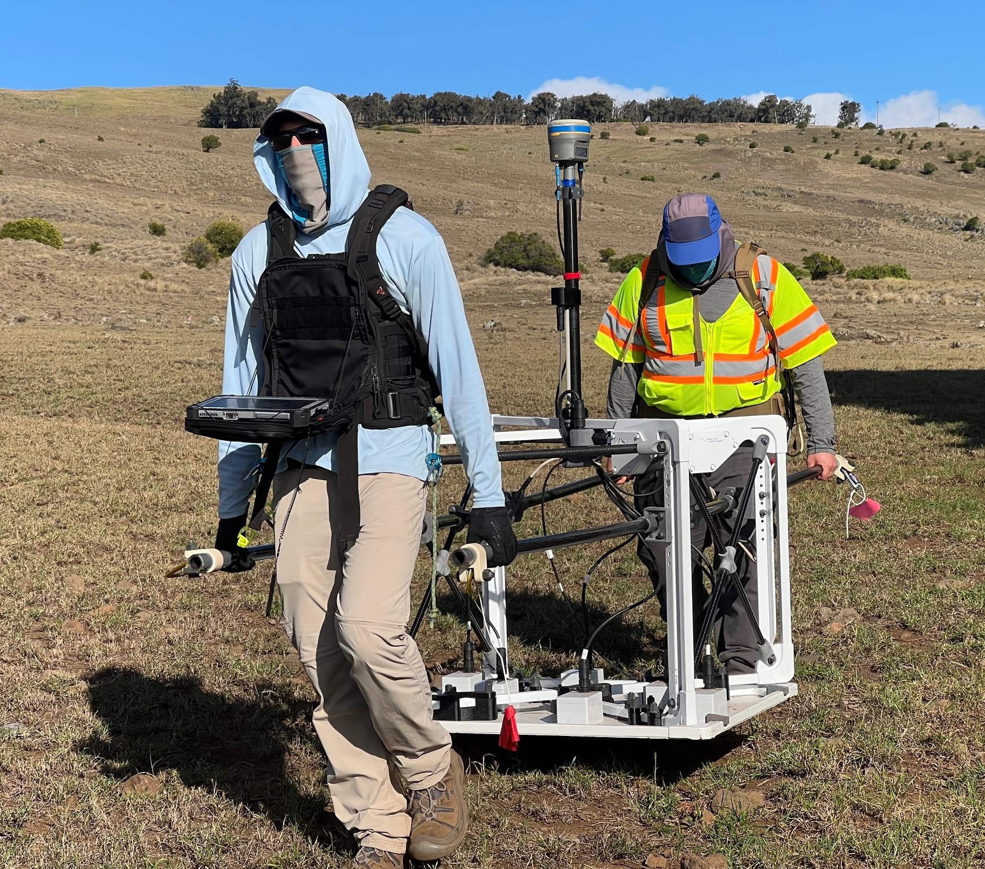
Assessment Conclusions
Coherence Filter Assessment Goal:
“Evaluate effectiveness of WRT’s Coherence Filter to minimize coherent electromagnetic powerline noise without compromising the APEX’s ability to detect and classify seed items as TOIs”
Assessment Conclusions:
“WRT’s Coherence Filter effectively minimized coherent electromagnetic powerline noise without compromising the APEX’s ability to detect and classify simulated munitions (test items) buried along transects as TOIs. In the assessment survey area, 100% of test items were correctly classified as TOIs.”
WRT’s Coherence Filter was applied to all APEX transect data collected during the RI at WMA Sector 16.
Notes:
Remembering back, the initial goal of the assessment was to “Evaluate the coherence filter….
-And based on the results, we presented to the PDT the conclusion that “the Coherence Filter was successful”
-and proceeded to use the filter on all of the APEX transect data collected across the site.

Slide 14
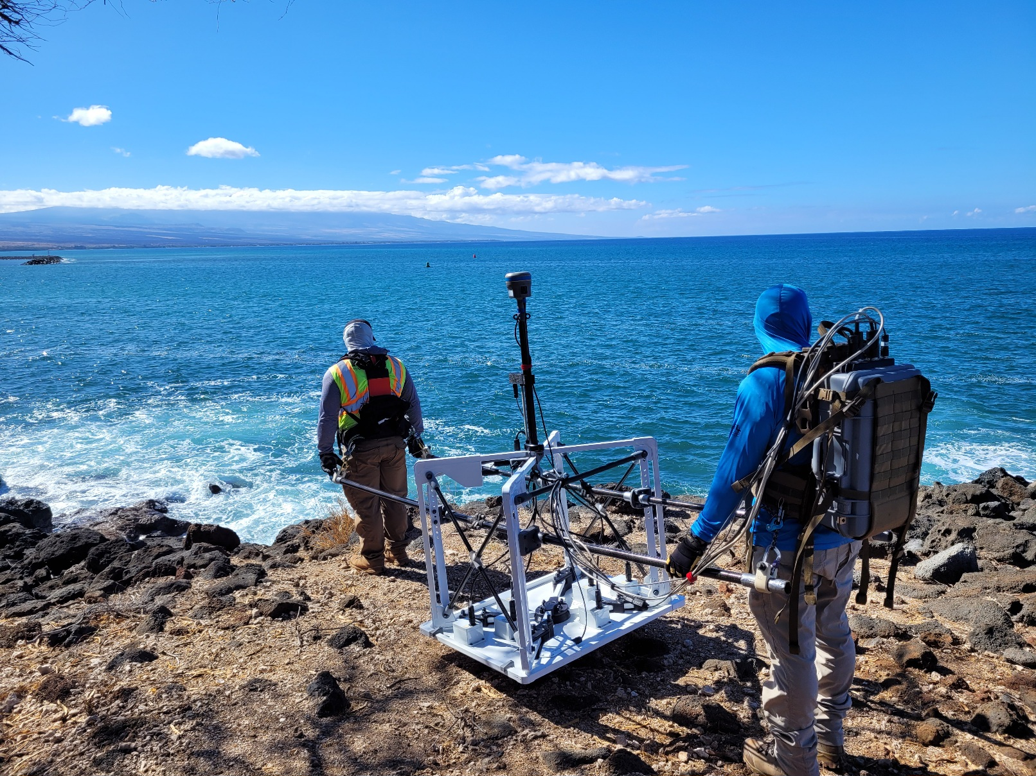
What’s next?
WMA Sector 16 RI:
Evaluate the effectiveness of coherence filtering on APEX data collected in Grids in areas affected by powerline noise.
Beyond Waikoloa?:
Evaluate filter effectiveness at other sites affected by powerlines with different noise characteristics?
Can general principals behind coherence filter be applied to filtering other types of noise? Geology? Etc.?
Notes:
Looking forward for this RI at Waikoloa, our next step is to “evaluate the effectiveness…..
And Beyond Waikoloa WRT is looking at additional applications, ill let Mike speak to those…

Slide 15
Questions?
Parsons Corporation

