Slide 1
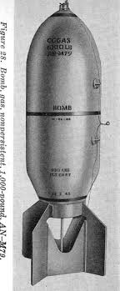
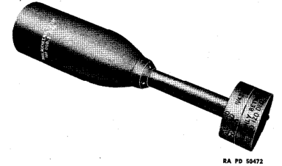
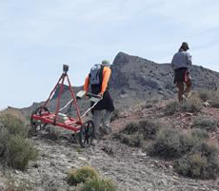
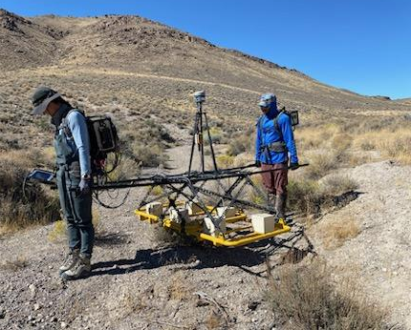
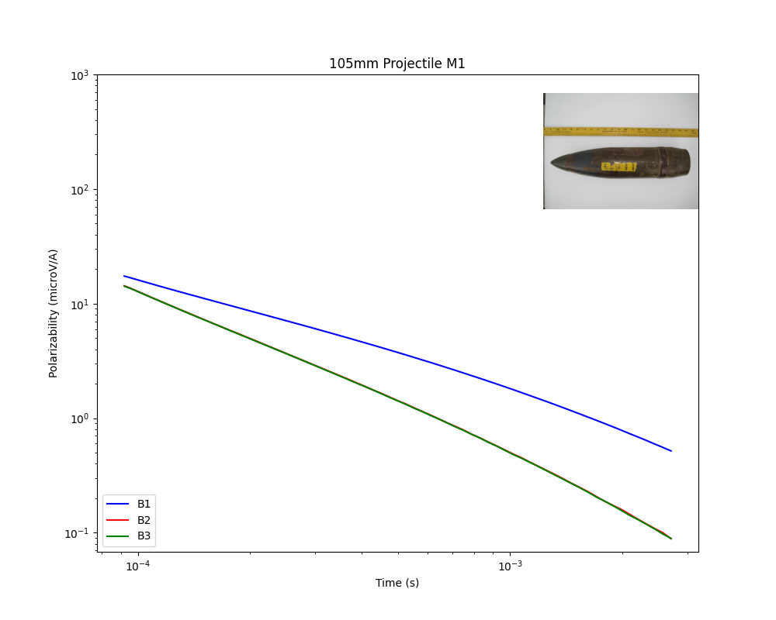
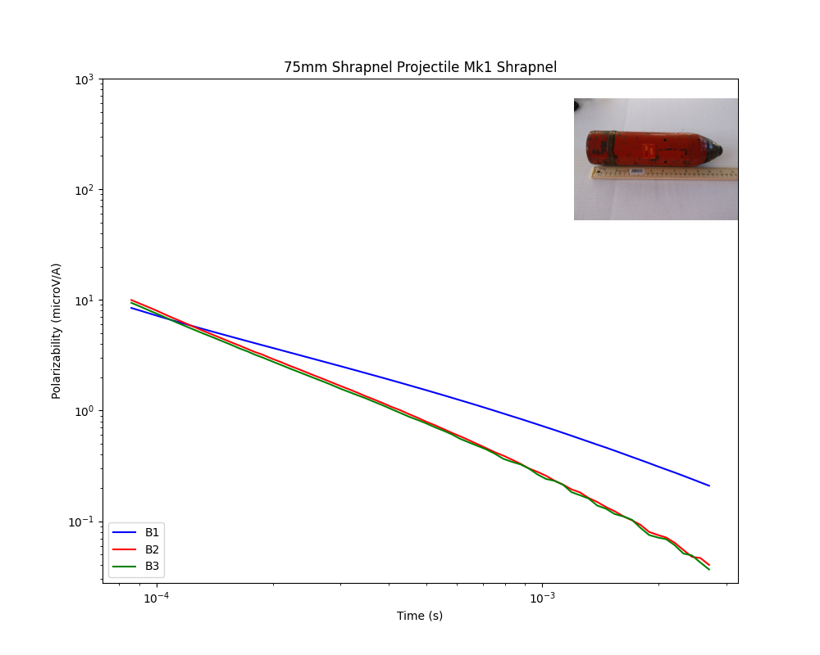
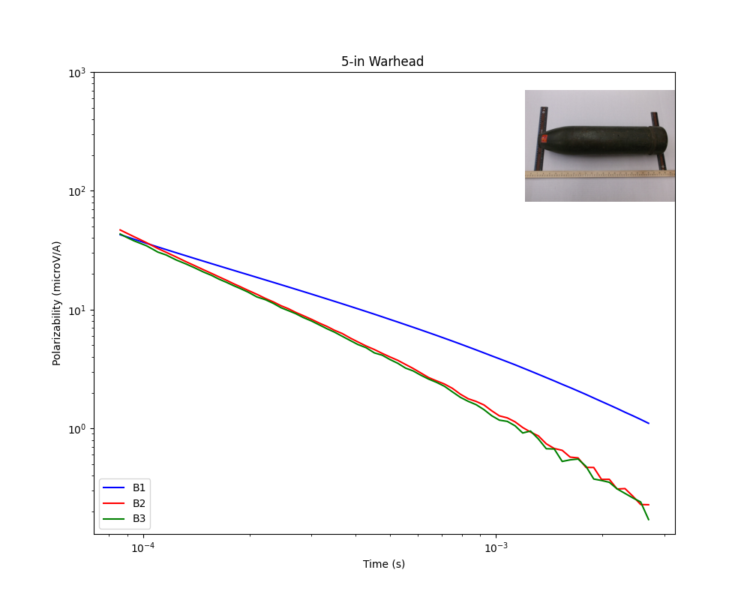
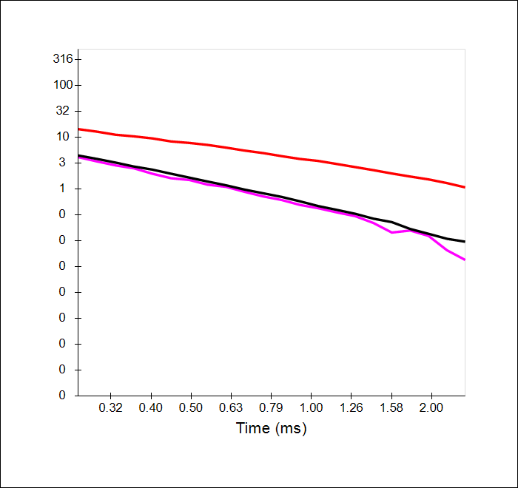
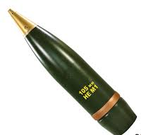
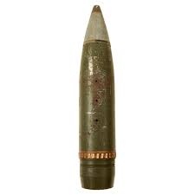
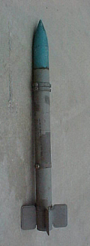
Advanced Geophysical Classification with Non-Library Munitions Yellow Jacket Target Area, Tooele County, UT
ABSTRACT
When performing advanced geophysical classification, inverted electromagnetic anomalies from picked targets above a set response threshold are compared against a site-specific library of known or expected munitions. A match metric is then calculated for each munition in the library to provide a prediction for the most likely source of the anomaly. Ideally, the library contains each known or expected munition at the site of interest to give the best chances of identifying each munition. However, this is not always possible because the Department of Defense (DoD) Target of Interest (TOI) library often does not contain each known or expected munition at Formerly Used Defense Sites (FUDS).
This was the case at the Yellow Jacket Target Area (YJTA) where UltraTEM Portable Classifier (UTPC) transects were collected. The approach for developing the YJTA site-specific library included a three-step process. First, identification of the munition within the DoD TOI library and adding that munition to the site-specific library. Second, identification of a proxy for munitions with a close match to size and shape to a munition in the DoD TOI library. Lastly, some known or expected munitions at the YJTA did not have a close match in the DoD TOI library, so a different approach was taken. These munitions were relatively larger munitions, so a size threshold was established where any inverted source with a size above the set threshold was added to the source database and investigated further.
Figure 1. A few of the notable munitions tested at the Yellow Jacket Target Area, includes 1,000-lb. bombs, thermal generator, and 7.2 demolition rockets.
PROJECT SPHINX
Between May and August 1945, the Department of Defense tested chemical weapons material (CWM) and conventional munitions at the 9,022-acre Yellow Jacket Target Area (YJTA) Munitions Response Site (MRS). The testing was focused on a series of mines and caves with a mission to determine the best material for reducing Japanese caves and underground fortifications, and the best means of employment of that material.
Delivery methods used included barrage, points source, or static firing. Oversight of the conventional munitions testing was conducted by a mobile unit from Army Air Forces Proving Ground Command – Eglin Field. The conventional tests were directed at the best method to seal cave and tunnel entrances or to mark targets for other weapons attacks. CWM testing was directed by Dugway Proving Ground and U.S. Navy’s Chemical Warfare Training Unit Micrometeorology School. These tests were designed to assess a lethal portfolio of “toxic agents” (phosgene, cyanogen chloride, hydrogen cyanide, sulfur mustard), smoke munitions, and incendiary munitions.
Figure 2. Geophysical sensors used for data collection. Left: EM61-MK2 used for preliminary characterization transects; Right: UltraTEM Portable Classifier used for high density area characterization transects.
MUNITION CHARACTERISTICS AND POLARIZABILITY
During Project Sphinx the type and quantity of the munitions tested was documented, which ideally would make it easy to create a site-specific library. However, the exact make and model of the munitions used was not identified. Munitions of the same caliber can vary in length and thickness, affecting the objects response to electromagnetic induction. When inspecting polarizability curves, keep in mind the effect of the munition’s size, shape, and thickness on the curve characteristics and look for curves that match those characteristics.
105mm
75mm
5-in Warhead
Amplitude:
Larger objects produce a larger response
Modeled polarizability curves for Medium ISO
Slope and Smoothness:
Polarizability curve slope depends partly on the wall thickness of the object
5-in Warhead + Rocket
Polarizability (uV / A)
Curve Separation:
One higher amplitude curve with two lower curves is typical of cylinder
Figure 3. Modeled polarizability curves for a Medium ISO
Figure 4. Modeled polarizability curves for a 105mm projectile, 75mm projectile, and a 5-in rocket.

Slide 2
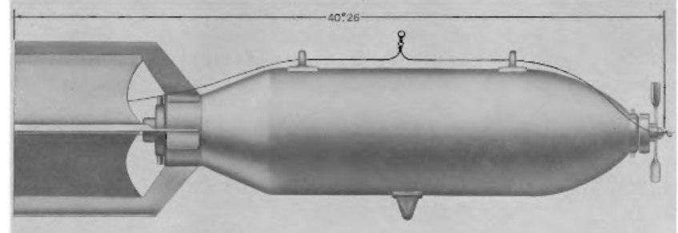
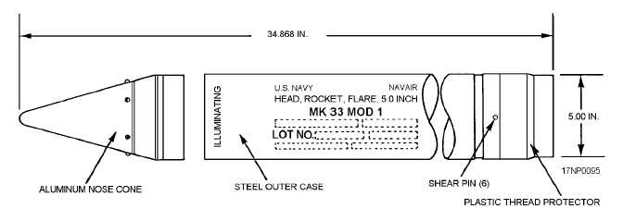
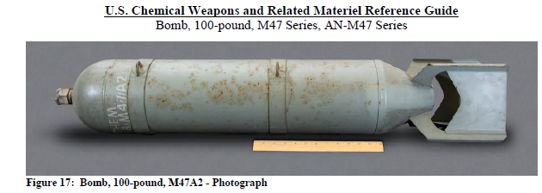
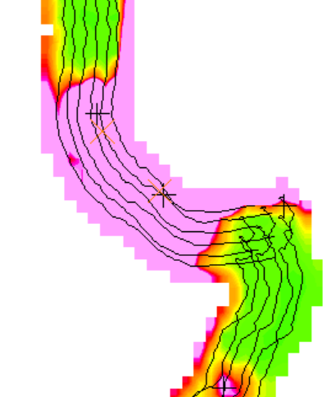
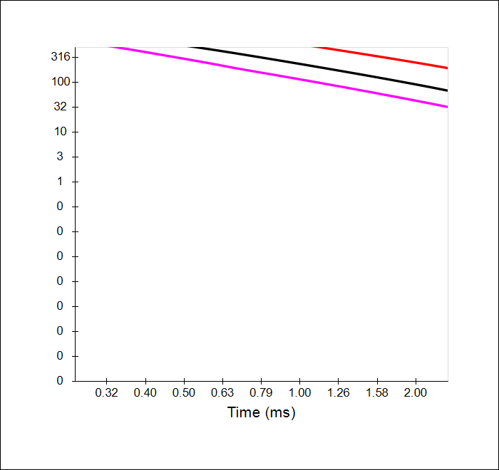
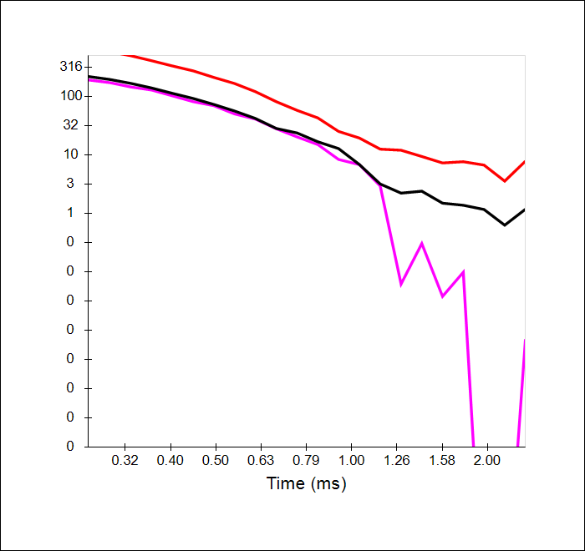
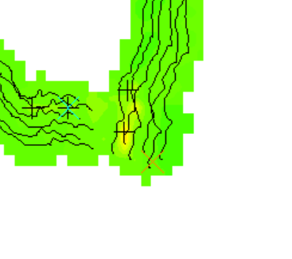
SELECTING PROXY ITEMS FOR CLASSIFICATION
When selecting proxy items for library matching, it’s important to know the differences between the make and models of different munitions. The same caliber munition can vary widely in length and thickness, two parameters which affect the modeled polarizability curves. If the selected proxy item does not match closely enough in size, shape, and thickness, it will likely not have a library match above the selected threshold. For the 5-in aircraft rocket listed at YTJA, the available munitions in the DoD TOI library included a Mk32 5-in Rocket and a Mk33 5-in Rocket. The Mk designates the warhead variant attached to the rocket motor. A Mk32 warhead was a high explosive anti-tank warhead, where the Mk33 was an illumination round. Both used with the Zuni rocket system starting in 1957. The Holy Moses High Velocity Aircraft Rocket was used during WWII and until 1955. The difference in rocket design between the two periods can affect the polarizability curves.
Figure 6. Comparison between the AN-M30 100-lb. bomb (top) and the AN-M47A1 100-lb. bomb (bottom). The M30 is 40.26 inches and the M47 is 45.52 inches, with similar diameters. The M30 crushes down to 2/3rds the size upon impact changing the shape and size. The M30 is in the DoD TOI library while the M47 is not. Important considerations when deciding to use the M30 as a proxy for the M47.
Figure 5. Design layout of the MK MOD 1 5-in Rocket Warhead. Included in the site-specific library as a proxy for the unspecified make and model of the 5-in Rockets used at YJTA.
MUNITION SIZE CALCULATION
During inversions of selected geophysical anomalies, many parameters are calculated including a “size” for each source. The sizerunis calculated such that larger objects should have a larger size. The processing software used for the Yellow Jacket RI, BTField, calculates the size based on the first five timegate responses. Starting with a vector comprised of the 5 timegate responses in one of the principal directions (X, Y, or Z) then calculating the mean of the that vector and adding that mean value to a 3-component vector where each component is one of the three principal directions. The mean value vector is then run through the log computation in Figure 7 on the left. It follows that larger metallic objects will produce larger responses and should give larger values for the size. Based on this, a size threshold was set at the YJTA MRS where any source with a size greater than the largest munition present in the site-specific library was reviewed by the data analyst and potentially added to the intrusive investigation.
Figure 7. BTField size equation for geophysical anomaly inversions.
SIZE THRESHOLD APPROACH
Because there isn’t published polarizability curves for some of the larger munitions at the YTJA MRS, a library match threshold was not viable for those munitions. Instead, a size threshold approach was taken and based on the largest munition available in our site-specific library, a 5-in rocket. The estimated size of a 5-in rocket in the BTField calculation was roughly 2.4 and that was chosen as the threshold. Any source with a size greater than or equal to 2.4 was reviewed by the data analyst. Other parameters of the source were considered when reviewing the sources above the size threshold such as distance from anomaly peak, modeled depth, model contribution, and anomaly amplitude.
SOURCE PARAMETERS
Size: 2.7
Amplitude Response: 13.8 uV/A
Library Match: 0.06% 5-in Rocket
Depth: 1.5 meters
At edge of collected data, modeled over a meter deep, and low amplitude response
SOURCE PARAMETERS
Size: 3.3
Amplitude Response: 48,830 uV/A
Library Match: 0.01% Large ISO
Depth: 0.22 meters
Polarizability curves off the scale, hints at a large round object
Figure 8. Example source added to intrusive investigation based on size parameter.
Figure 9. Example source not likely to be anything. Inversions often produce sources unlikely to exist and require review.
Notes:
Polarizability equation creates a vector with 5 components of the first 5 time gates of each dimension (X, Y, Z). Takes the mean of each dimension for a 3 component vector. Calculates the magnitude of the 3 component vector, adds 1, then takes the log to get the single number. Talk about model contribution and inversion artifacts and how we deal with those.

