Slide 1
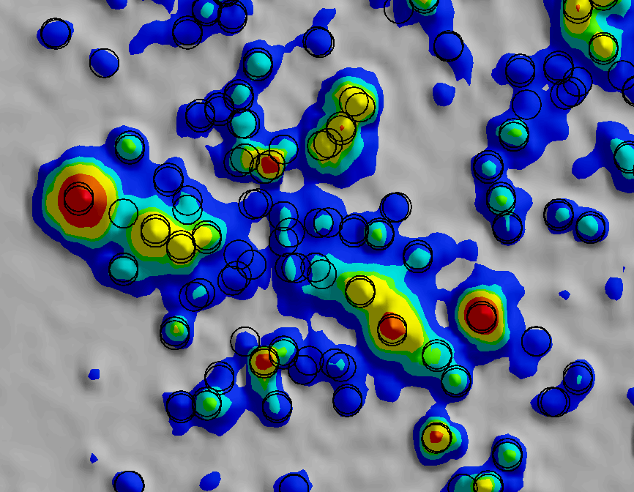
A Call to Develop New Approaches to Manage AGC Source Data
Bonus: Behind the Scenes of Forward Modeling
Stuart Bancroft
SAGEEP 2025, Denver, Colorado
Wednesday, April 16, 2025

Slide 2
Overview of Duplicate Sources
Managing and Locating TOI (Cued vs. Dynamic Data)
Implications for Recovered Item Comparison
Implications for Minimum Separation Distance reduction
Bonus Material: Synthetic Modeling in UX-Analyze
Small ISO
37 mm
81 mm Mortar

Slide 3
Problem Summary
The evolution of AGC into one-pass makes duplicate source data management a much larger task.
The reliance on AGC data to make decisions beyond just TOI discrimination makes source selection far more important.
More computational tools are needed to more effectively and efficiently refine source data to evaluate intrusive recovery and minimum separation distance reduction.
Example of overlapping duplicate sources overlaid on a detection grid
Notes:
Duplicate AGC sources are both inevitable and useful for munitions response, a good thing to have, especially for difficult classification situations. This issue is not being ignored, however, we tend to rely on manual data analysis and workflows designed for cued AGC.

Slide 4
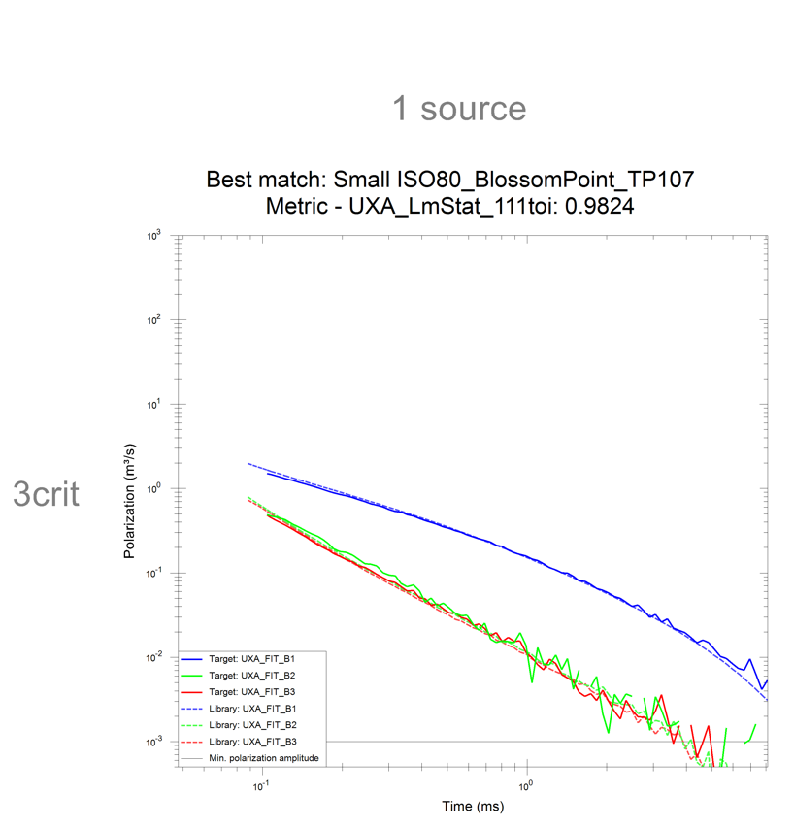
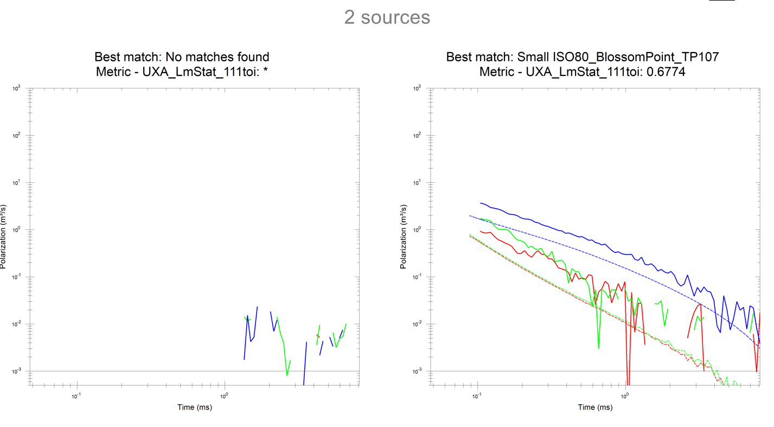
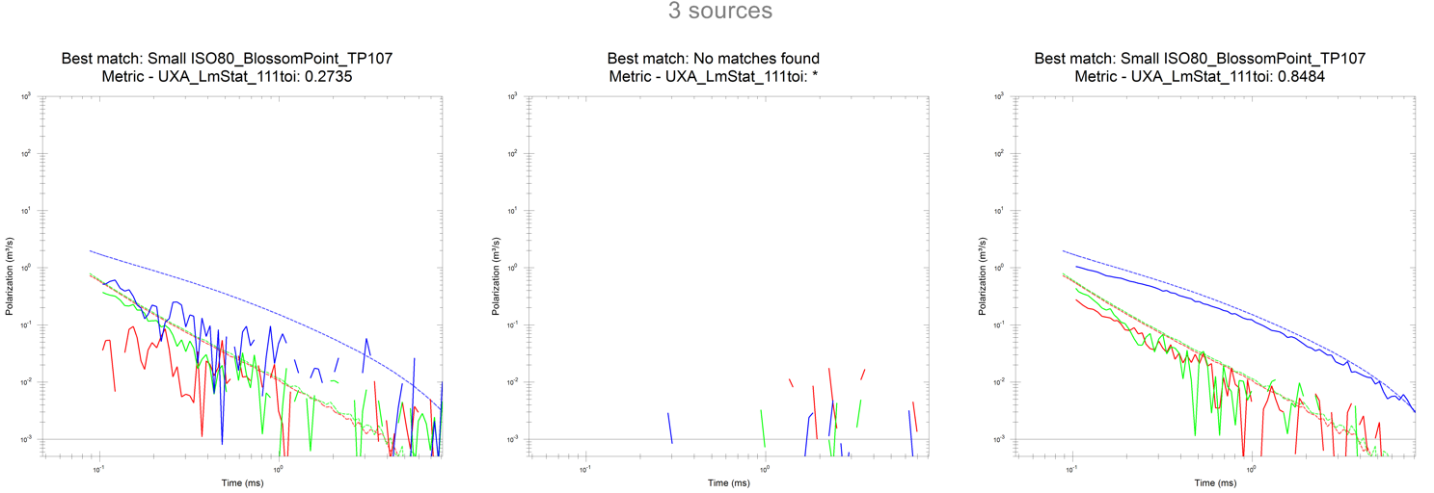
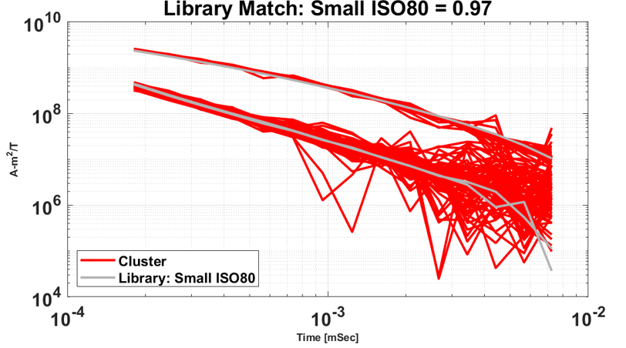
Overview of Duplicate Sources
The number of actual metallic sources is typically unknown but usually assumed to be no more than 3.
Duplication occurs when the model is run with just one presumed source, then again with two presumed sources, and once again with 3 presumed sources.
A single item may get captured multiple times (exact location and library match tends to vary)
Each red box is duplicating a single seed item
Each set of 3 polarizability curves is duplicating a single seed item
Notes:
Duplicate sources overlap geographically, sometimes within a couple centimeters of each other. They often indicate consistent information about a source, but certainly not always.

Slide 5
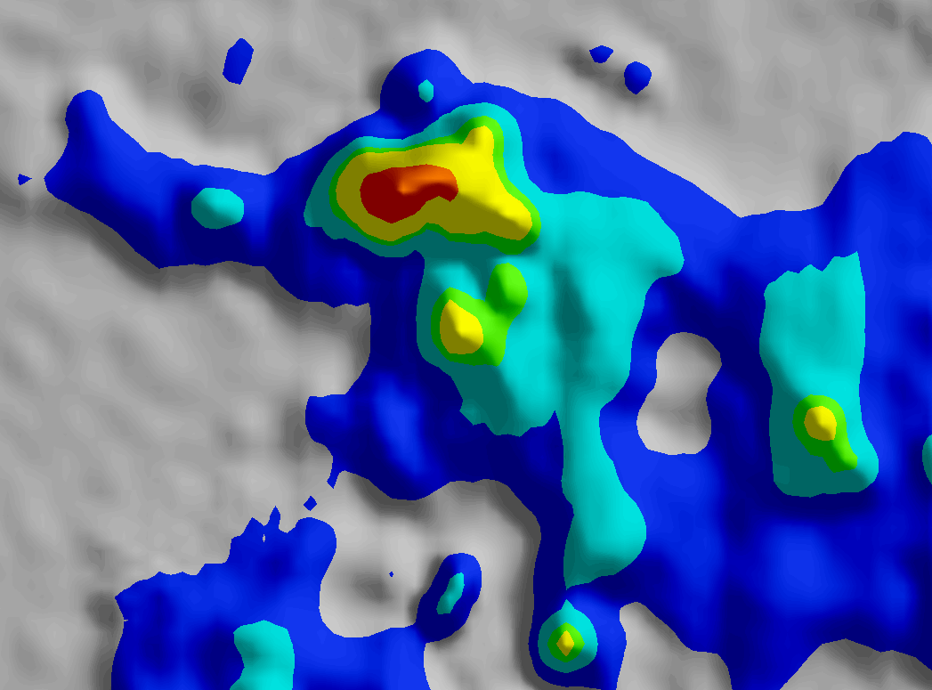
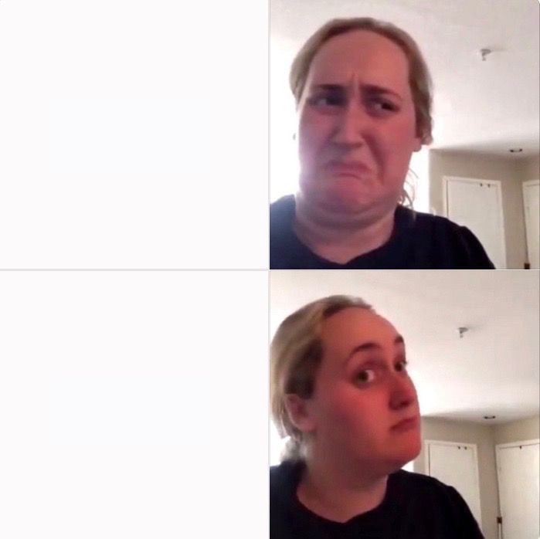
Locating and Recovering TOI
Get the folks with shovels to the right spot to dig on!
A valid source with a good library match, model fit, and fit location gets the job done, right?
Challenges:
AGC allows us to leave metal in the ground, so we need quality control procedures.
A dig / no dig decision is easier to make than selecting an expressing the best information available about a source
Notes:
This has always been the prime objective of AGC. Of course we need quality processes in place all the way through intrusive recovery.

Slide 6
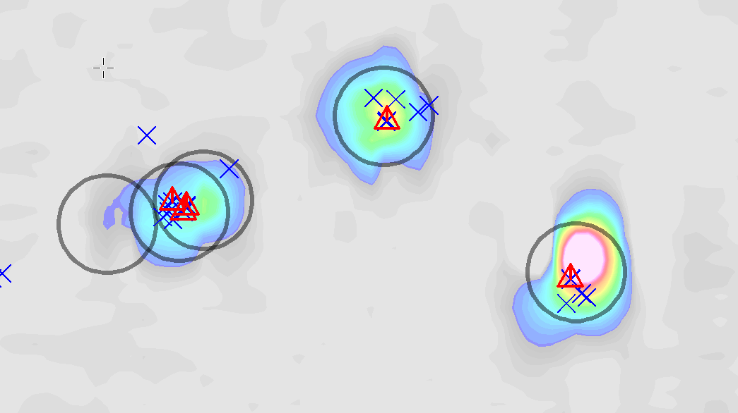
Locating TOI with Cued AGC
Sources for each cued shot (6 sources for a 3-dipole model) are managed together as an organizational unit.
1 source is selected as the representative source unless there are other valid sources located at a non-overlapping distance.
Two or more cued shots within close proximity can produce duplicate sources that need to be manually managed by discarding or merging.
Classify and Rank refines sources this way (Targets vs Targets Final list)
Some effort required to manage duplicate sources caused by cued measurements collected close to each other.
Black circles – cued target locations
Blue Xs – preliminary sources
Red Triangles – refined sources
Notes:
This goes back to the rudimentary objective of AGC for UXO discrimination.

Slide 7
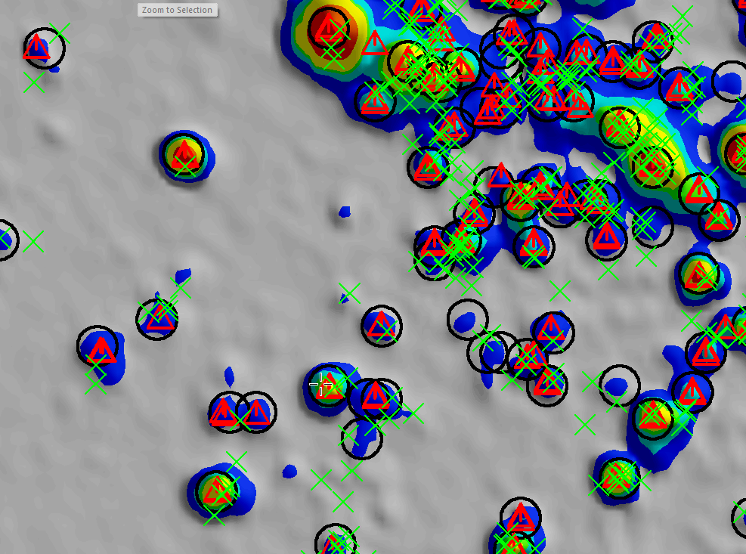
Locating TOI with One-Pass AGC
Inversions are “FREE”!! Computational cost not included. Less motivation to bypass or merge inversion locations.
Additional sources tend to lead to a higher quality product and information about a source beyond the library match.
More sources, more (data management) challenges
Geographic clusters
More sources with poor model fits
More sources with good library matches, but conflicting source parameters
Yes, I know the anomaly density is higher than the previous slide!
Black circles – target locations
Green Xs – all sources
Red Triangles – refined sources (above library match threshold)

Slide 8
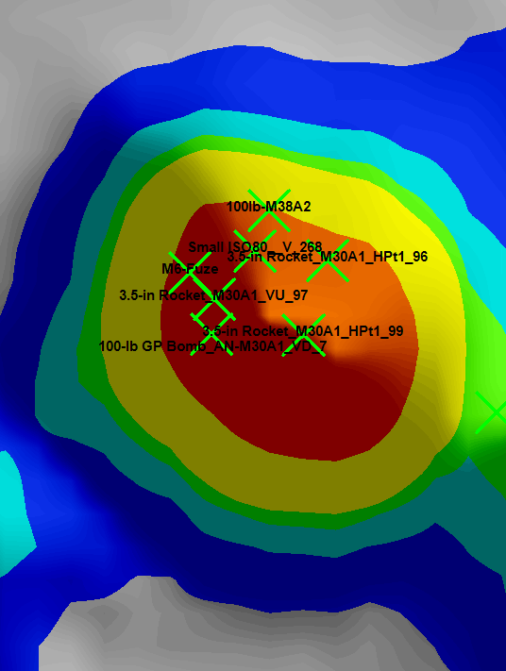
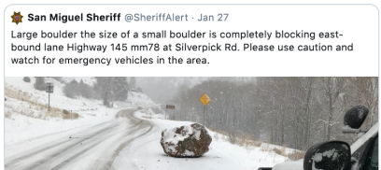
Recovered TOI Comparison
AGC results are being relied upon to not only discriminate TOI from non-TOI but also provide an accurate prediction of the recovered source.
A data analyst may have several valid sources to choose from to place on a dig list.
A source database for a single grid can easily contain thousands of sources.
How do we know which source is the best representation of the source’s size and shape?
Highest Library match?
Highest Model Fit?
Number of Samples (EMClass)?
A combination? A range?
100lb M38
Small ISO
3.5 in Rocket (x3)
100 lb GP Bomb

Slide 9
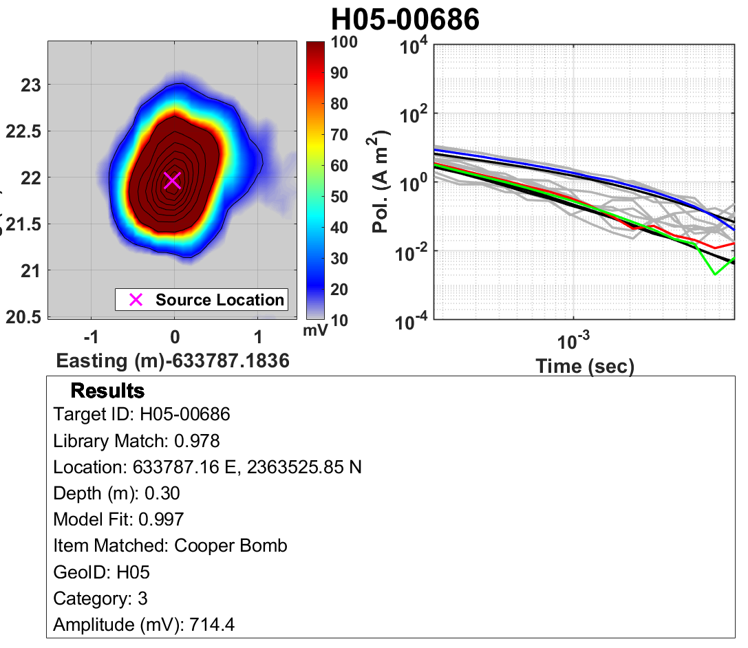
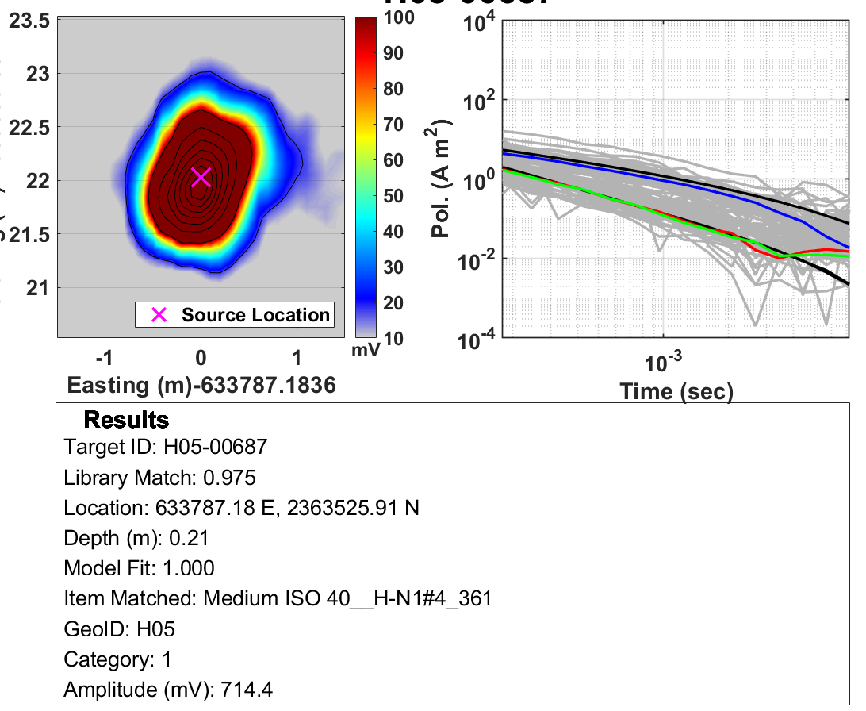
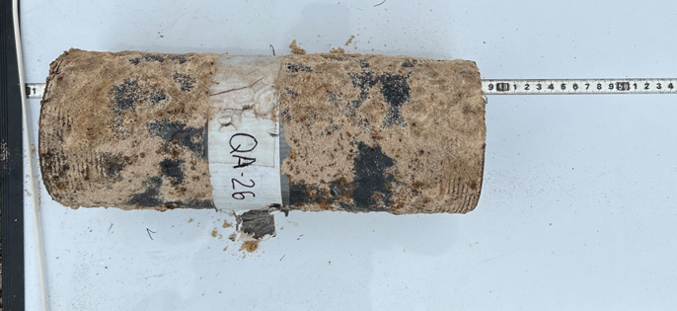
Recovered TOI – Cooper Bomb or MISO?
Expressing a range of valid predictions for depth, size, and perhaps thickness would help give a more complete view of source properties used for recovered item comparisons.
Cooper Bomb: Size: 24” x 5”, 20 lbs”
Medium ISO40: Size: 8” x 2”, xx lbs

Slide 10
Recovered TOI – Cooper Bomb or MISO?
This dig produced a…
Using library match only, finding the MISO40 (0.975 confidence) instead of a “large” Cooper bomb (0.978 confidence) may have resulted in a recovered size failure
The duplicate source came through as solid evidence for finding a MISO40
The number of source clusters turned out to be a better indicator of the actual item compared to library match.

Slide 11
MSD Reduction
Recoveries somewhat smaller than predicted are ok, but there is a large safety risk involved when a selected source turns up a much larger MEC item with a hazardous fragmentation distance larger than planned for.
Duplicate targets may be better suited to be the representative MSD bin target even if it doesn’t have the highest library match out of a duplicate population.
Grouping and prioritizing sources for MSD requires emphasis on the largest plausible TOI size, not necessarily the most likely.
Target ID | Category | Library Confidence | Best Matching Item | Number of Samples (EMClass) | Source Depth (m) | Size | Maximum Source Cluster Size | MSD Bin | Status
N/A | 3 | 0.8652 | 37mm Projectile_M59 | 5 | 0.02 | 0.34 | 0.38 | 1 | Below confidence threshold
N/A | 3 | 0.9506 | Rocket Motor | 77 | 0.10 | 1.84 | 2.63 | 2 | Converted to a duplicate pick
N/A | 3 | 0.8984 | AP Landmine_M2A1 | 14 | 0.41 | 2.55 | 3.31 | 2 | Converted to a duplicate pick
N/A | 3 | 0.8916 | 60mm Illumination Mortar_M83A1 | 43 | 0.16 | 1.99 | 1.99 | 2 | Converted to a duplicate pick
1 | 1 | 0.9293 | 37mm Projectile_M74 AP-T | 113 | 0.07 | 0.52 | 0.89 | 1 | Selected for intrusive investigation
N/A | 3 | 0.8911 | 60mm Illumination Mortar_M83A1 | 4 | 0.52 | 2.43 | 2.43 | 2 | Converted to a duplicate pick
N/A | 3 | 0.8002 | 3.5-in Rocket_M30A1 | 1 | 0.64 | 4.41 | 4.41 | 2 | Below confidence threshold
N/A | 3 | 0.7426 | 2.36-in Bazooka Warhead_M6 | 2 | 0.04 | 0.96 | 0.96 | 2 | Below confidence threshold

Slide 12
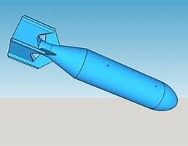
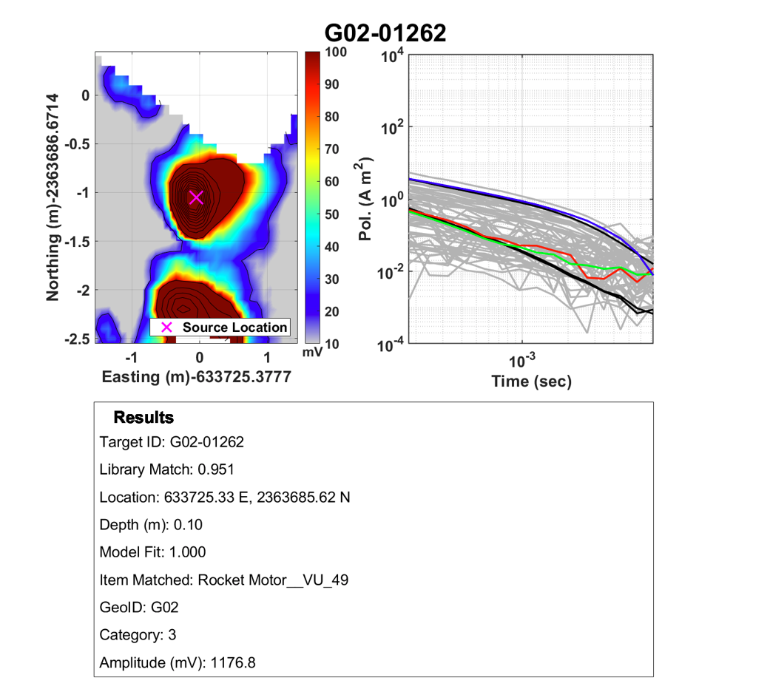
100 lb. Bomb modeled as a 37mm Projectile?
Unique Circumstances
Vertical with tail fins pointing up: tail fins may have partially masked thin but large bomb body
Thin sand filled practice bomb: Huge difference in explosiveness when comparing practice version vs HE (high explosive) version
Body was crushed and is highly modified from pristine shape/size
Key Take Away: Although this find did not constitute an MSD safety hazard, it provides a caution to consider decent quality duplicate sources for assigning targets to MSD bins.

Slide 13
Recommendations for Managing Sources
AGC processing software should have a source refinement routine to segregate useful sources from less useful ones, i.e., a list of all sources and a list of refined sources
AGC processing software should allow for different refinement methods to give weight to different parameters.
Projects that incorporate MSD reduction may need to give a “best guess” size estimate for recovery purposes but also a “we don’t think it is bigger than…” size estimate for MSD bin grouping
While library match is a crucial parameter, additional secondary parameters should be incorporated into dig lists to give all members of the intrusive team and QC a comprehensive view of what AGC is actually predicting.

Slide 14
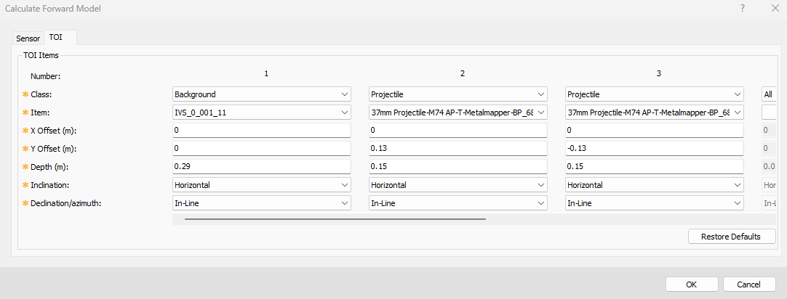
How to Create a Forward Model with Complex Seeds
TOI Only results in perfect library matches
Remnant Background Response to mimic the real world
Large/Deep Munition Item can mimic a ground response
Synthetic Background can be inverted and added to a library
Remnant Background
TOI
Inversion Results
Forward Model
Forward Model generates a Located database
Process through UXA to generate source database
Don’t use more dipoles than TOI sources

Slide 15
Background Depth Calibration
Using a synthetic background to represent a remnant response implies that the synthetic measurement should be placed deeper than the TOI to mute the response, but how much deeper?
Seed Depth SNR Library Match
Gradually increase Seed to background distance until
Repeat for multiple seed depths
Analyze Trend

Slide 16
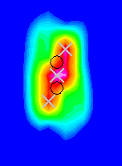
Results for Complex Small ISOs (Shallow)
2 Small ISOs, 30 cm horizontal offset (c2c), depth range from 10-30 cm bgs, 1 and 2 dipole solutions
2 SISOs were “retrieved” in all model runs, however there were key differences…
Model results varied based on the auto-picked target location
Inversions located between the two seeds never yielded 2 SISOs

Slide 17
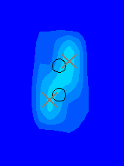
Results for Complex Small ISOs (Deep)
Inversions located between the two seeds never yielded 2 ISOs
Inversions centered on the southern edge always yielded 2 ISOs
ISO geometry |  |  | Target Selection | Did target yield two correct sources? |  |  | Noise Source
Depth bgs (cm) | Separation (cm) | Orientation | # of Detections | north | south | center | TOI/depth | Depth (cm)
10 | 30 | in-line, Horizontal | 3 | no | yes | no | synthetic SBG | 23
14 | 30 | in-line, Horizontal | 3 | yes | yes | no | synthetic SBG | 28
16 | 30 | in-line, Horizontal | 3 | yes | yes | no | synthetic SBG | 30
18 | 30 | in-line, Horizontal | 3 | no | yes | no | synthetic SBG | 32
20 | 30 | in-line, Horizontal | 3 | no | yes | no | synthetic SBG | 35
30 | 30 | in-line, Horizontal | 2 | no | yes | n/a | synthetic SBG | 46

Slide 18
Take Home Points
Dynamic classification provides a lot more inversion data compared to cued classification
The additional data is helpful for providing a more comprehensive AGC prediction
AGC predictions are more important than ever to aid recovery item comparisons and MSD reduction
With more duplicate sources than ever, source refinement is a crucial component to meet the above goals and to verify MQOs
Source refinement methods need to consider more than just library match and cluster distance
Refinement needs to be balanced with providing a comprehensive view of a source to dig teams and geophysicists to capture the natural uncertainty of AGC predictions

Slide 19
Acknowledgements
My Jacobs teammates including those here today
Jenn, Peter, Nate, Ricky, and Laz but not least… Laz
All the software providers
EEGS
Memes
Viewers like you!

