Slide 1
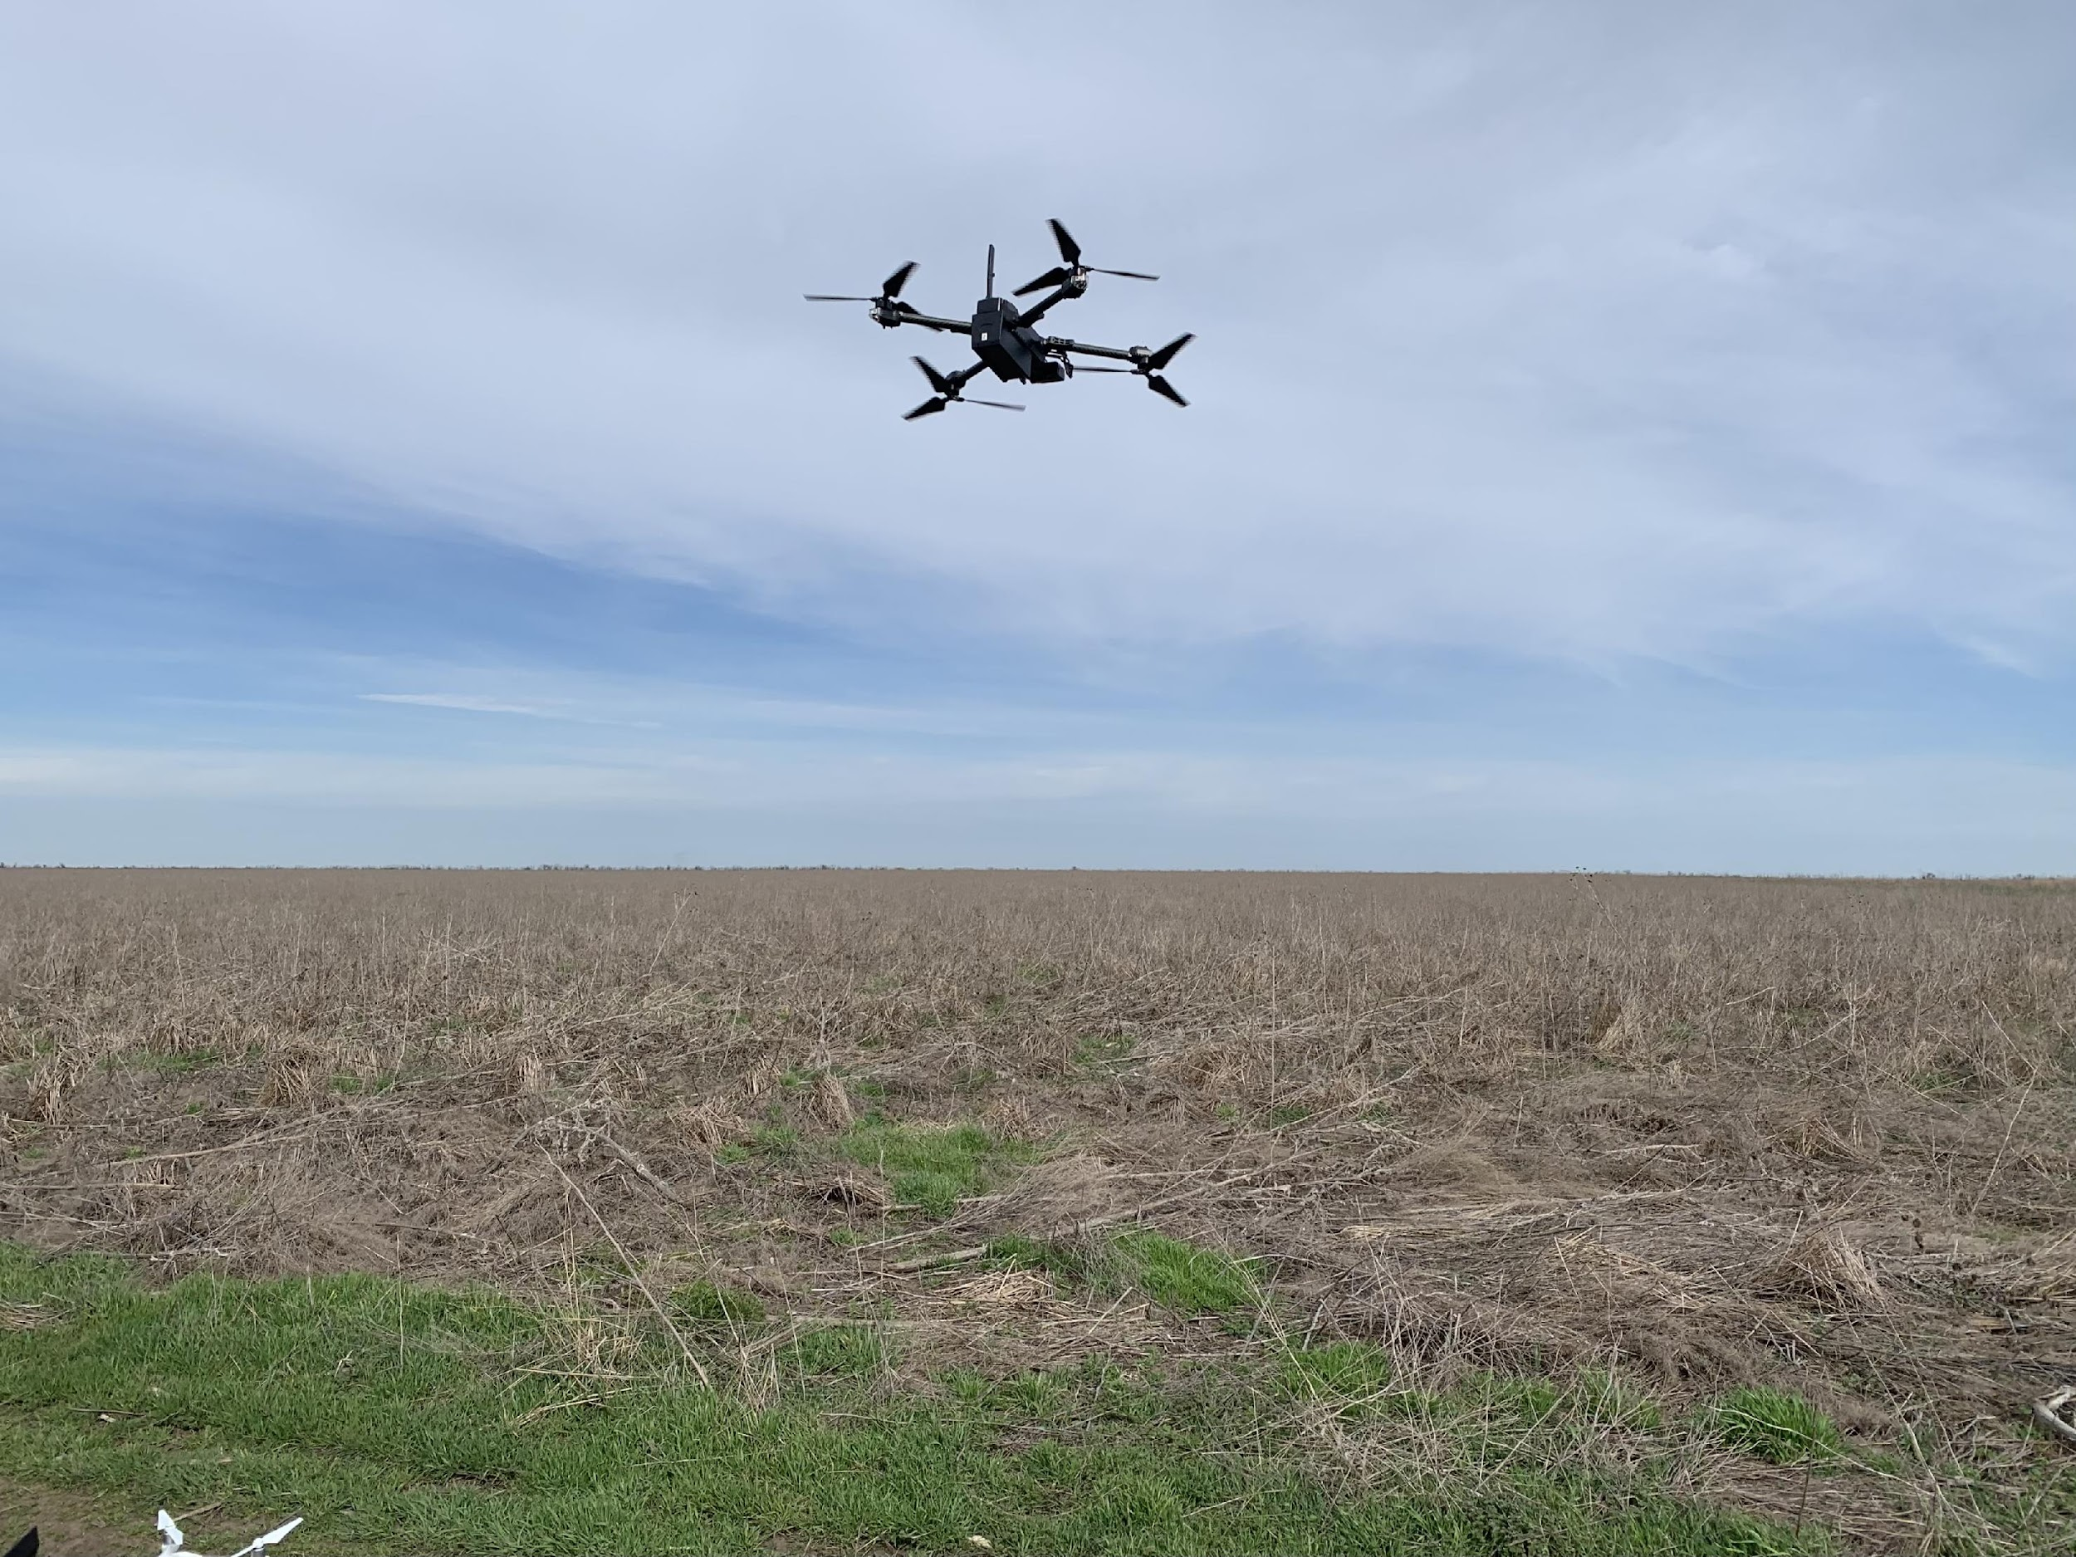
Drone-based AI Explosive Ordnance detection and mapping
Gabriel Steinberg - Lead Software Engineer, Safe Pro AI
Notes:
Demonstrate the work we’ve done in Ukraine and make a case that this tool can help save time and money in the field of MMR as well.

Slide 2
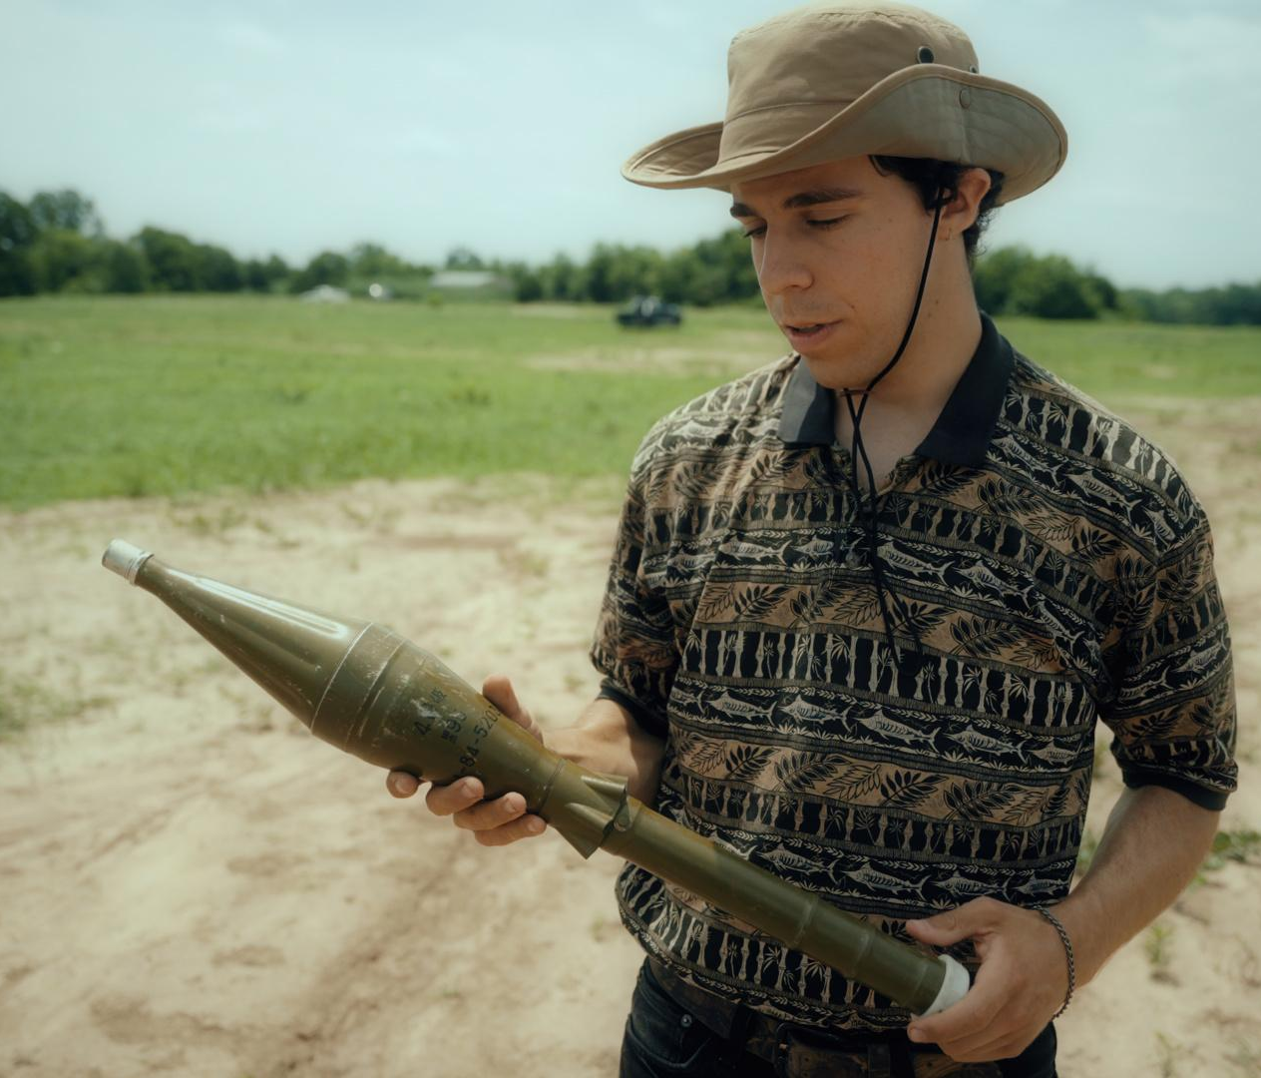
Who am I?
B.S. Computer Science
M.S. in AI
Computer vision for Humanitarian Demining since 2018
Based in NYC
Notes:
Who am i

Slide 3
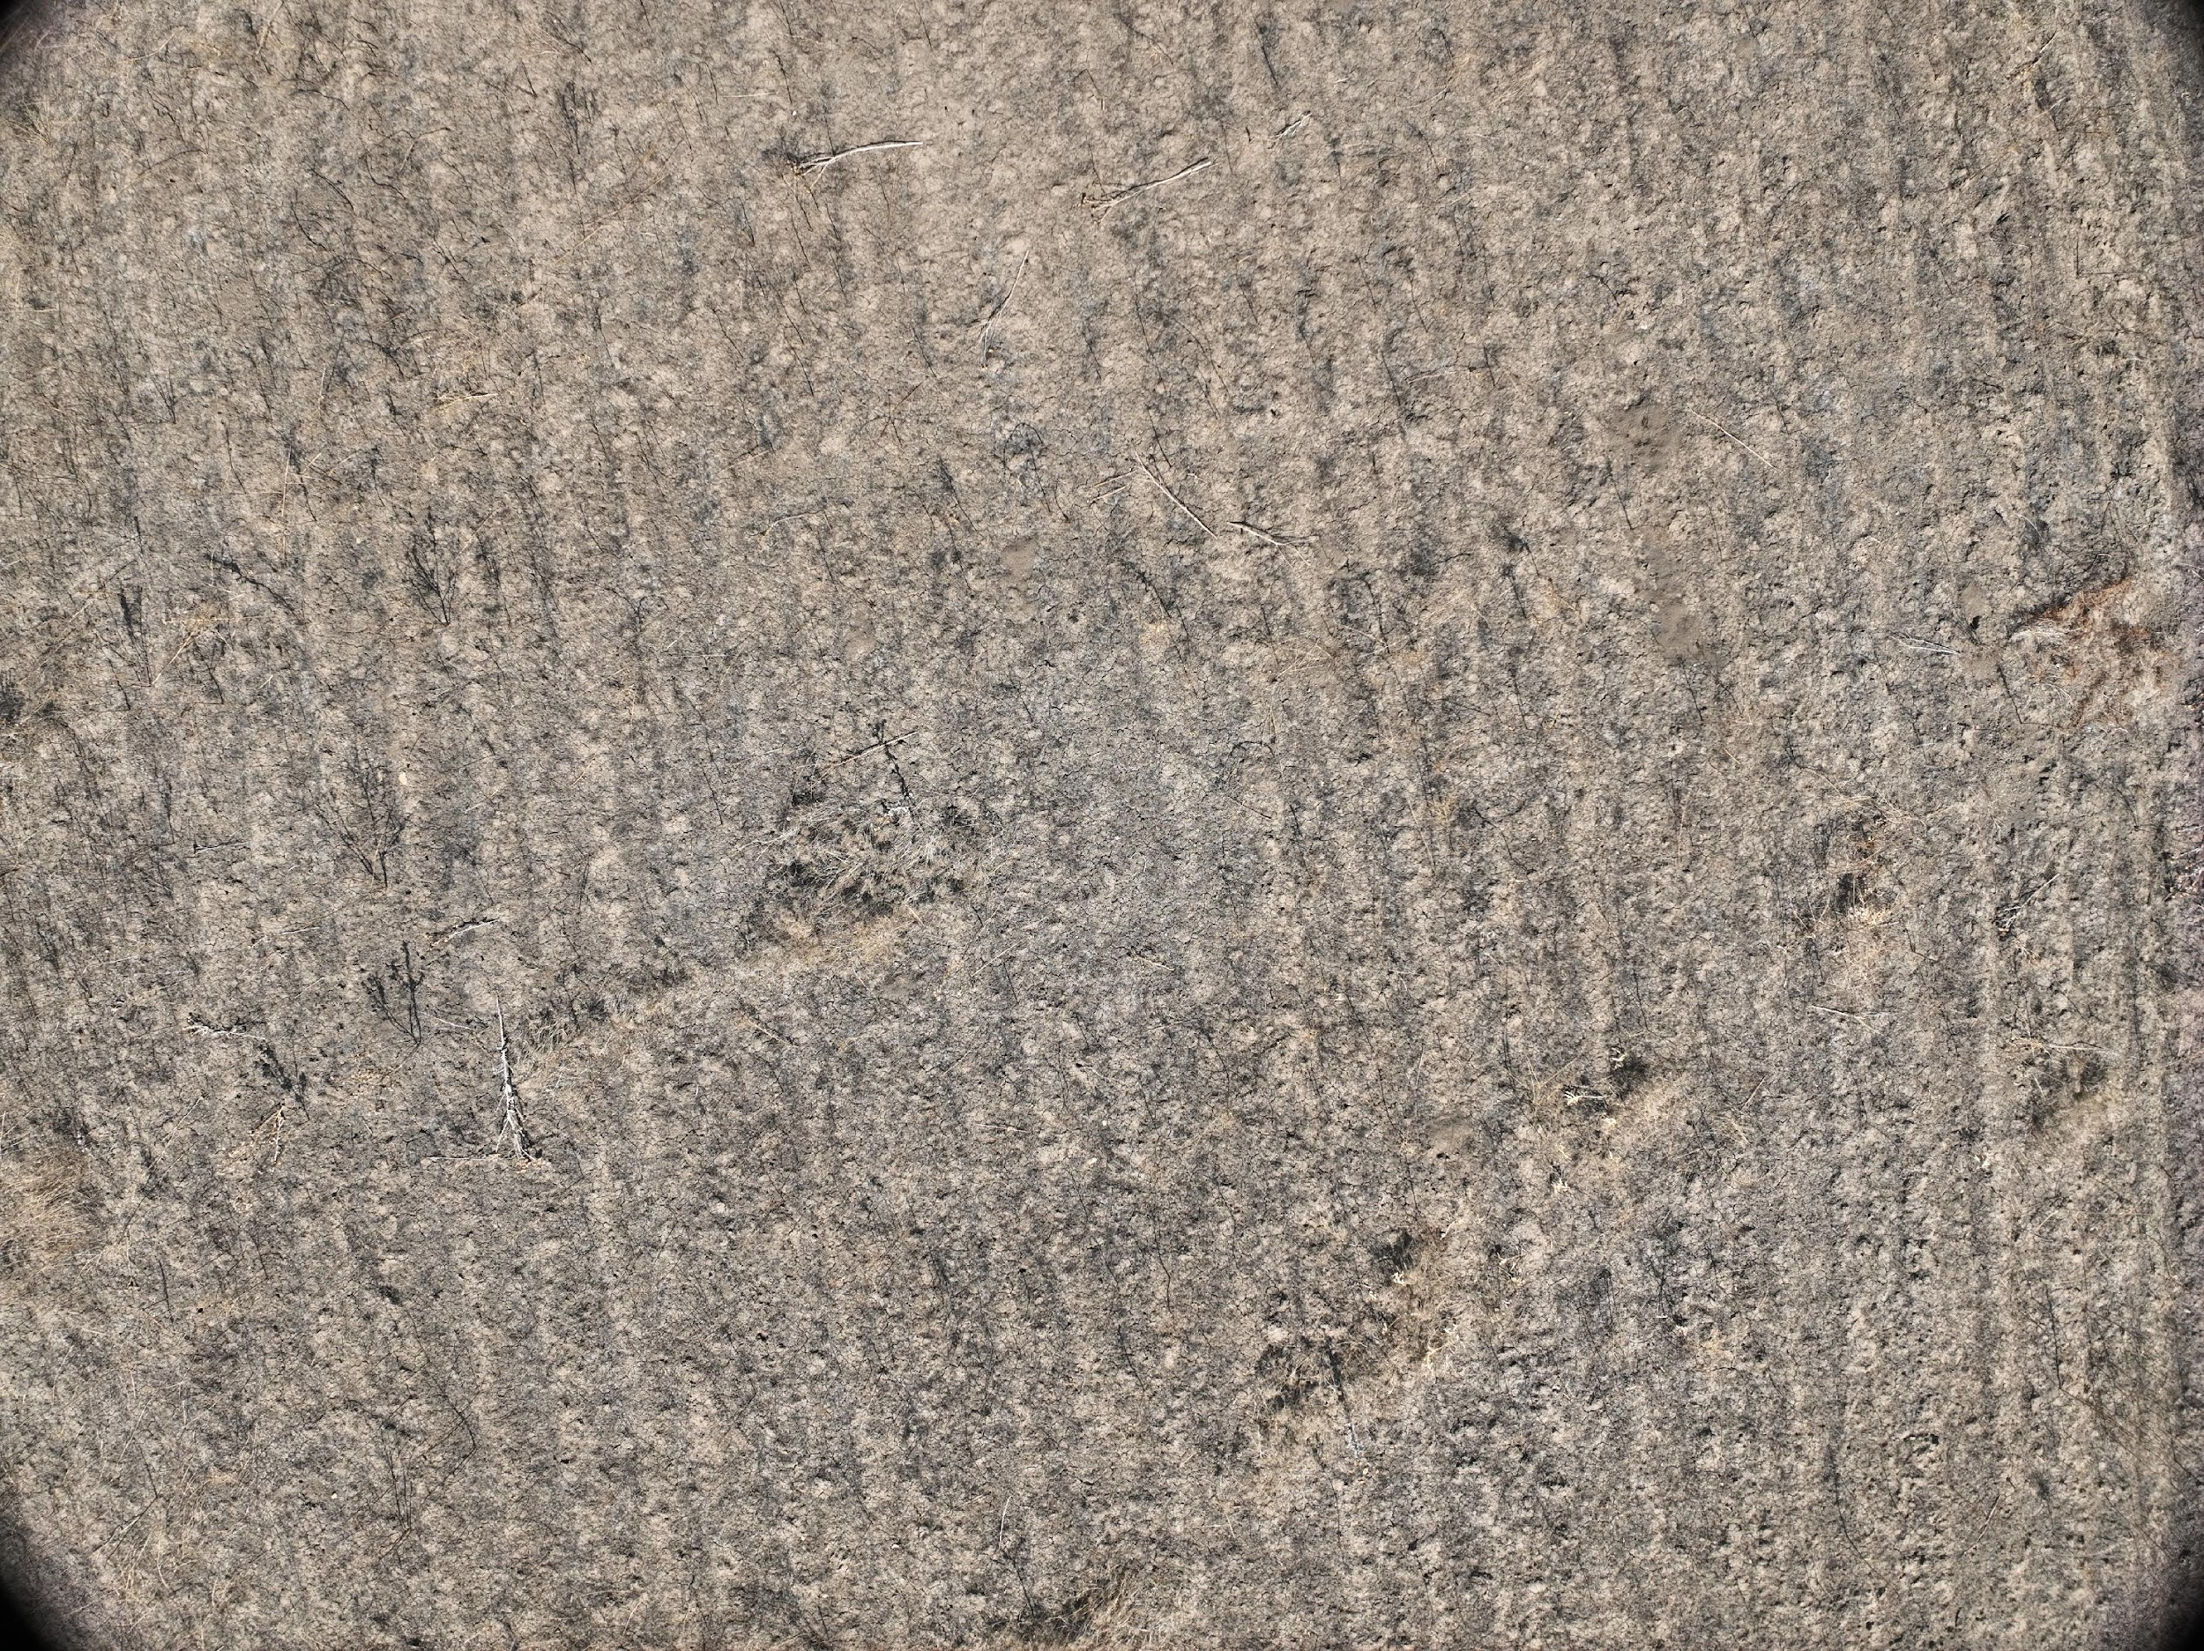
Find the PFM-1
0m
2m
4m
Notes:
Image in Ukraine processed by SL
Start with little exercise to demonstrate our core offering in the Ukrainian demining context

Slide 4
Find the PFM-1
0m
2m
4m
Notes:
Find the PFM-1

Slide 5
Find the PFM-1
0m
2m
Notes:
Find the PFM-1

Slide 6
Find the PFM-1
0m
2m
Notes:
Find the PFM-1

Slide 7
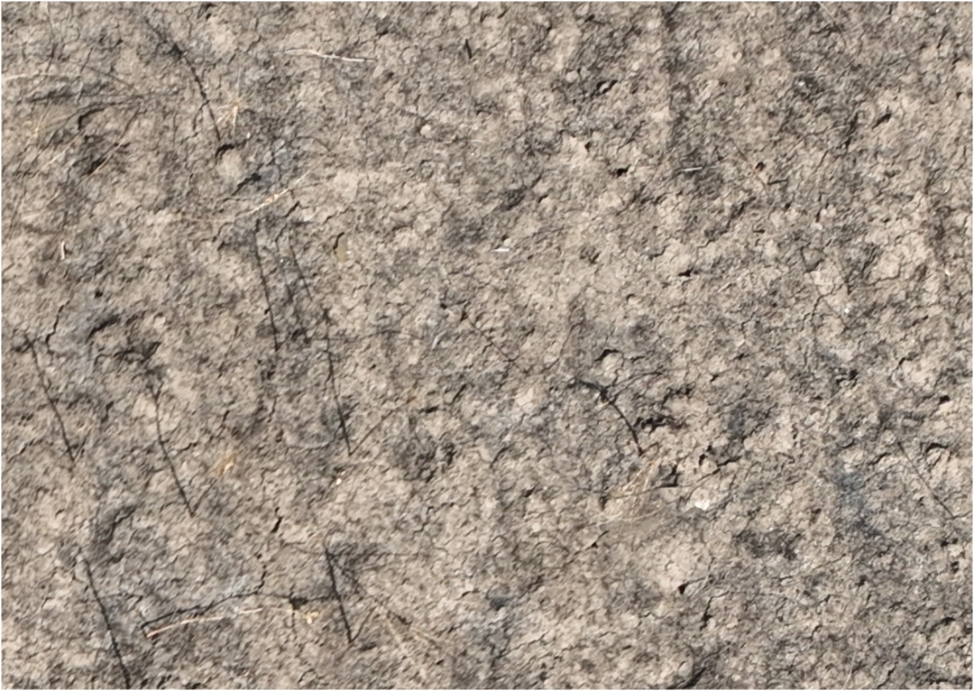
Find the PFM-1
0m
1m
Notes:
Find the PFM-1

Slide 8
Find the PFM-1
0m
1m
Notes:
Find the PFM-1

Slide 9
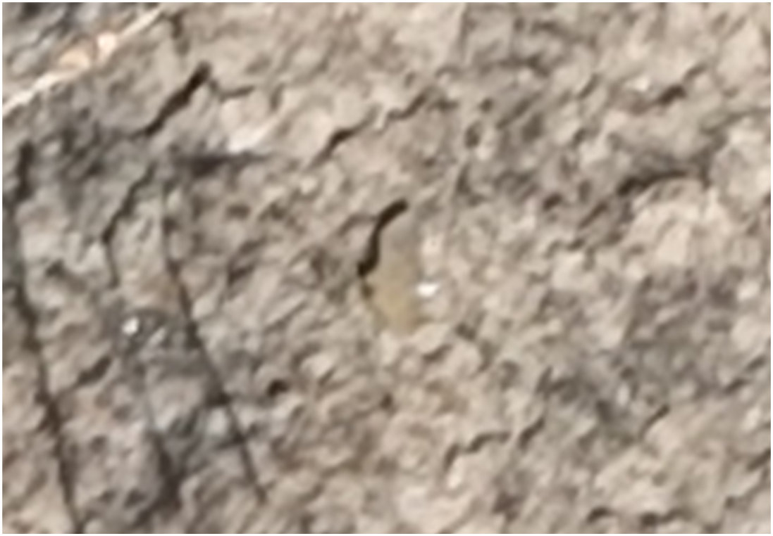
Find the PFM-1
1cm
Notes:
Find the PFM-1

Slide 10
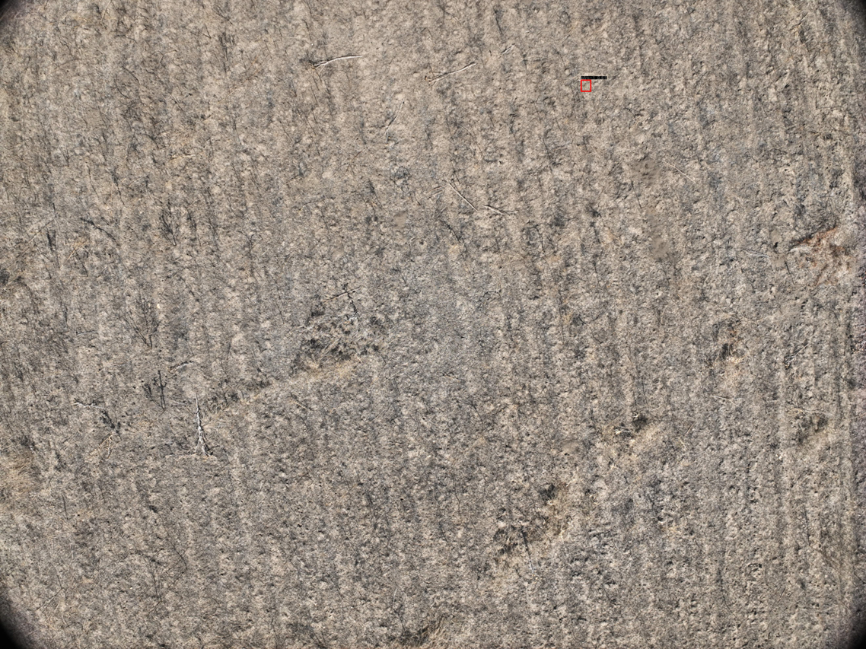
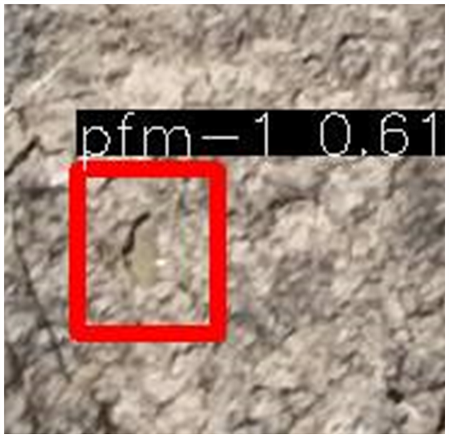
Zooming out
0m
2m
4m
Notes:
What might take days to find by eye looking through drone images or even longer by walking the area, Spotlight finds effortlessly in minutes

Slide 11
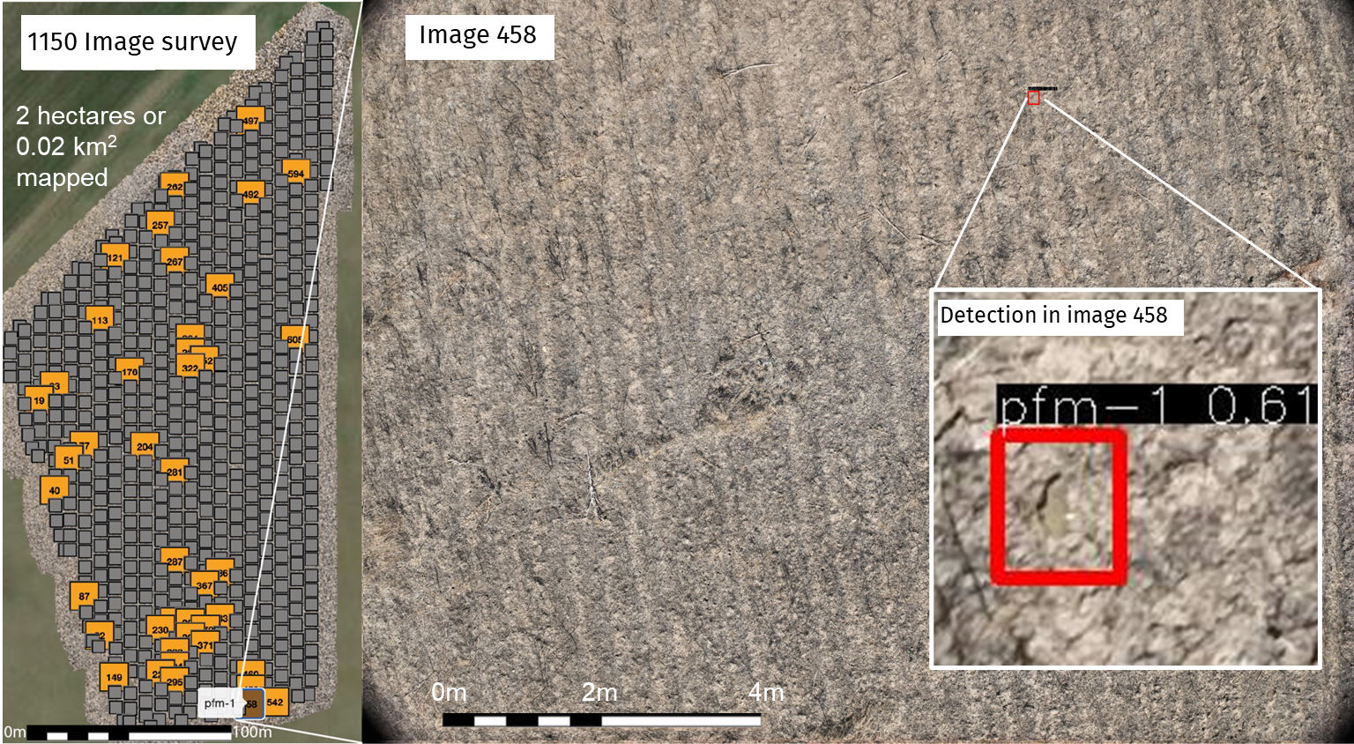
Notes:
Needle in the haystack problem

Slide 12
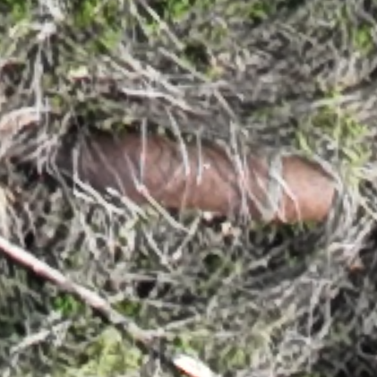
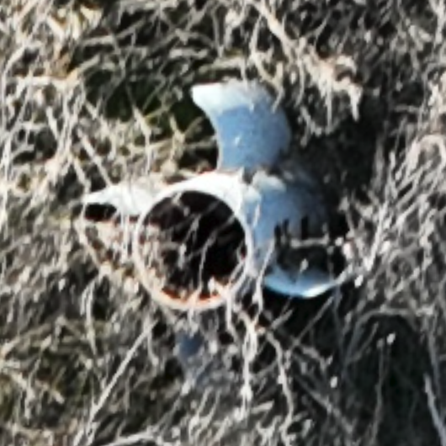
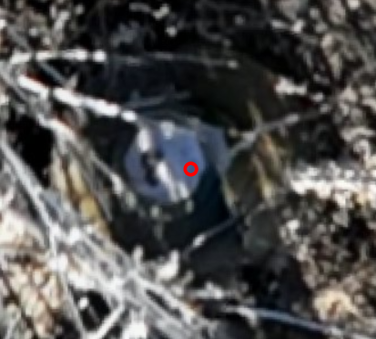
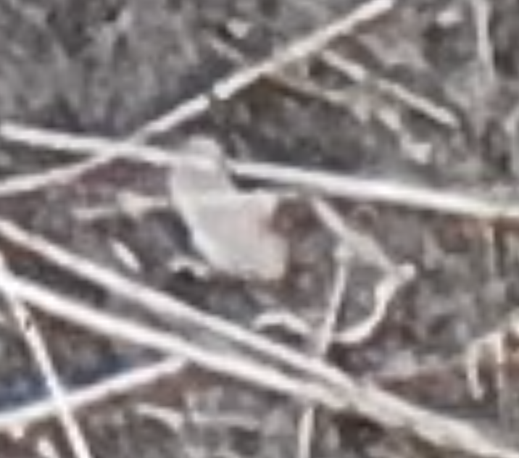
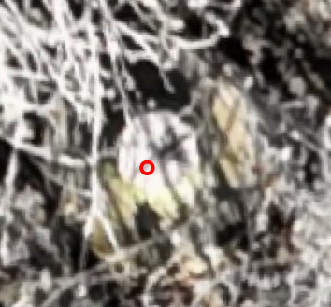
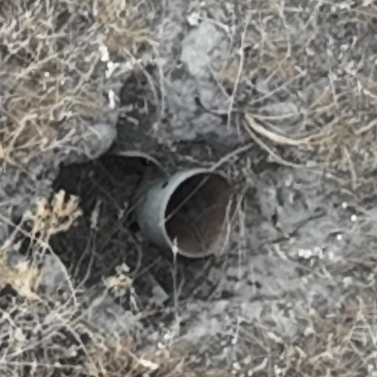
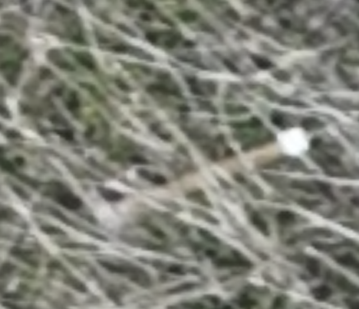
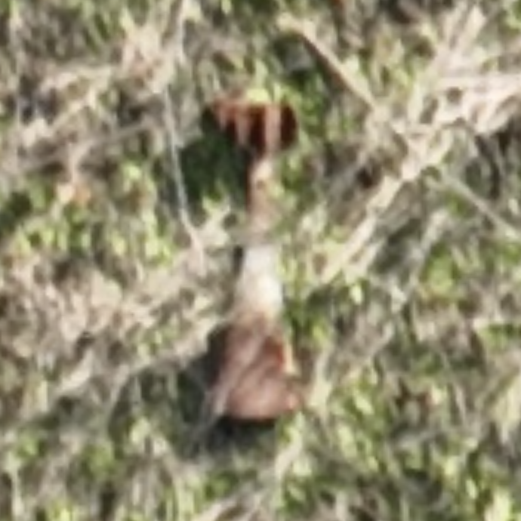
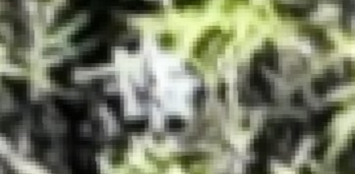
Notes:
We don’t find only the PFM-1, Spotlight was explicitly trained on around 200 types of landmines and UXO and can find many more by extrapolating from what it knows.

Slide 13
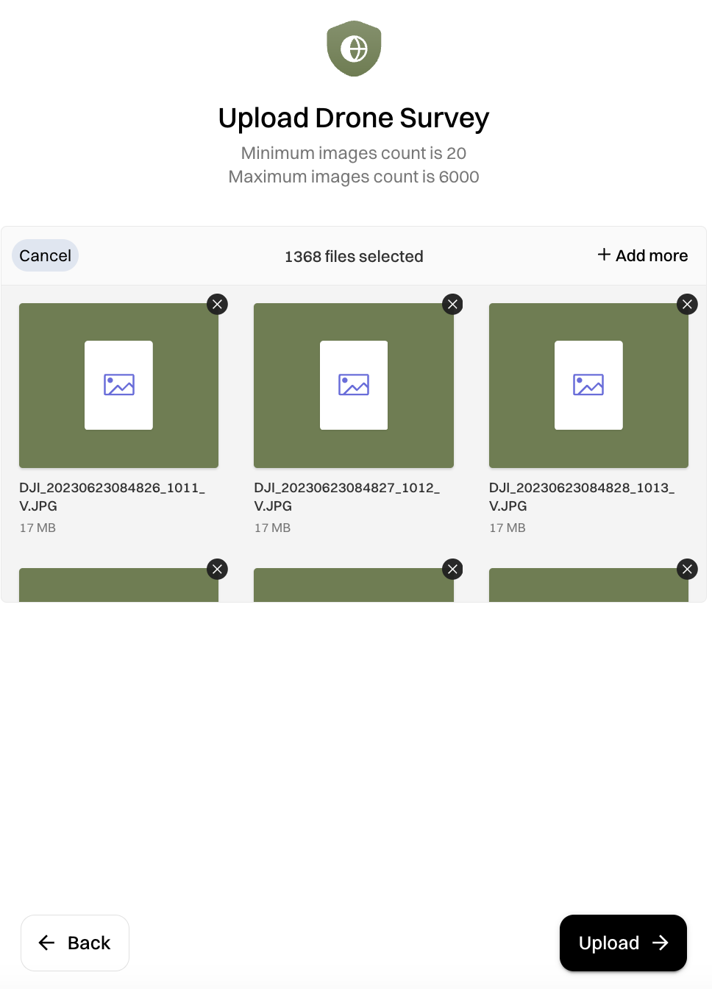
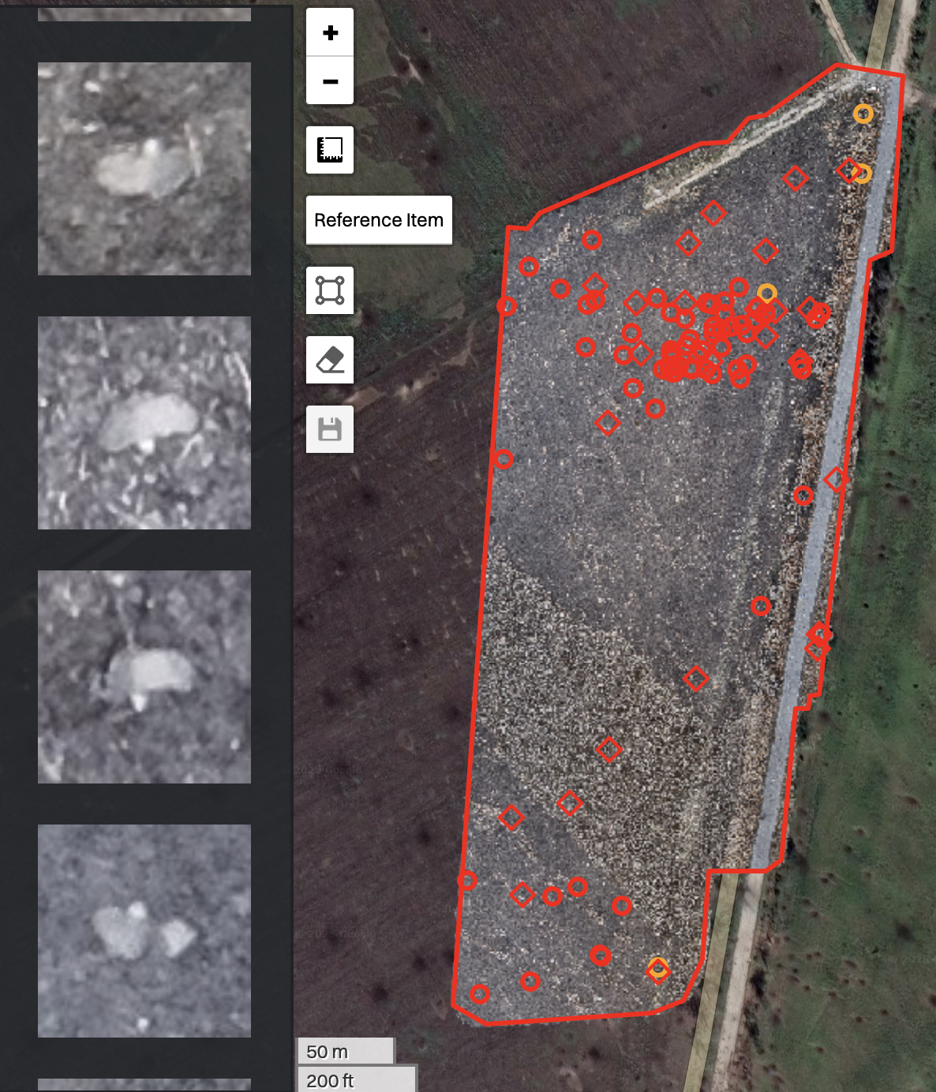
SpotlightAI: SaaS Web Application
Make sense of large amounts of drone imagery
User-friendly, secure, scalable
Compatible with COTS UAVs & GIS
UAV Survey
Upload imagery
Detection & Mapping
Notes:
SLAI is a web application where a user with any drone with an optical RGB camera simply uploads imagery and the application automatically:
creates orthomosaics
finds the visible EO in the surveyed area
makes maps and reports

Slide 14
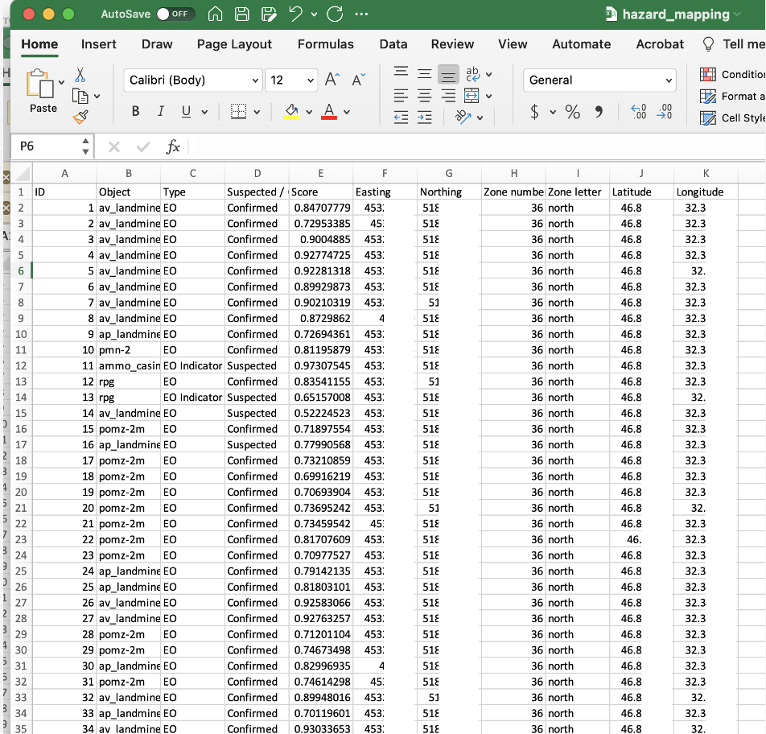
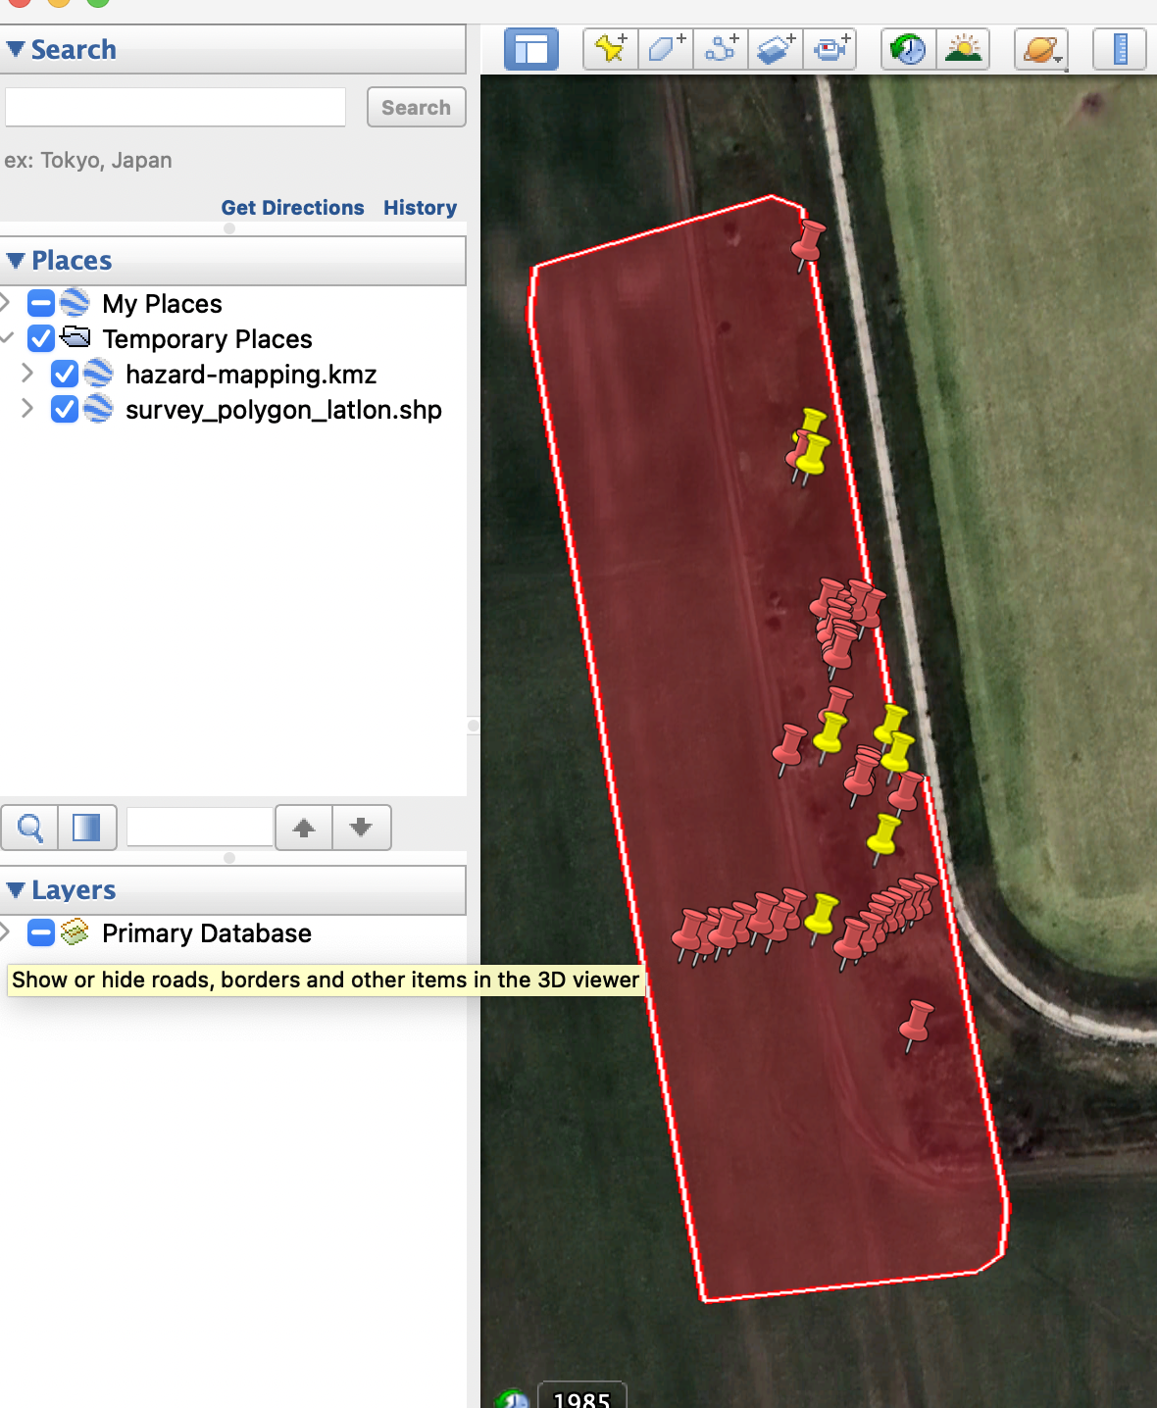
CSV & KMZ with EO Locations + Survey Polygon
Notes:
A box on an image is nice, but at the end of the day, you need to be able to transfer this information to the systems you are currently using
All of these outputs are created only by uploading your drone images
CSV
KMZ

Slide 15
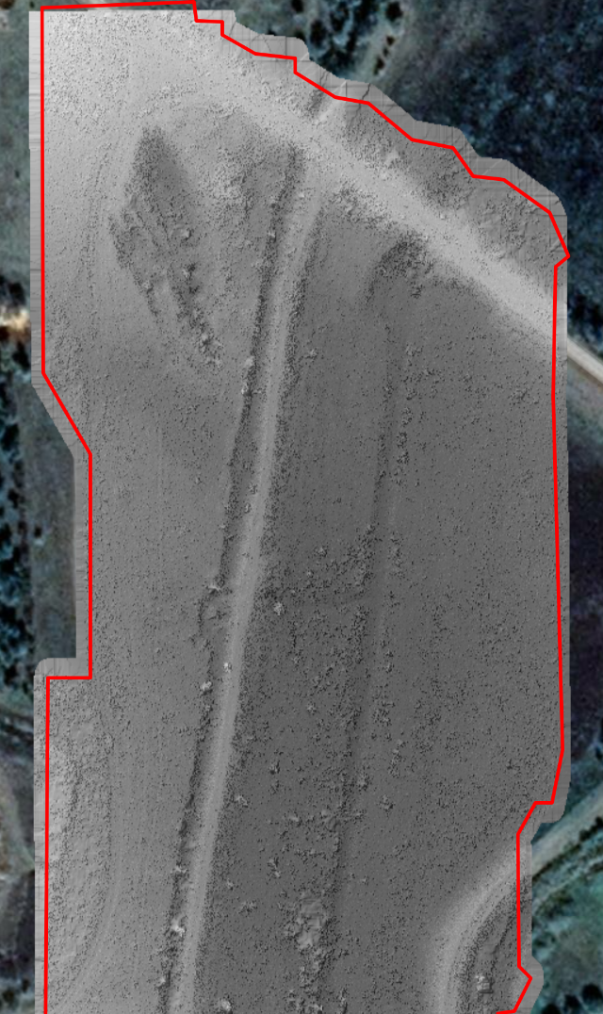
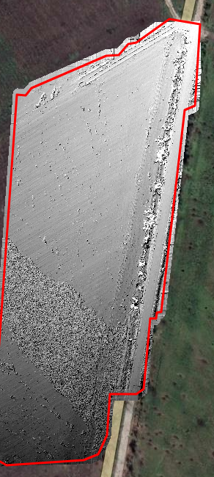
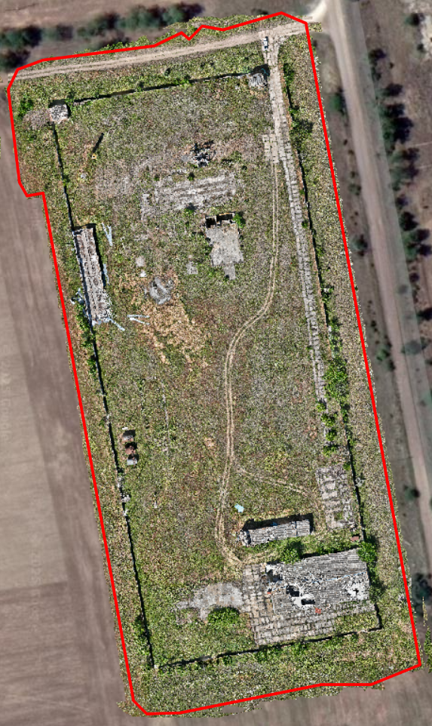
DSM
Orthomosaic
DSM
Notes:
DSM
Ortho
Spotlight is not meant to be the platform where you spend your whole day
we just want to supercharge your drone image analysis workflow and
allow you to transfer that data to wherever you need it

Slide 16
What factors have impacted the results of this survey?
Notes:
Something we spend a lot of time thinking about is “how do we include the proper context along with the results of this survey”

Slide 17
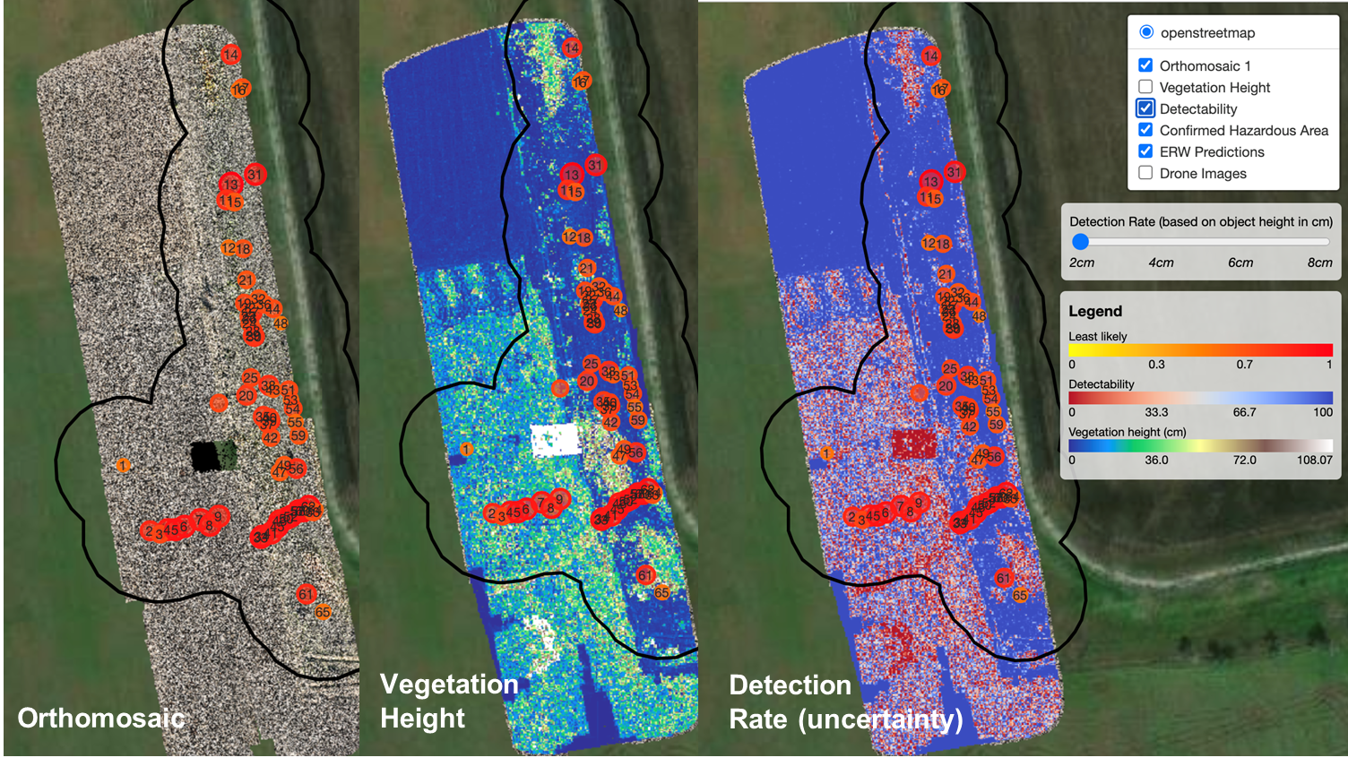
Notes:
Vegetation height maps and uncertainty maps: show you where you are likely to have found all the surface EO and where you may find more upon further inspection

Slide 18
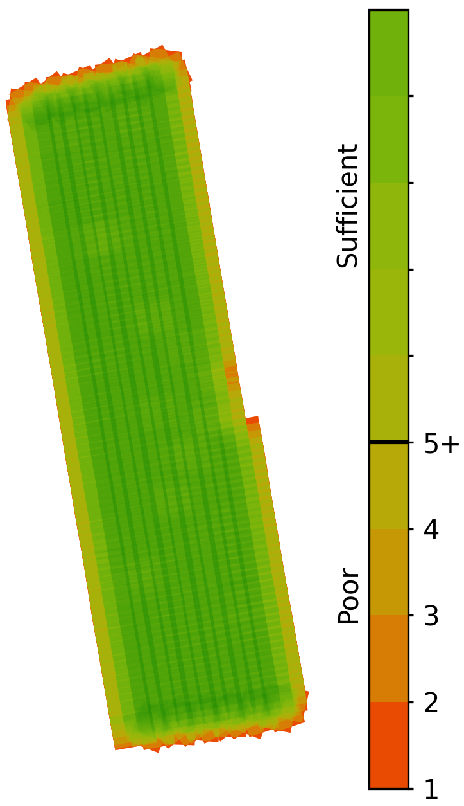
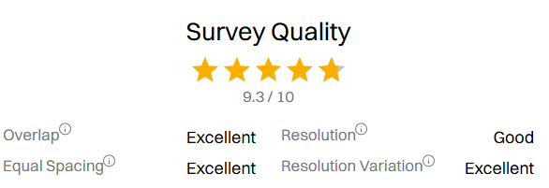
Drone Survey QA Panel
Notes:
Drone survey QA panel: show you if this drone survey was collected according to our recommendations to get the best results

Slide 19
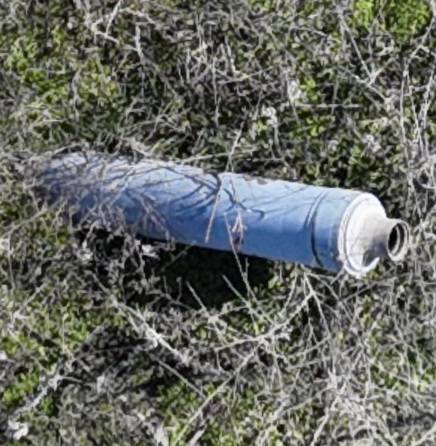
Possible Features of Interest
Notes:
Challenge people usually encounter while using drone-based imagery for analysing large areas
Suspicious objects for which the resolution is not high enough to confirm their identity
For this reason, we provide the core SpotlightAI functionality on a fully offline desktop application
Solve this with 2 step approach
Users had success getting a low-overlap assessment of the entire area
finding objects of interest
confirming them with a low-altitude waypoint mission

Slide 20
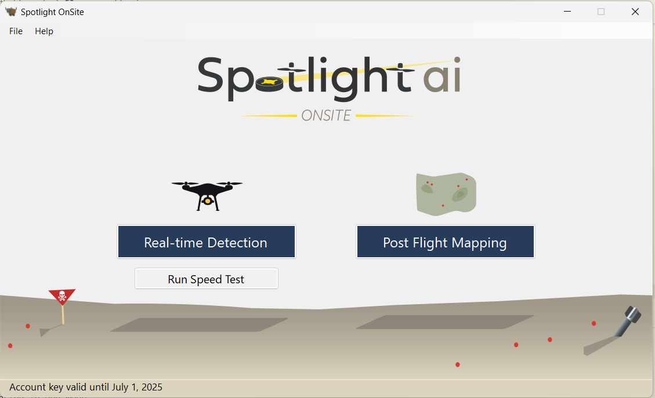
Notes:
Possible Features of Interest

Slide 21
Notes:
This tool is being widely being used in Ukraine with much success
I know MMR has different needs so I’m going to out on a limb and summarize some of the use-cases that I’ve discussed with several of you over the past few days to throw out some ideas about how I see this potentially helping some of you.
I am by no means an expert in MMR so please if any of this is off-base, please let me know.

Slide 22
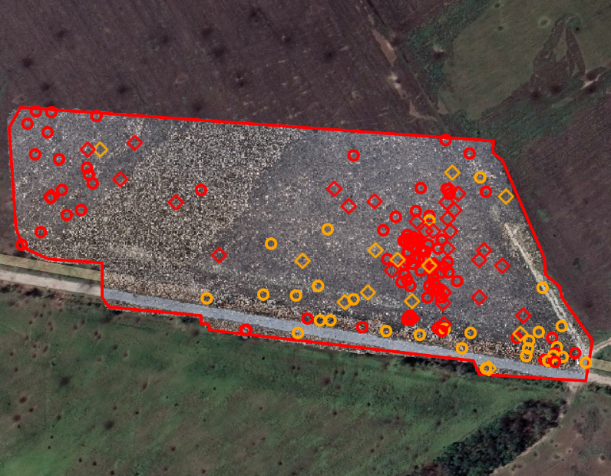
1. Determine extent of
Surface EO
and
Metal Clutter
during RI
Notes:
1. Determining extent of surface contam and metal clutter during RI
Features
Density maps and points
Using our review section
Use
Would not be applicable to all projects
Just ones with known surface contam and reasonable vegetation (show veg images)

Slide 23
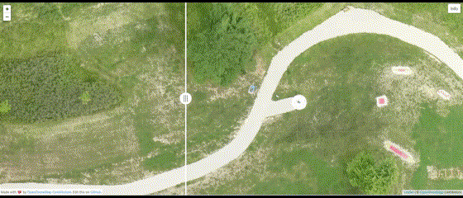
2. Conducting surface clearance on active ranges
Notes:
2. Conducting surface clearance on active ranges
Features
A/B sliding feature
Change detection
Drone has pre-programmed flight that it conducts regularly
Benefit
Mostly concerned about surface contamination
Frequent, repetitive processes which could be streamlined with a tool like this

Slide 24
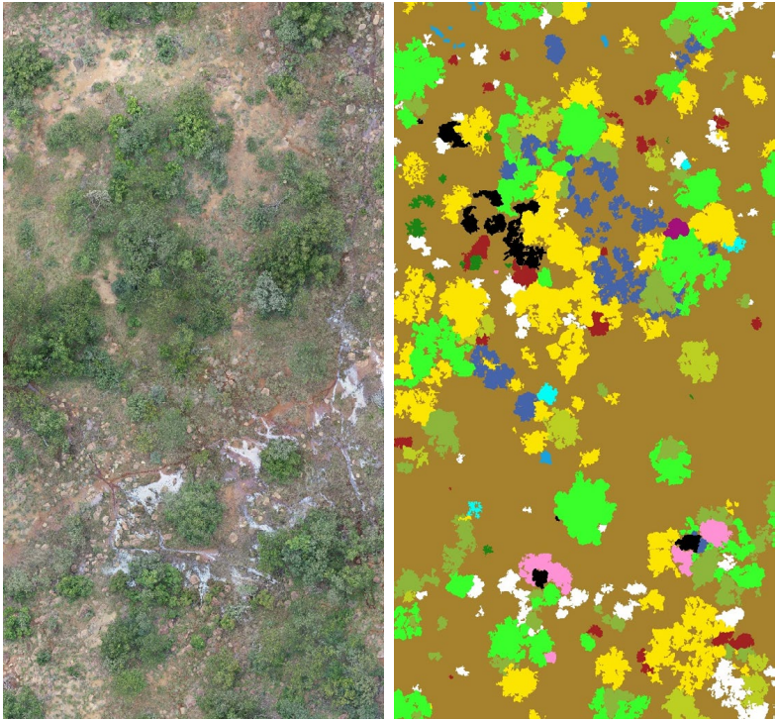
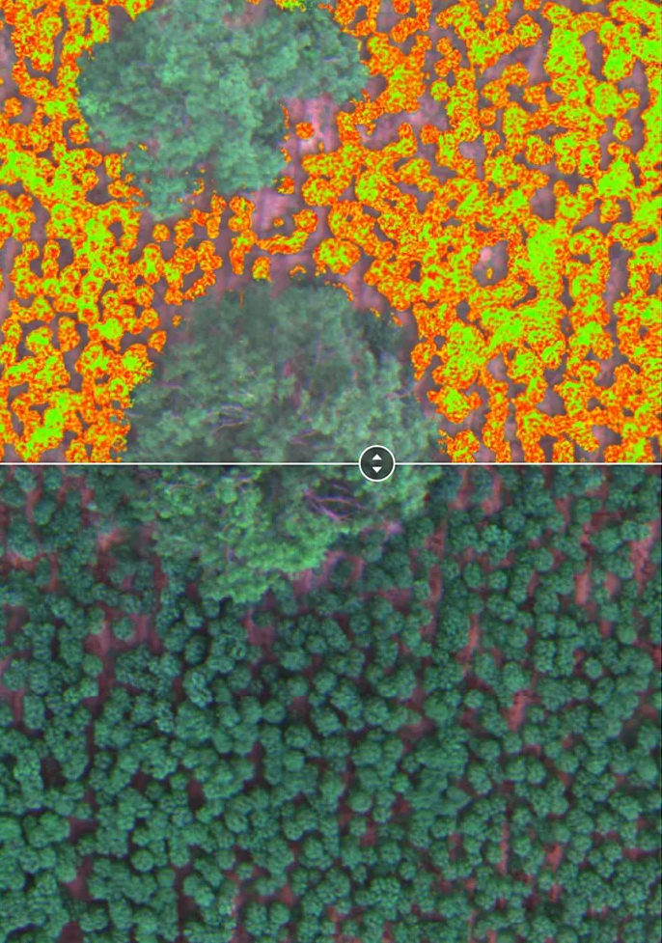
3. Wide-scale Vegetation Assessment
Notes:
3. Vegetation assessment
Features
Doesn’t involve finding UXO at all
Characterizing the height, density and type of vegetation
Showing maps of where it is
Benefit
A large part of the RA process involves dealing with vegetation - oftentimes ballooning the scope of the project beyond what was expected.
If you could have an accurate picture of the height, density and type of vegetation in the entire area, you could develop a much more accurate estimation of what that budget will be.

Slide 25
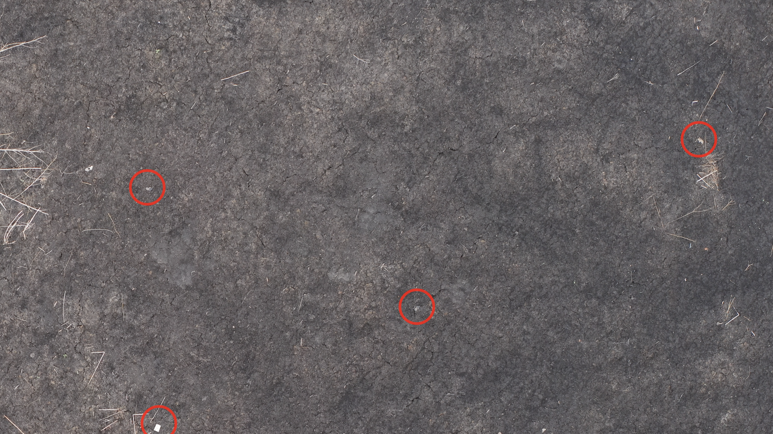
Thank you! Questions?
Scan if you’re interested in SpotlightAI
Contact: gsteinberg@safeprogroup.com
Notes:
If we haven’t talked and you’re interested, please approach me afterwards or fill out this form and we can talk later.

Slide 26
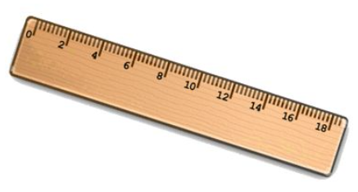
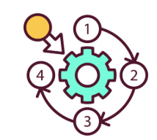
Core Tasks Accomplished by SpotlightAI
Finding all surface ordnance
Understanding factors impacting results
Distills info so it can be transferred to next step
Notes:
Fundamental needs

Slide 27
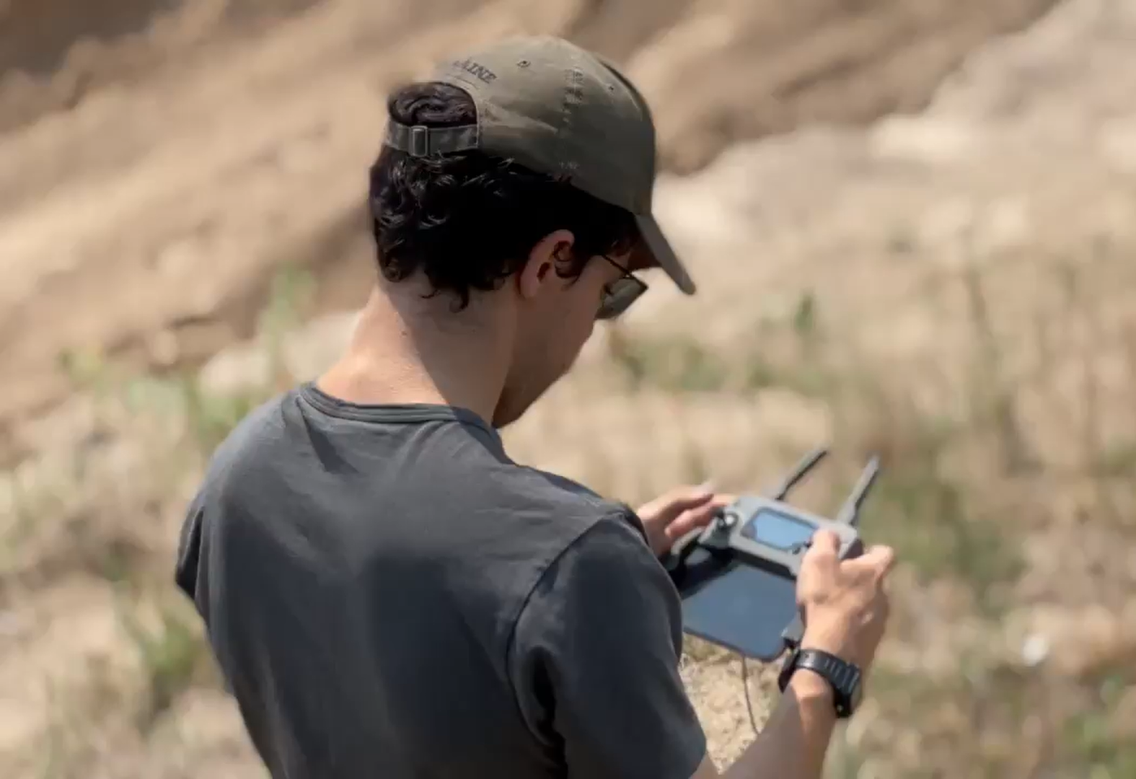
Less of this
More of this

